Slide 1

Constraining the masses of OGLE microlenses with astrometric microlensing
Noé Kains
(STScI)
with Kailash Sahu, Jay Anderson, Andrzej Udalski, Annalisa Calamida, Stefano Casertano

Slide 2
A key problem in microlensing
Lens masses are generally not tightly constrained by modelling
Instead, only mass ratio + sometimes some additional constraints; direct mass measurements are rare
Improving on that on a routine basis would help us understand better
    Planet mass function (Gaudi+ 2002, Tsapras+ 2013, Gould+ 2006, Sumi+2010, Gould+ 2010, Cassan+ 2012, Suzuki+ 2016, Shvartzvald+2016, Tsapras+ 2016)
    Black hole demographics (Agol 2002, Bennett 2002, Lu+ 2016, Wyrzykowski+ 2016, Kains+ 2016)

Slide 3
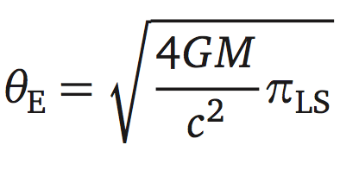
Measuring masses of isolated objects
t_{E} = θ_{E} /v_{ang}
t_{E} is proportional to M^{1/2} ; typical t_{E} for lens of ~0.5 M is 40 days, ~a few M is ~80-100 days
But t_{E} is a degenerate function of source velocity, lens mass, and lens/ source distances
Long t_{E} could be due to
    Large lens mass;
    Close lens; or
    Small lens-source motion
Mass is a function of θ_{E} and lens/ source distances
How to determine those parameters to obtain a mass measurement?

Slide 4
Determining the lens distance
The source distance is usually determined either by assuming it is in the Bulge, or by determining it from photometry
The lens distance can sometimes be determined using parallax
    “Ground” parallax: orbital or terrestrial (e.g. Dominik 1998, Gould+ 2004)
    “Space” parallax (e.g. Refsdal 1966, Dong+ 2007, Yee+ 2015)

Slide 5
Orbital parallax
The Earth’s orbit around the Sun can be detected in the light curve if t_{E} is large enough, u₀ is small enough
Parallax is fitted from the light curve so requires good time resolution and precise photometry;
Yields π_{E} = π_{LS}/θ_{E}; with D_{S} → D_{L}

Slide 6
Terrestrial parallax
Event observed from two (or more) distant observatories on Earth (Gould 1992)
If the event is very highly magnified, this small difference in perspective provides good constraints on π_{E} (Gould+ 2009, Muraki+ 2011)
Very few events
Gould+ 2009

Slide 7
Space parallax
Offset between ground and space-based observations due to separation → Different t₀ and u₀→ π_{E}
Yee+ 2015

Slide 8
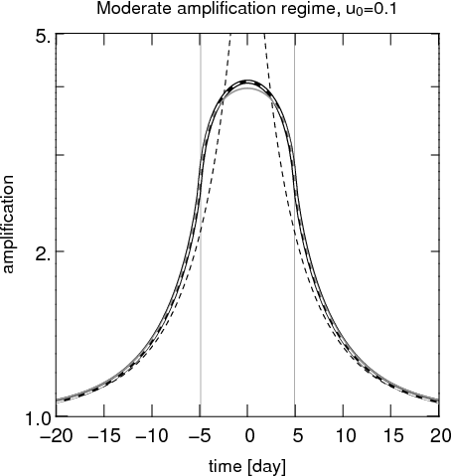
Constraining θ_{E}
Finite source size events → parameter ρ*=θ*/θ_{E}
θ* can be estimated using photometry and surface brightness-colour relation (e.g. Kervella & Fouqué 2008)
Allows us to constrain θ_{E} via θ_{E}=θ*/ρ*
Lee+ 2009

Slide 9
Constraining θ_{E}
Problem: this can only be done for relatively bright sources, or events with large magnification gradients (e.g. caustics)
Most stars are faint M dwarfs
As surveys go deeper, especially from space, most sources will be point-like
Need another way to measure θ_{E}

Slide 10
Astrometric microlensing
In addition to magnification, microlensing produces an astrometric shift due to asymmetric images
Source’s light centroid deviates from rectilinear motion
The amplitude of the astrometric shift scales with θ_{E} (e.g. Hog+ 1995, Dominik & Sahu 2000)
As the event unfolds, the apparent position of the source also follows a characteristic pattern
Measuring and modelling this allows us to determine θ_{E}

Slide 11
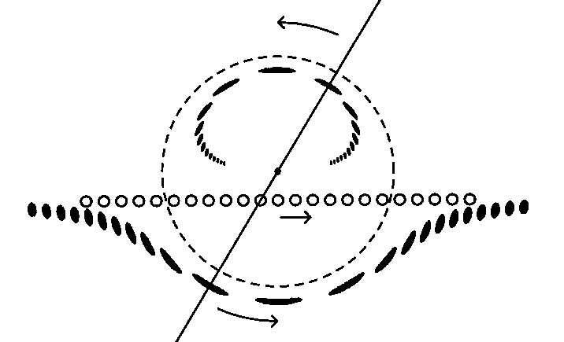
Einstein ring radius θ_{E}
Impact parameter u₀
source path
Images
u₀=0.5

Slide 12
Without proper motion (source’s view)…
θ_{E} scales the ellipse

Slide 13
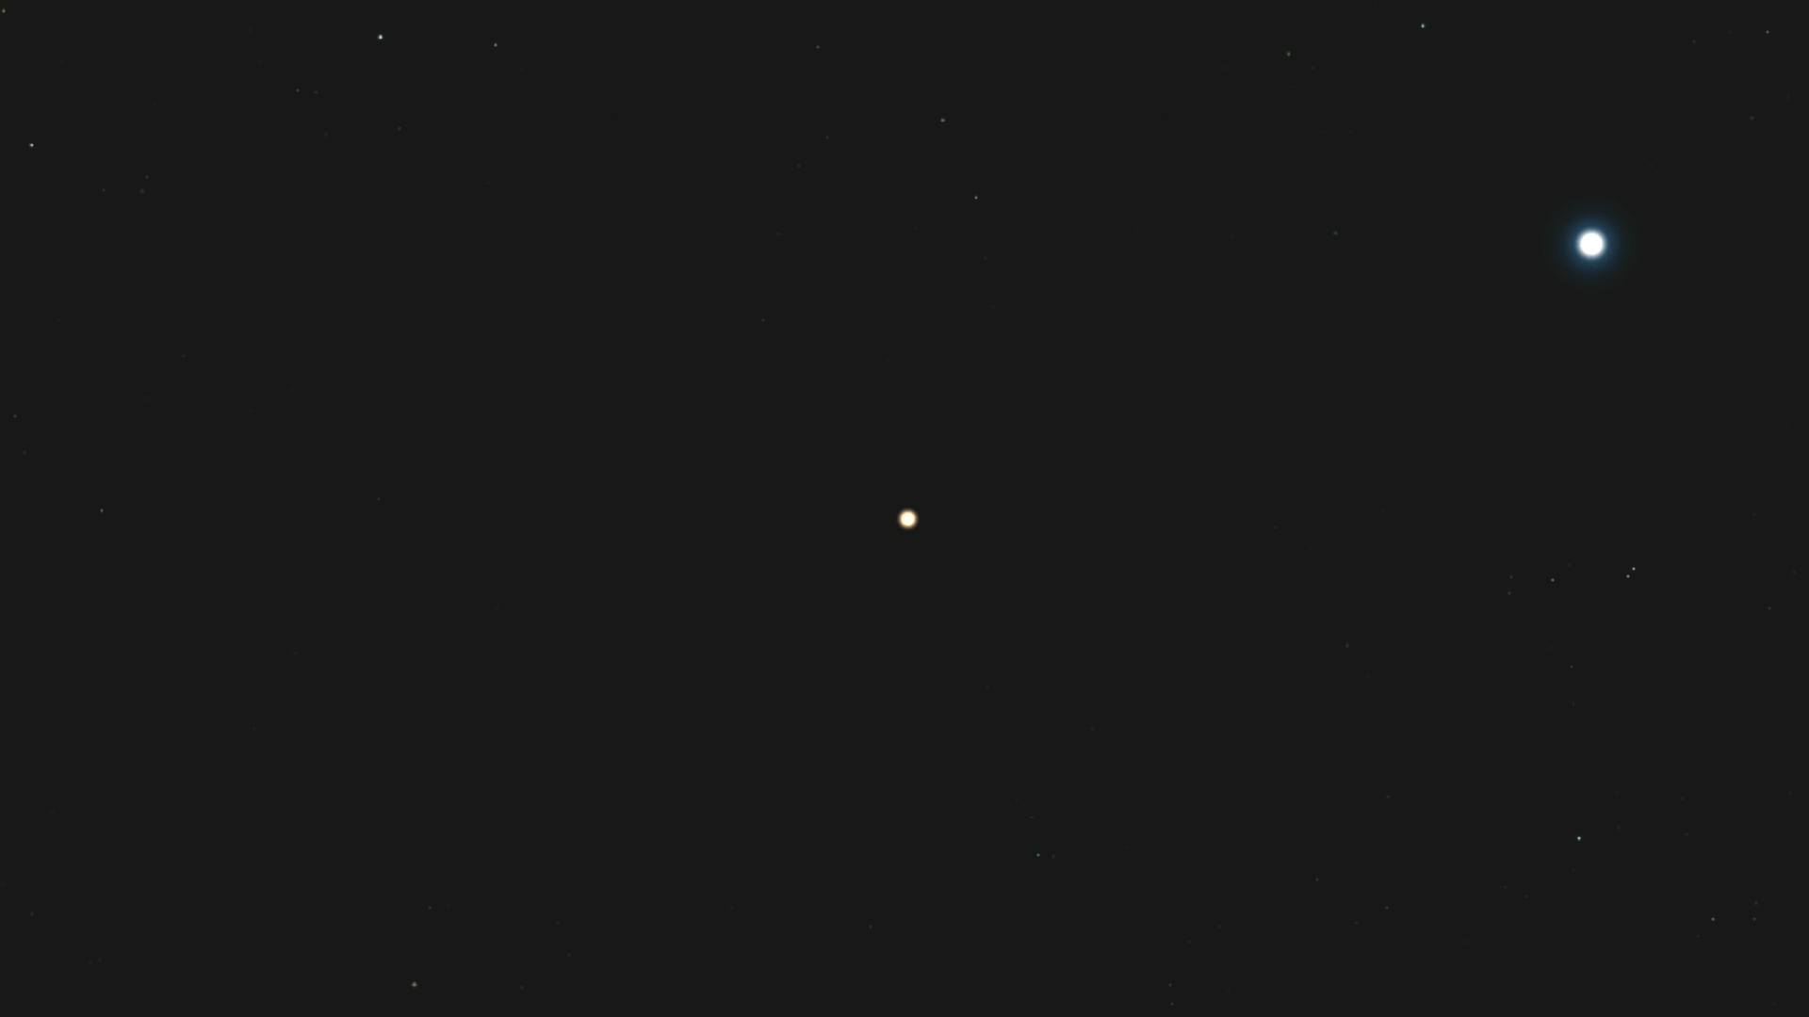
Source
Lens
Animation: K. Sahu

Slide 14
With proper motion (observer’s view)…

Slide 15
Can we detect this?
Shifts are small, but can be detected longer before/ after the peak of the event (t₀), unlike photometric signal
10 M lens at 4 kpc
Lu+ 2016

Slide 16
Astrometric microlensing
Amplitude of ~0.5-1 mas for typical stellar lenses
Currently can only be routinely detected from space with HST, soon with JWST, later on with WFIRST
3-year HST program (PI: Sahu) a good experiment to see how this can done routinely

Slide 17
HST project
‘Detecting and measuring the masses of stellar remnants’ – PI: K. Sahu – 192 orbits (2011-2014)
    Primary science goal: detecting astrometric microlensing by black holes and neutron stars
    Observed with Advanced Camera for Surveys (ACS) and Wide Field Camera 3 (WFC3) UVIS channel; pixel sizes of 50 and 40 mas
    Monitoring ~1.5-2 million stars in total
    Each ACS field observed every 2 weeks, 8 months/ year for 3 years; WFC3 fields 4 months/ year
    HST observations to measure astrometric shifts + photometry
    Ground-based observations with VIMOS@VLT to constrain parallax: every 3-4 days (PI: M. Zoccali)

Slide 18
Test cases for astrometry: OGLE events
Can we constrain θ_{E} for OGLE events in our HST footprint?
HST data contains 20 OGLE + 1 MOA events
Of these
    5 were too short to be caught by our observations,
    4 were too bright (saturated)
    5 were too early/ late in the season
    1 non-PSPL
6 events with HST astrometry and photometry (Kains+ 2017)
Good test cases for routine astrometric measurements in large-scale survey (WFIRST microlensing survey)

Slide 19
Data reduction
Used Jay Anderson’s software to extract photometry & astrometry from HST observations (e.g. Anderson & King 2006)
Additional local corrections to account for systematics (Kains+ 2017, Sahu+ in prep.)
Used Difference Image Analysis software DanDIA (Bramich 2008) to extract photometry from VLT observations

Slide 20
Modelling procedure
Fit PSPL + parallax parameters; check whether parallax is well constrained
    MCMC yields distributions of t₀, t_{E}, u₀, π_{E,E}, π_{E,N}
Use the posterior distributions on the parameters as priors for the astrometric microlensing model
    Yields final parameters: t₀, t_{E}, u₀, α, θ_{E}, x₀, y₀
    α is the lens-source trajectory relative angle, x₀, y₀ are reference positions (arbitrary)

Slide 21
Astrometric microlensing model
Subtract the mean proper motion of the source to keep only the elliptical motion caused by lensing (e.g. Dominik & Sahu 2000)
Fit the residual astrometric motion with elliptical trajectory (e.g. Kains+ 2017, 2016)

Slide 22
Example: OGLE-2013-BLG-0804
Detected by OGLE EWS (Udalski+ 2003) in April 2013
V~20, within ACS footprint, and peaked halfway through 2013, with t_{E}~42 days
Should be an excellent target for our observations
Do we reach the astrometric precision we should?
See all events in Kains+ 2017, ApJ 843, 145

Slide 23
OGLE-2013-BLG-0804 – PSPL+parallax

Slide 24
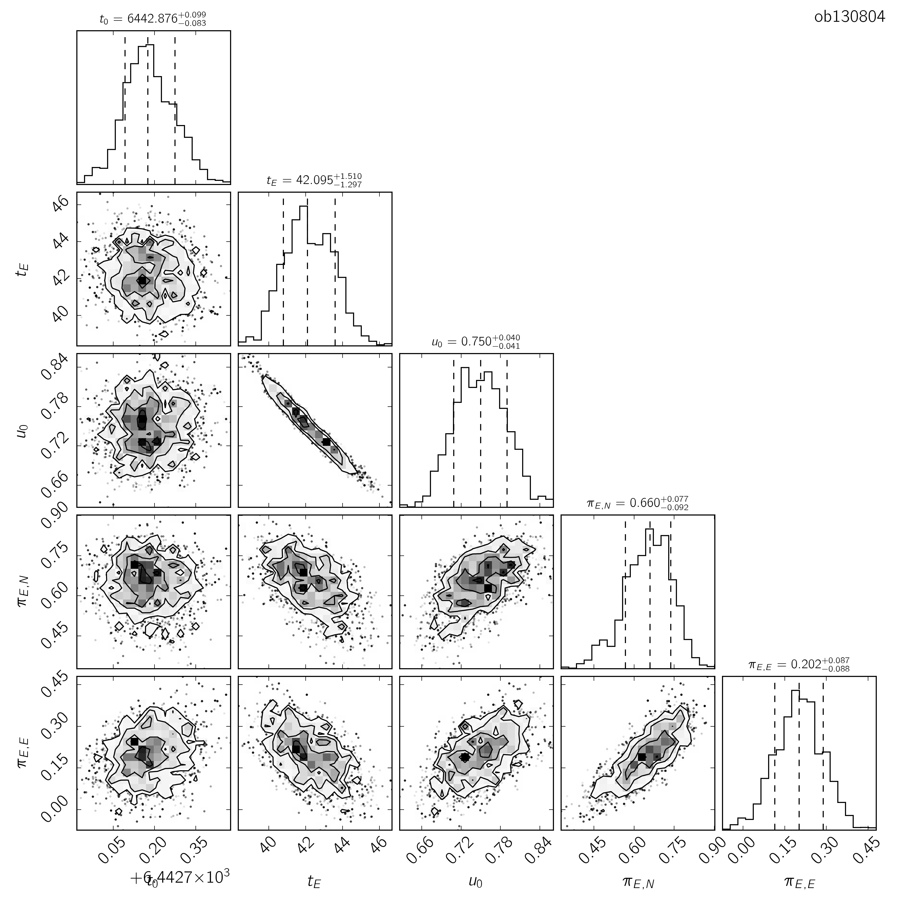
OGLE-2013-BLG-0804 – PSPL+parallax

Slide 25
Astrometric data with PM (3 years)

Slide 26
Astrometric data with PM subtracted
Rms= 0.4 mas
1 pix = 50 mas

Slide 27
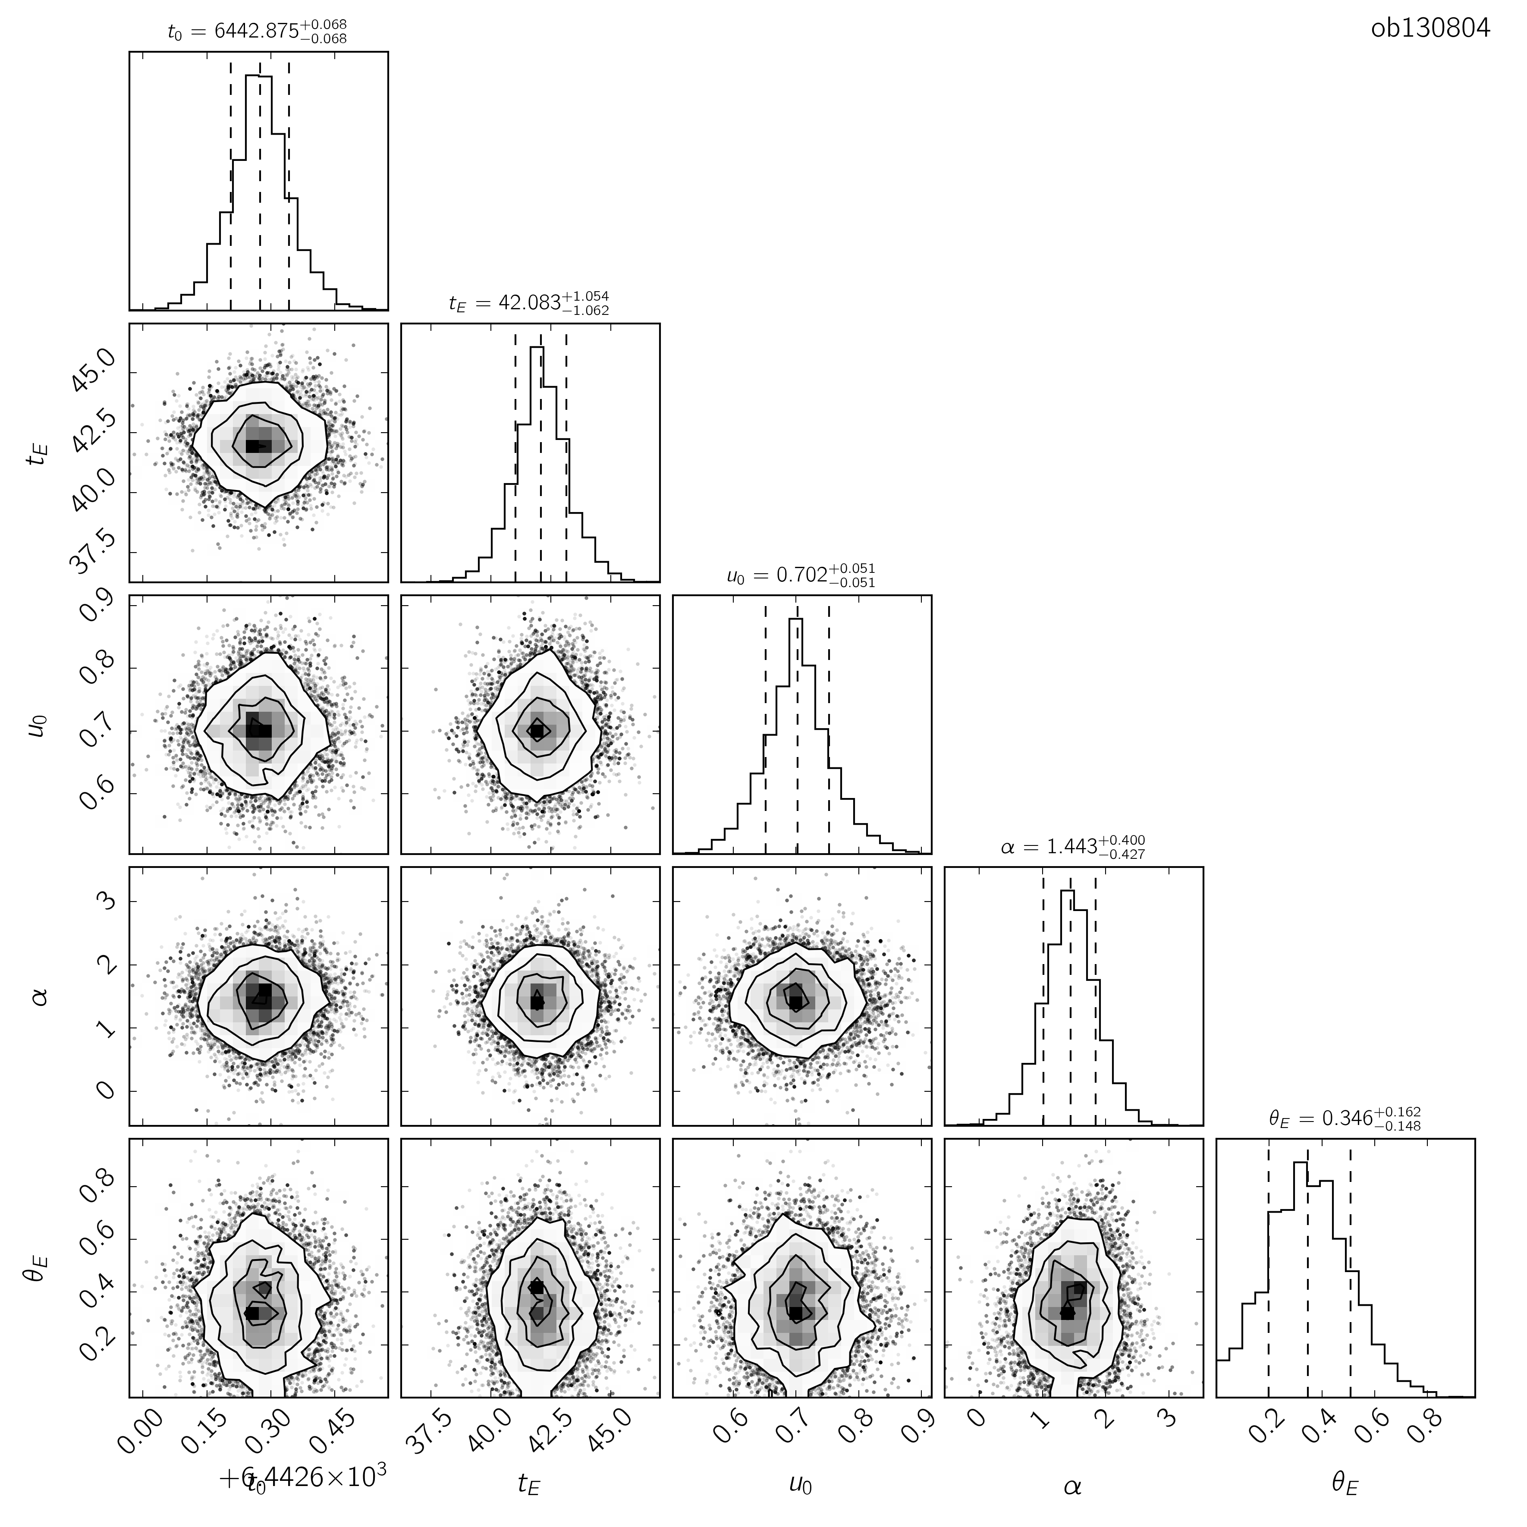
Astrometric fit

Slide 28
Astrometric model - 2D
Number of t_{E} to/from peak

Slide 29
Astrometric model – 1D

Slide 30
Mass constraints
Astrometric fit has θ_{E}= 0.26±0.14 mas,
Best-fit parallax is π_{E}= 0.55±0.08, giving a lens distance of 3.7±0.3 kpc, assuming a source at 8.0±0.3 kpc (Yelda+ 2011)
This yields a 3-σ upper limit for the lens mass of 0.43 M
No lower mass limit since no signal detected (θ_{E}=0 within 3-σ)
The constraint comes from how “non-linear” the astrometric curve is

Slide 31
Other OGLE events in our HST footprint
Most other events are either too short or do not have sufficient photometry to constrain parallax
However, θ_{E} is well constrained by our HST measurements
This means that if parallax had been detected for these events, their mass could be measured
What does this mean for future surveys?

Slide 32
WFIRST
WFIRST microlensing survey
    L2 orbit
    Six 72-day seasons
    15 minute cadence
    FOV ~100 times larger than HST
    60 million stars over 3 deg² with ~40000 measurements!
    Hundreds (!) of events at any given time
Microlensing parallax due to Orbit around Sun, space parallax if parallel ground-based observations (only for brighter events)

Slide 33
Astrometry with WFIRST
Astrometric capabilities: per measurement, very similar to HST, but many more observations means better astrometric precision
Combined with photometry, will provide tight constraints on lens masses
Planetary host masses + mass ratio from modelling → planet masses
    Deep exoplanet demographics
    Cool exoplanet mass function
    Planet formation models (probe large low mass populations predicted by core accretion)

Slide 34
Core accretion demographics predictions
Ida, Lin & Nagasawa 2013

Slide 35
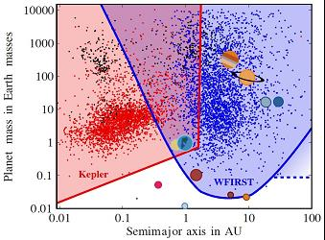
Core accretion demographics predictions
Ida, Lin & Nagasawa 2013

Slide 36
Conclusions
OGLE events combined with HST observations are excellent test ground to prepare for astrometric microlensing with WFIRST
High-interest OGLE events can be (and are) followed up with HST to provide tight mass constraints
Astrometric microlensing from space can be used to constrain θ_{E} routinely. Useful down to V~24 (still work in progess)
WFIRST microlensing survey will allow to measure both astrometry and parallax for many events
Much deeper insights into exoplanet demographics (esp. low-mass), but also isolated black holes

