Slide 1
23 Years of Gravitational Microlensing by the Japan/NZ/USA MOA Project
Philip Yock
“Celebrating 25 Years of the OGLE Project”
Warsaw University
July 2017
presented by David Bennett

Slide 2
Abstract
The Microlensing Observations in Astrophysics (MOA) project was founded in
1994 by Japan and New Zealand with the aim of searching for dark matter and exoplanets by the then-new gravitational microlensing method. In this paper the main features of the project are summarized, including brief details of the telescopes used by MOA in New Zealand, the discovery of the first planet by microlensing, a brief overview of the theory of planet detection by microlensing at high magnification, examples of detections of planets made at high magnification including the recent low-mass planet OB161195Lb, the first search for free-floating planets by microlensing, the abundances of planets of various types beyond the snowline, the crucial role that the OGLE group played in most of the above, and, briefly, current plans by MOA for the future.

Slide 3
A pleasure
to acknowledge sustained successes by the OGLE team over a quarter of a century
to thank Andrzej and his team for collaborative research conducted in the true scientific spirit over this time
to acknowledge the crucial foresight of Bohdan Paczynski in the early years of microlensing
Phil was Charles Alcock’s undergraduate advisor

Slide 4
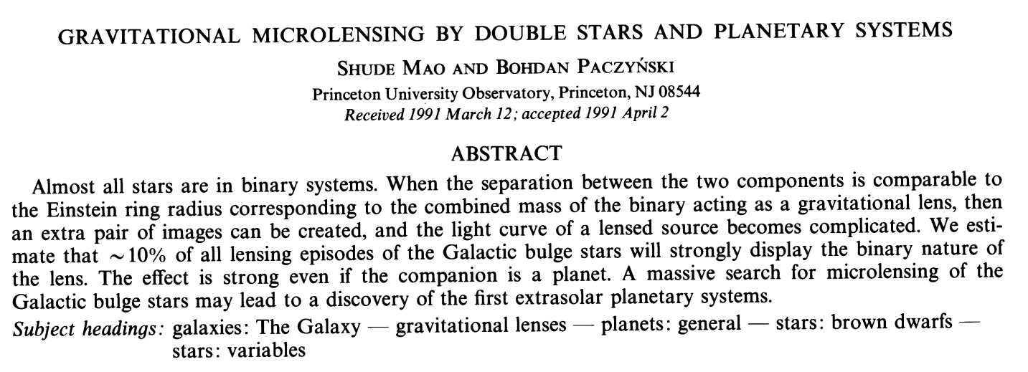
Pioneer papers

Slide 5
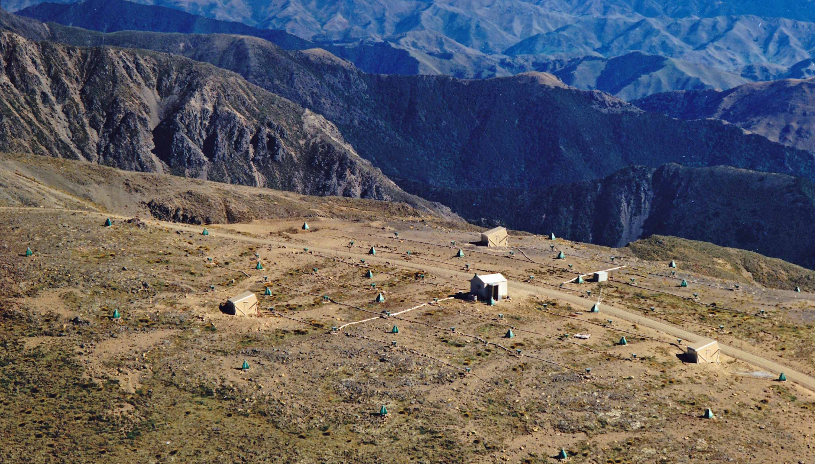
JANZOS – Japan/Australia/NZ precursor to MOA
Searched for cosmic rays from SN1987A from 1987 to 1994 – NZ Science Review 69, 3, 2012

Slide 6
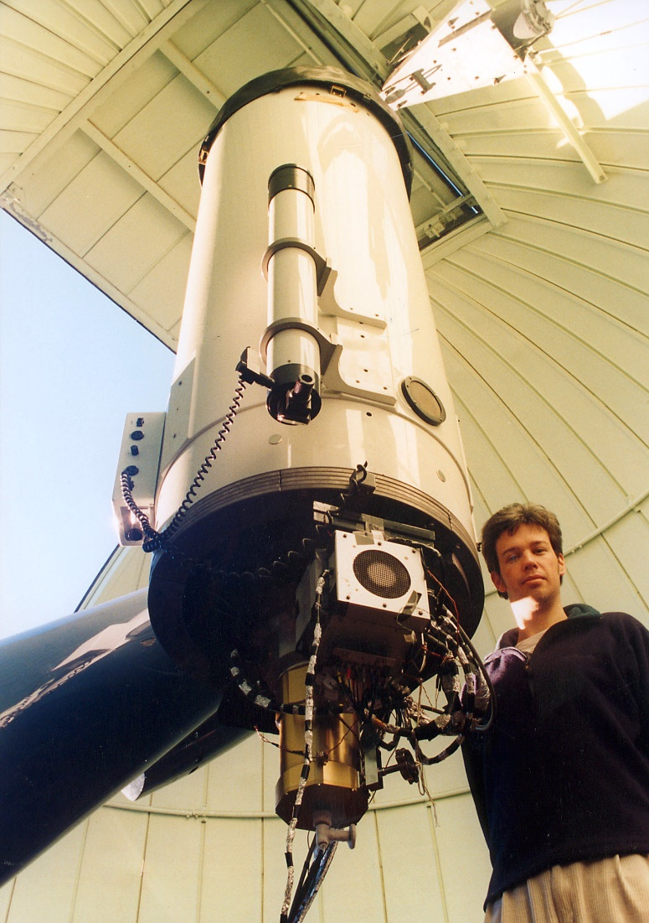
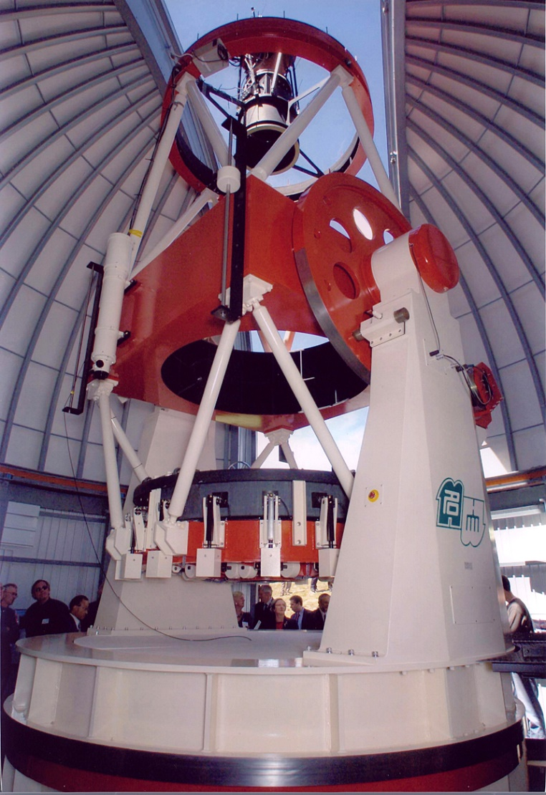
1994 – started gravitational microlensing
MOA-1 1994- MOA-2 2004-

Slide 7
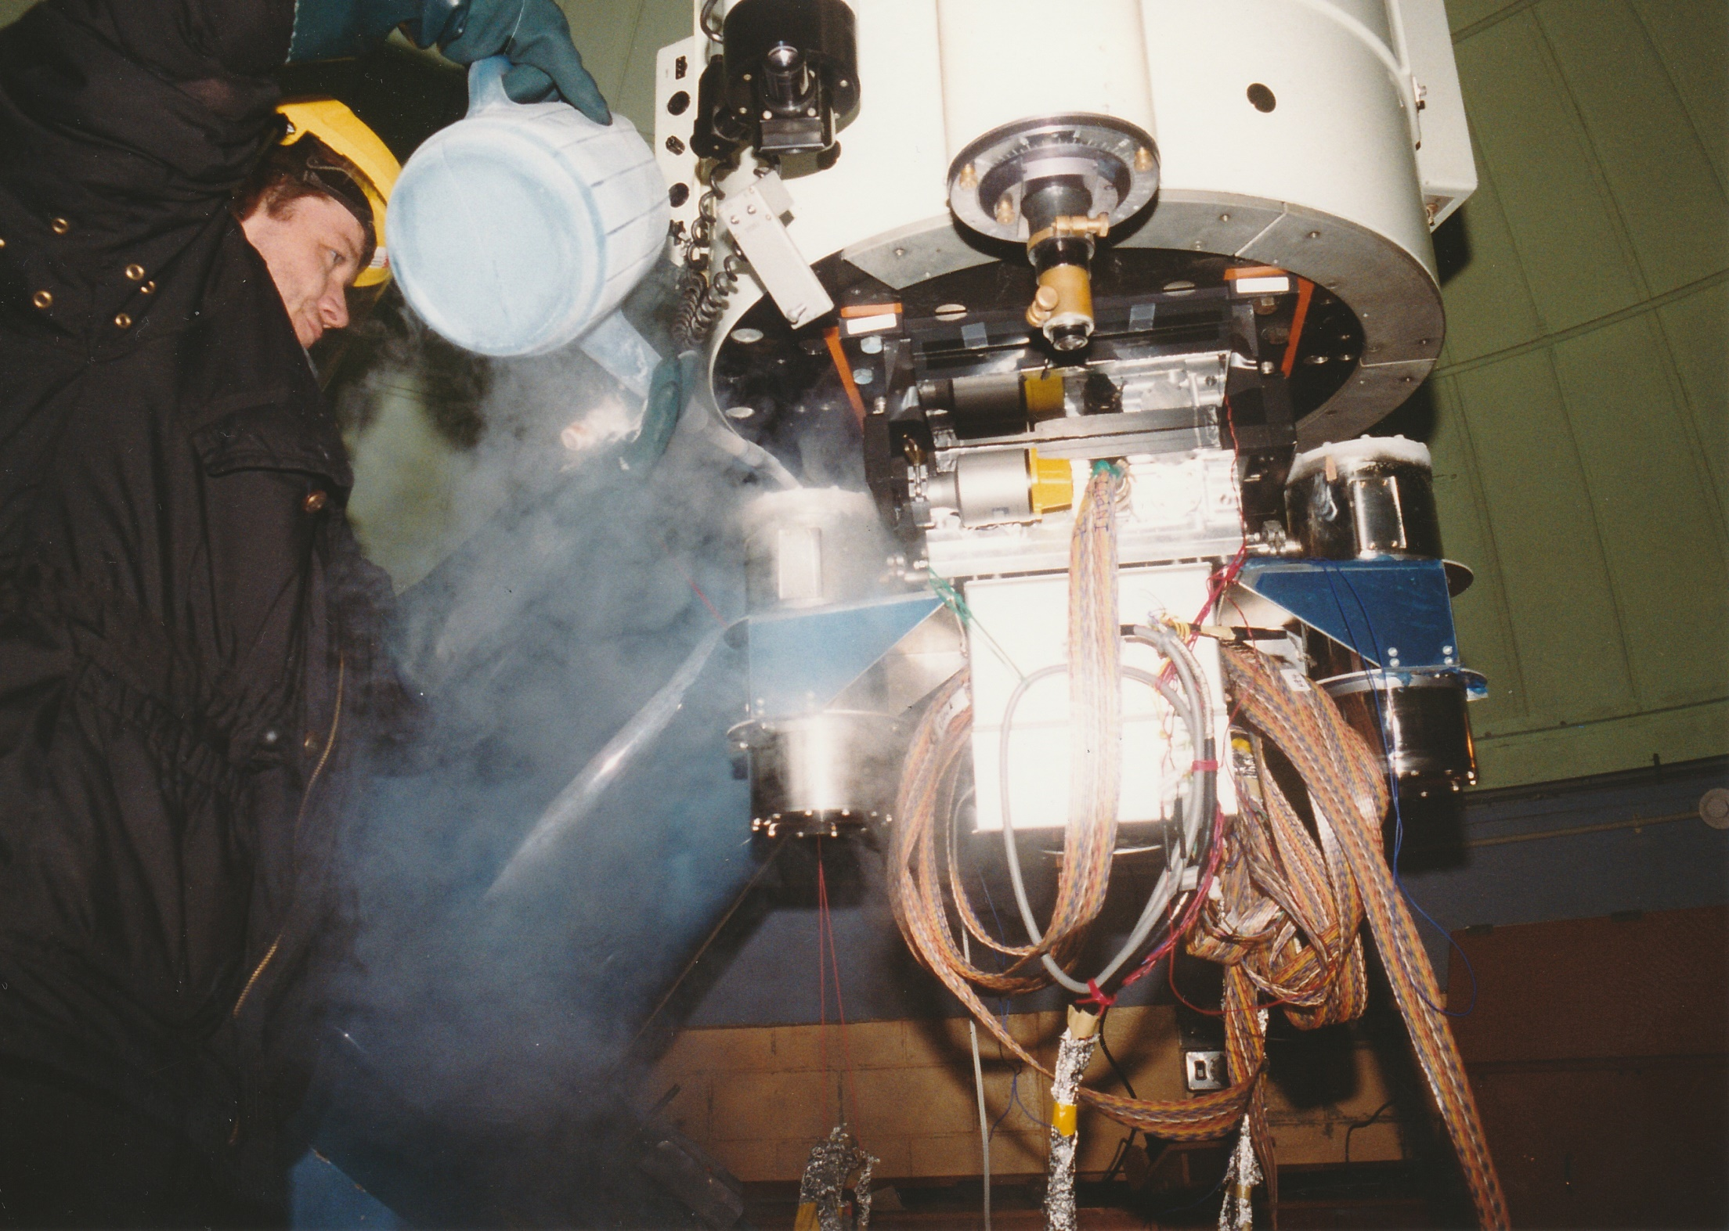
Watering can for LN2 for MOA1

Slide 8
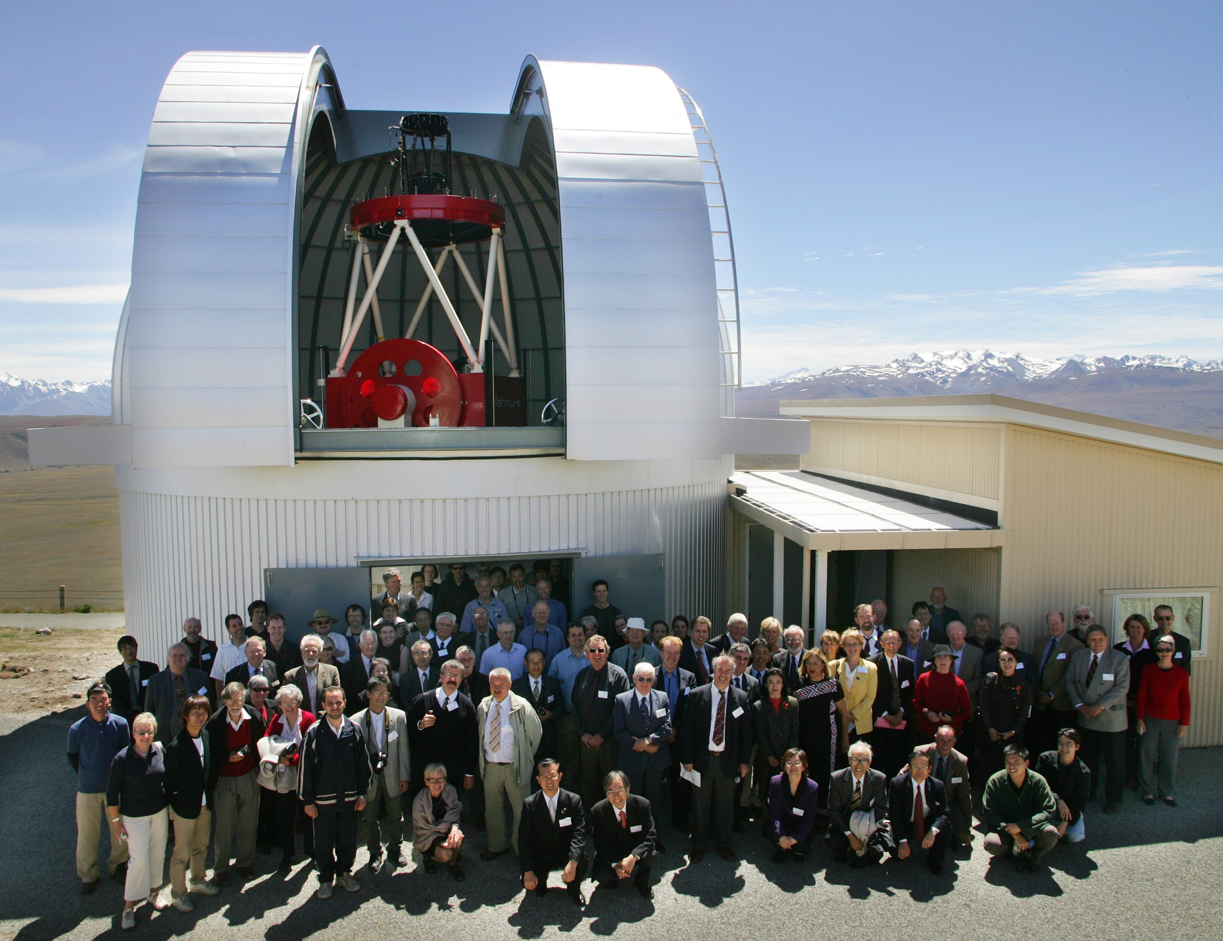
MOA telescope
Opening day
December 2004

Slide 9
The method
Dark objects detectable.
Exoplanet detection – the lens star
magnifies the source star, and the
planet disrupts the magnified image.

Slide 10
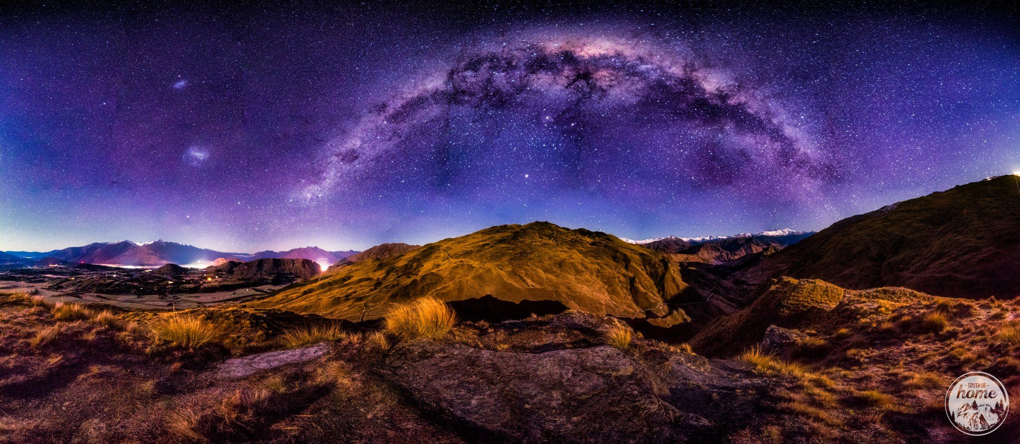
Targets – Magellanic Clouds and the Galactic Bulge

Slide 11
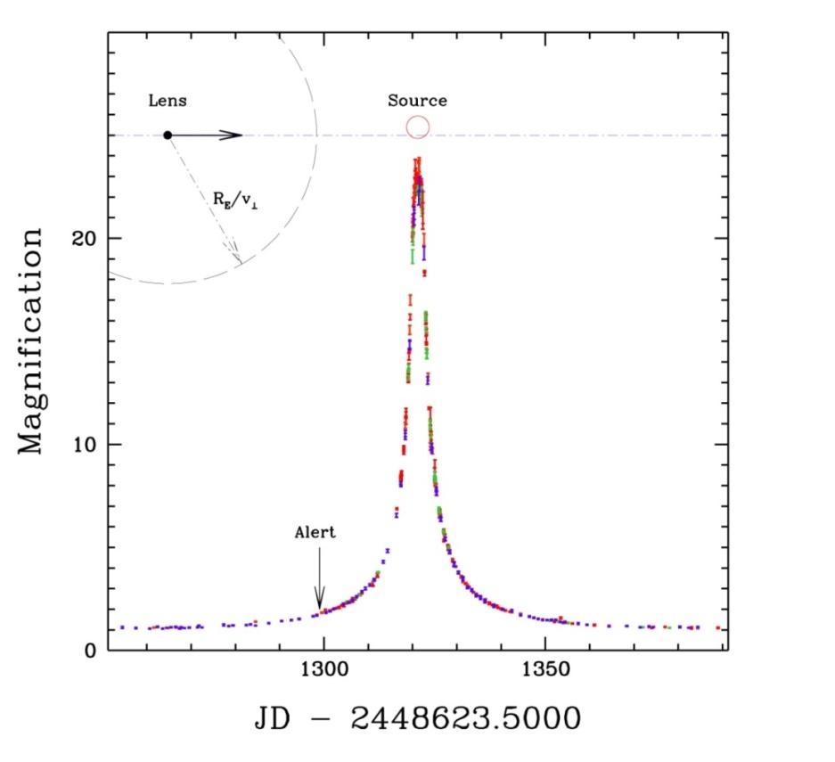
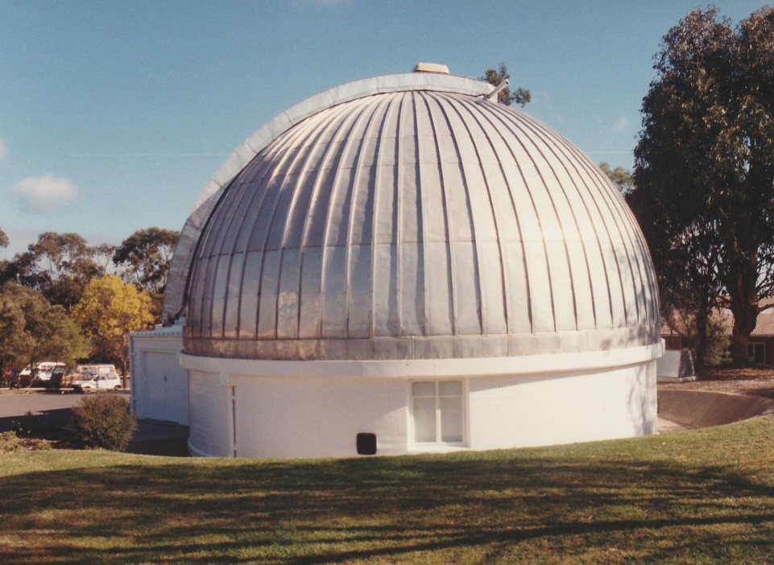
MACHO-95-BLG-30
MACHO telescope
First finite source event; resolved a distant star
Alerted by David Bennett
Alcock et al, ApJ 491, 436, 1997

Slide 12
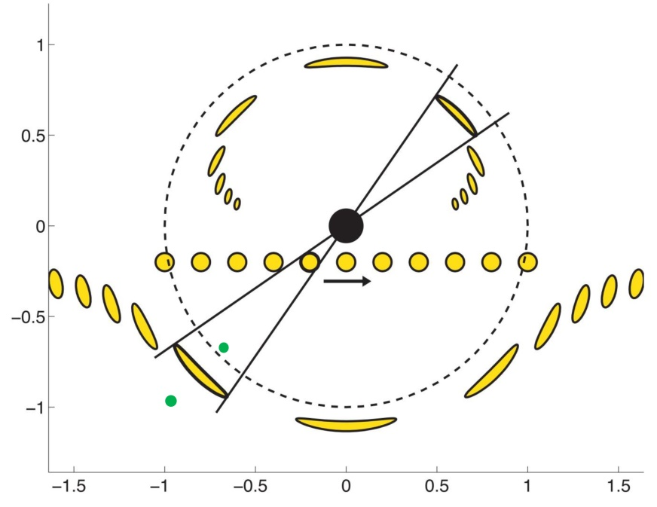
High magnification technique for planets
Good sensitivity to planets near the ring.
Modest requirements on telescope time.
Two solutions, wide and close.

Slide 13
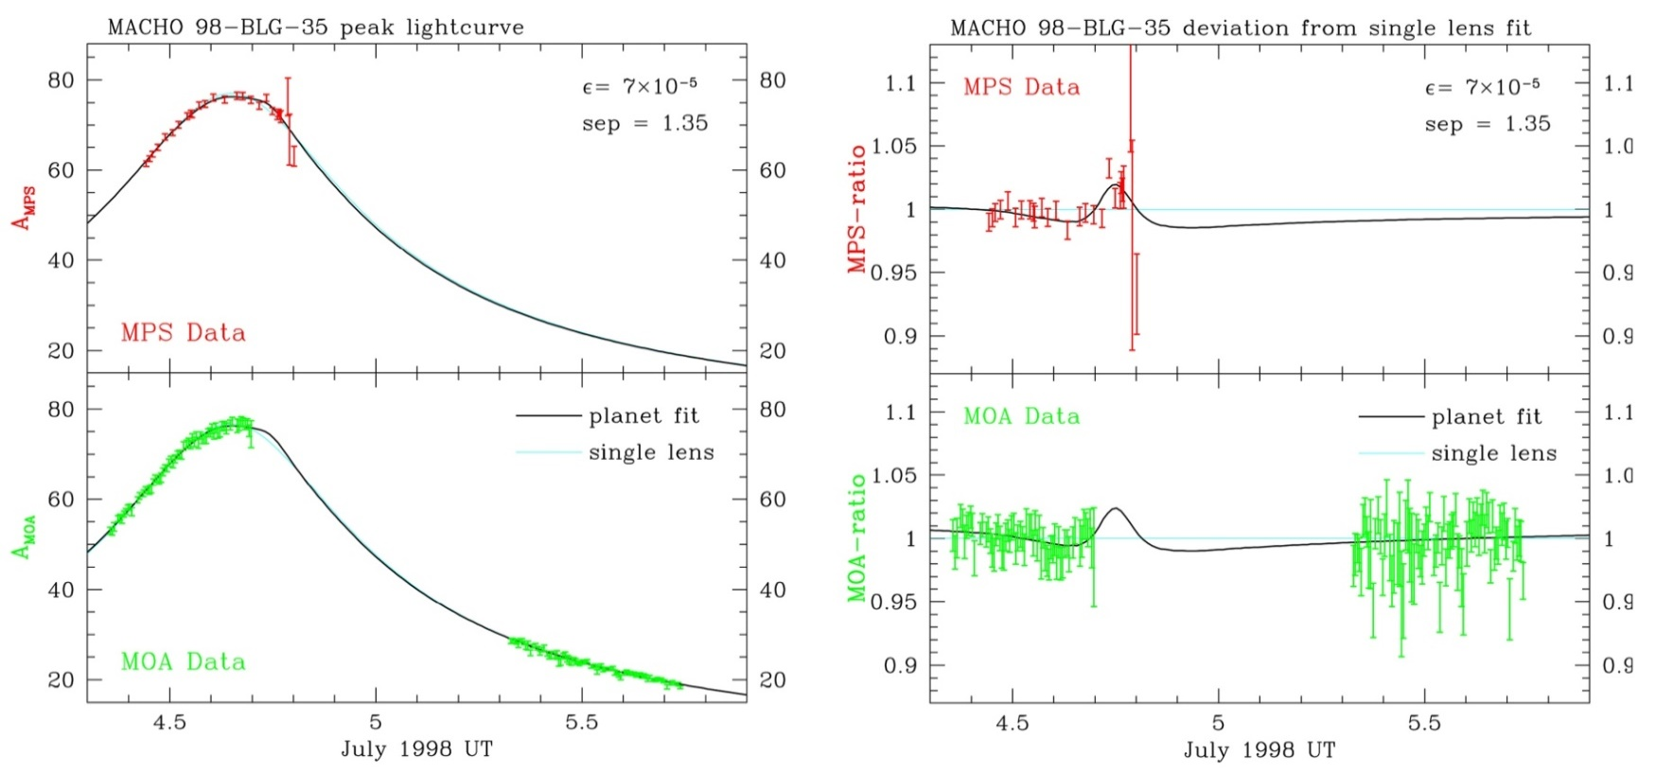
MACHO-98-BLG-35
First planet search at high magnification
Alerted by David Bennett
Sun Rhie et al, ApJ 533, 378, 2000
Influential in New Zealand
Ian Bond et al, MNRAS 333, 71, 2002
Nick Rattenbury et al, MNRAS 335, 159, 2002
Re-analysis?

Slide 14
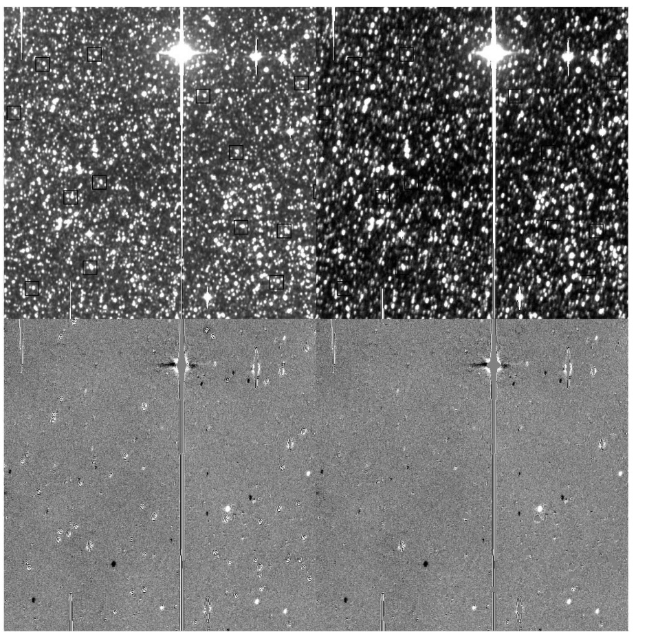
Difference imaging
First large scale implementation
Bond et al MNRAS 327, 868, 2001
(also Wozniak Acta Astron 50, 201, 2000)

Slide 15
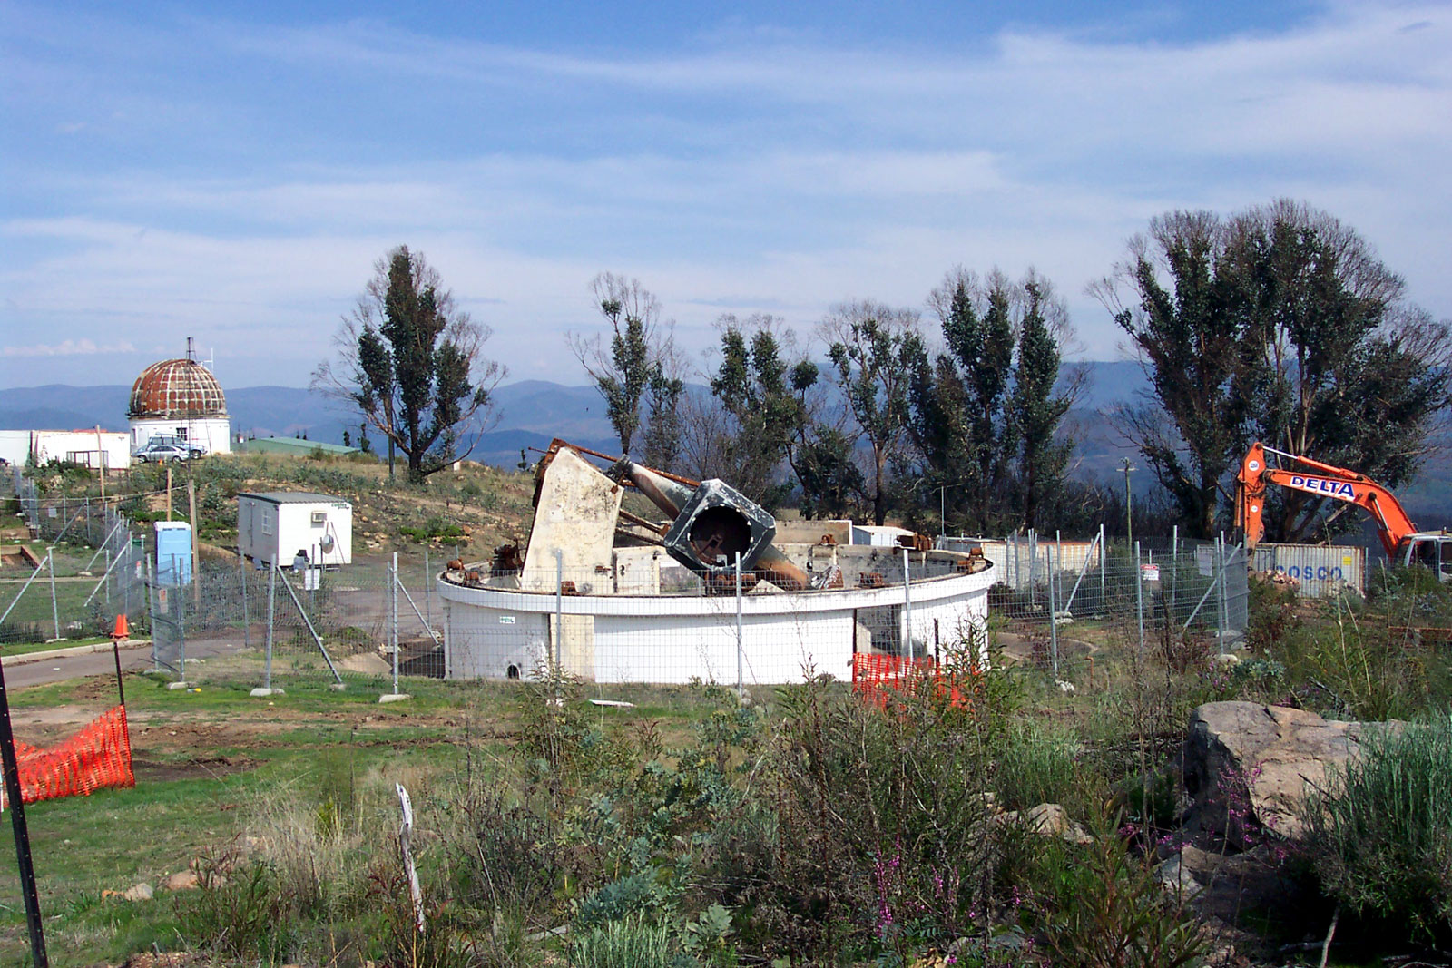
MACHO telescope January 2003
MPS Telescope:
MSO 74”

Slide 16
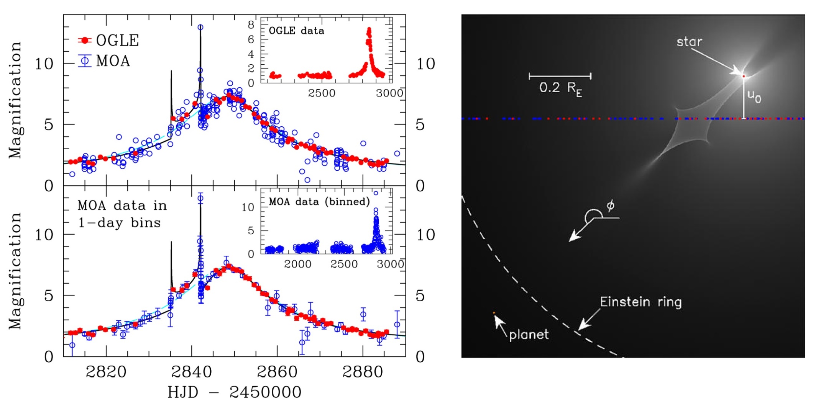
First microlensing planet – July 2003
2.8 M_{J} 0.63 M_{solar} 4.3 AU
I. Bond et al, ApJL 606, L155, 2004

Slide 17
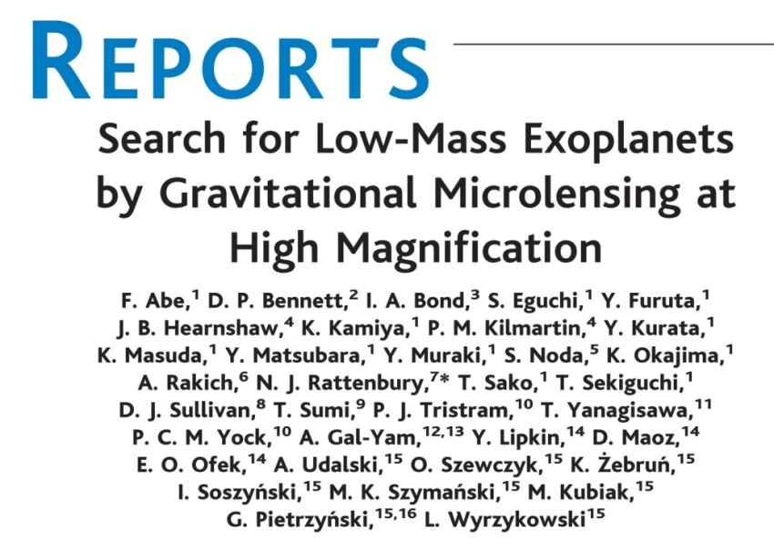
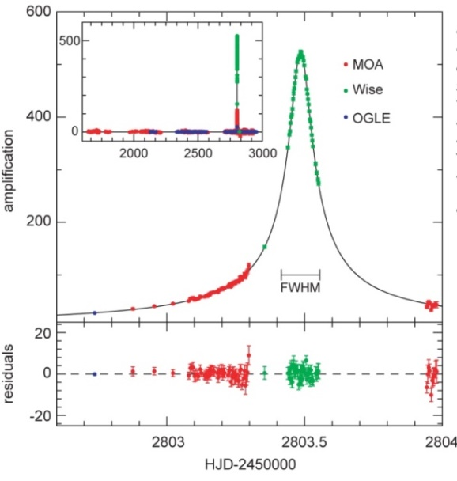
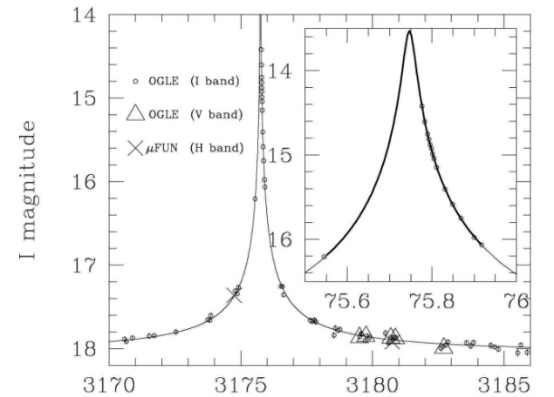
Race for the highest magnification

Slide 18
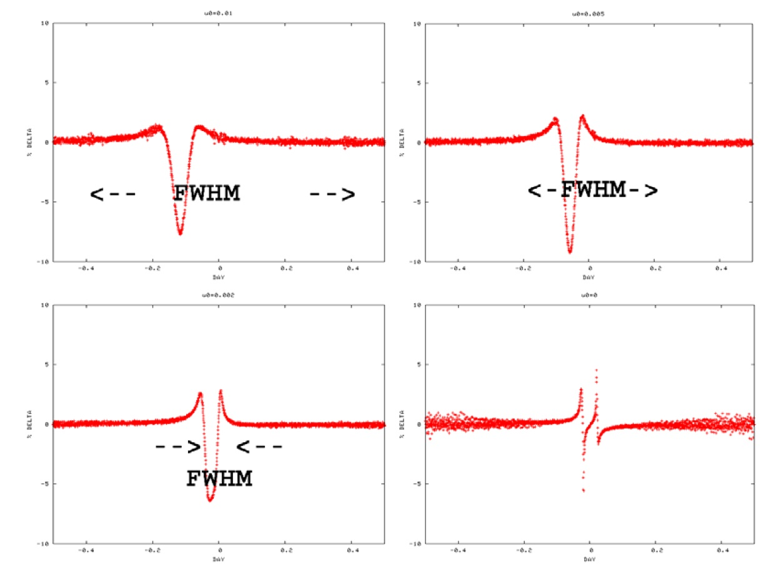
Manchester workshop (2007)
Typical low-mass planet:- q = 3 × 10⁻⁵ ρ = 0.001 θ = 60° d = 0.9
A_{max} = 100 A_{max} = 200
8% 9%
A_{max} = 500 A_{max} = 2,000
6% 4%
Moderately high magnification adequate.
More events.
Multi-planets detectable.
Small response at highest magnification due to cancellation effect.
P. Yock, arXiv:0805.1775

Slide 19
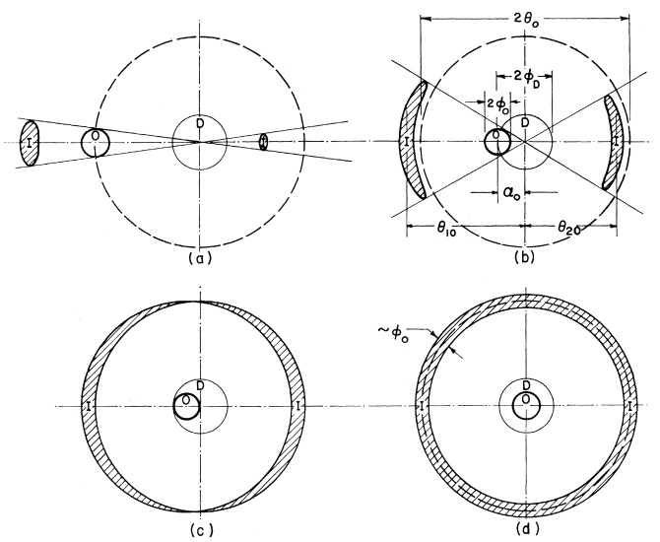
Loss of sensitivity at highest magnification
High magnification Highest magnification (Liebes PR 1964)
-ve
+ve
If the source star threads the
lens system (star plus planet)
the perturbation is positive, and
vice versa. No cancellation occurs.
For highest magnification, the
perturbation switches from positive
to negative (or vice versa) and severe
cancellation occurs

Slide 20
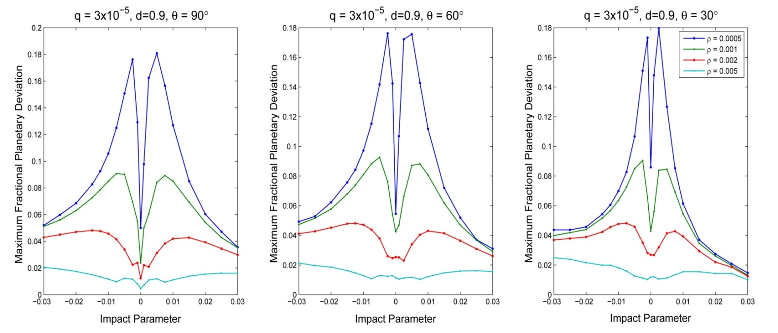
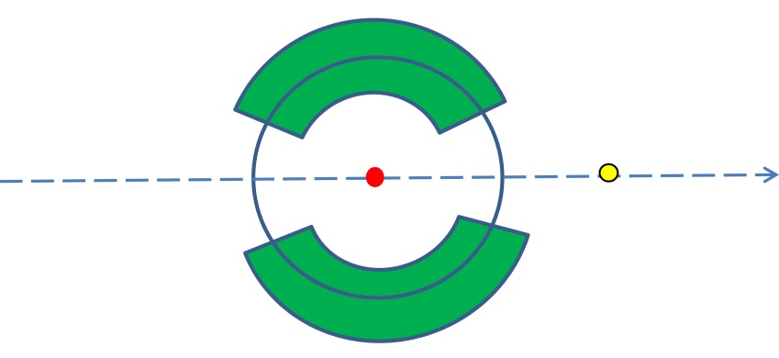
Dependence on hour angle
Consider a super-Earth at d=0.9 r_{E} at various angles:-
ρ = θ_{s}/θ_{E}
The dependence on θ is flat from 30° to 90°:-
planet
θ
source
lens
?
Dependence on separation?

Slide 21
Dependence on separation
Follow Abe et al (MNRAS 431, 2975, 2013) or Han (ApJ 691, 452, 2009):-
Assume magnification ~ 100 needed to conduct 1% photometry
on solar-like stars in the bulge
Assume ~ 4% perturbation sufficient for planet detection
Find ‘typical’ events for Neptunes, super-Earths and Earths

Slide 22
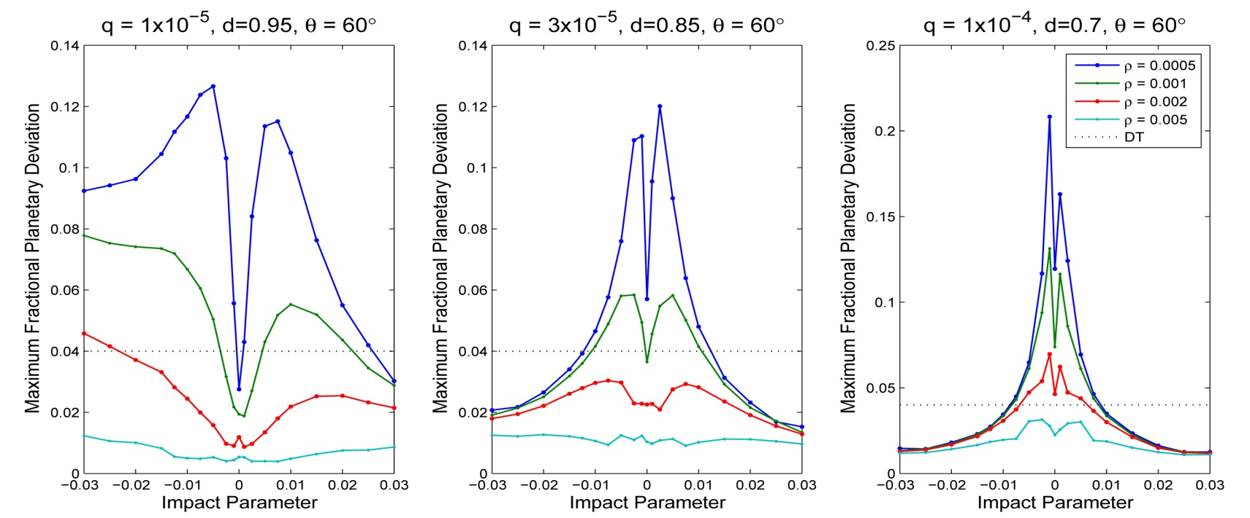
Typical detections
Earth Super-Earth Ice-giant
“In hunting for the lowest mass planets it will therefore be
advantageous to monitor events with the broadest range
of magnifications possible.” Abe et al, MNRAS 431, 2975, 2013
Co-operative effect between stellar and planetary caustics.

Slide 23
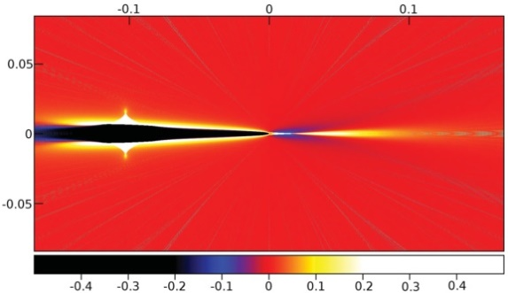
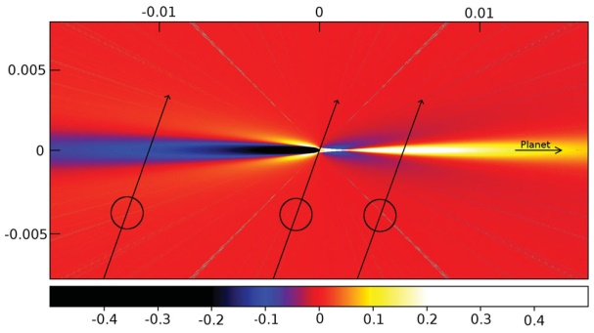
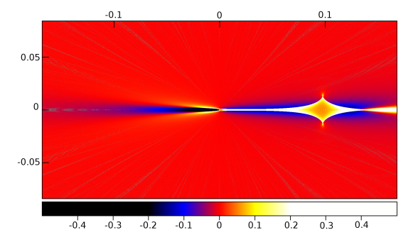
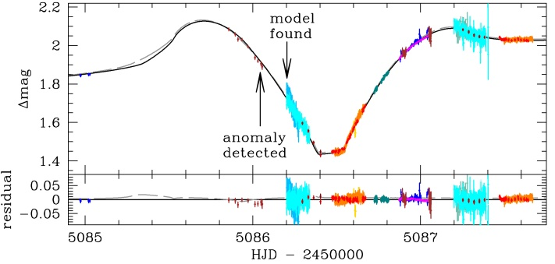
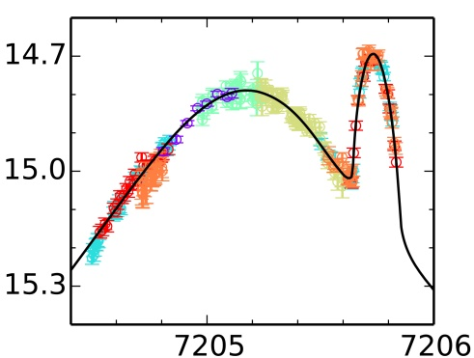
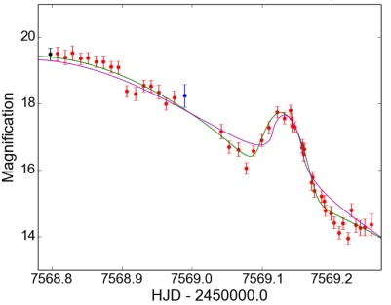
Planetary magnification maps
q=10⁻⁴; d=0.95 q= 3×10⁻⁵; d= 0.9 q=10⁻⁴; d=1.05
(all colours except easily detectable)
MB09266 OB150966 OB161195
mass = 10 m⊕ 21m⊕ 2m⊕
Y. Muraki et al, R. Street et al, I.Bond et al
ApJ 741, 22, 2011 ApJ 819, 93, 2016 MNRAS 469, 2434, 2017

Slide 24
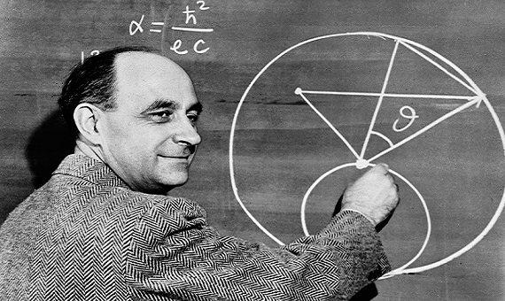
Fermi’s two approaches to physics
“The Pope of Physics”
P. Yock, Nature 540, 199, 2016
A precise and self-consistent mathematical formalism – inverse ray shooting in the source plane (inverse ray shooting goes from image plane to source plane)
A clear physical picture of the process being calculated – Fermi’s preference – the lens plane picture of microlensing
Follow Fermi - but ignore his (incorrect) equation above for the fine structure constant

Slide 25
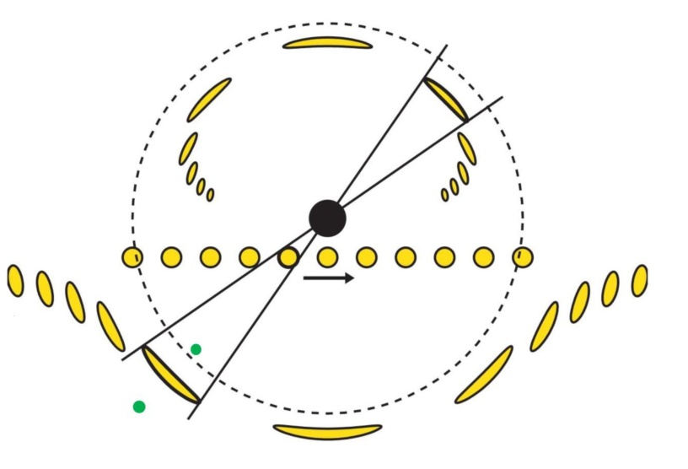
Image plane picture
The hour angles of the source star and a planet coincide when a planetary perturbation occurs.
θ = tan⁻¹ u₀t_{E}/(t_{p} – t₀) ………………………………………………………(1)
The duration of a planetary deviation is the time required for an arc to slide by the planet (Abe et al MNRAS 2013) and determines the Einstein radius.
t_{w} ≈ 3 ρ t_{E} = 3 t* …….…………………………………………………………(2)
Wide and close planetary solutions satisfy a modified Griest/Safizadeh symmetry
(s_{wide} – d_{arc}).(s_{close} – d_{arc}) = 1 .…………………………………..…………….(3)
where d_{arc} = ± u₀/2 sinθ is the separation of an exterior/interior arc from the ring.

Slide 26
Check with OB150966 (mag = 87)
t_{w} = 0.25d
3ρt_{E} = 0.24d
θ = 50.5°
tan⁻¹u₀t_{E}/(t_{p}-t₀) = 50.5°
s_{wide} – d_{arc} = 1.115 – 0.007 = 1.108 and
(s_{close} – d_{arc}) = (0.909 – 0.007) = 0.902
Hence (s_{wide} – d_{arc}).(s_{close} – d_{arc}) = 0.999
But s_{wide} . s_{close} = 1.014 ± 0.005.
R. Street et al, ApJ 819, 93, 2016
(NOTE: d_{arc} = u₀ /2 sin θ from Liebes 1964)
t_{W}
t0
tp
lens axis
θ
source
track

Slide 27
OB061195/MB06350 (mag = 19)
t_{w} = 0.09 d
3t* = 0.10 d
θ = 55.3°
tan⁻¹u₀t_{E}/(t_{p}-t₀) = 50.0°
s_{wide} - d_{arc} = 1.070 – 0.033 = 1.037
s_{close} - d_{arc} = 0.996 – 0.033 = 0.963
Hence (s_{wide} – d_{arc}).(s_{close} – d_{arc}) = 0.999 but
s_{wide} .s_{close} = 1.066 ± 0.011. The correction term is highly significant.
The distance of the planet from the arc is
≈ 0.037 r_{E} for both solutions. Hence the good sensitivity to a low mass planet.
50% of the FWHM was monitored by MOA at a duty cycle of 10%. 90% of the FWHM was monitored by KMTNet at a duty cycle of 20%.
planet
binary source
I. Bond et al, MNRAS 469, 2434, 2017

Slide 28
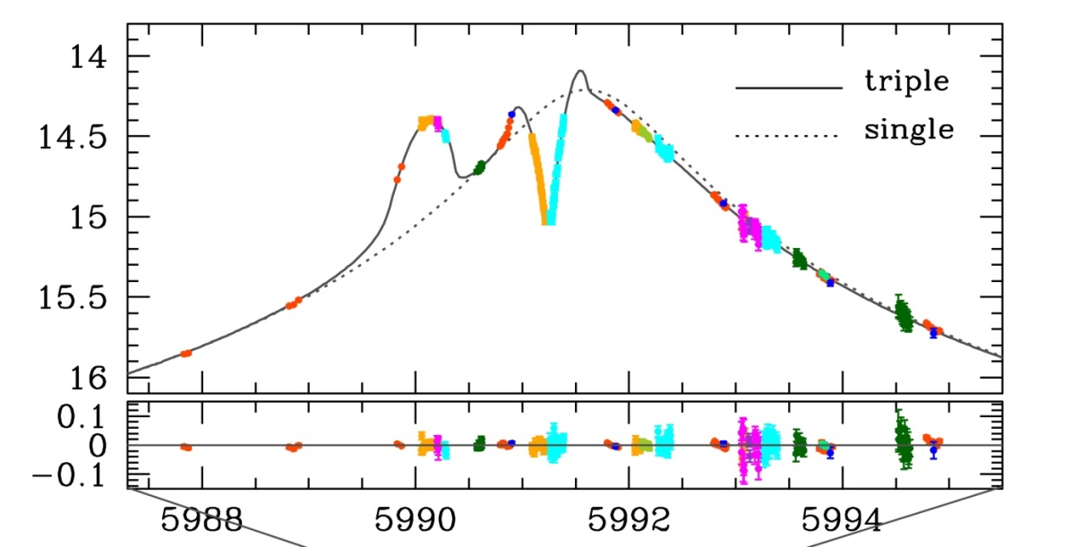
Two planet system ̶ OB120026 (A_{max}= 106)
t_{w1} = 0.6d
t_{w2} = 0.7d
3t* = 0.5d
θ₁ = 73°
θ₂ = 29°
tan⁻¹ u₀t_{E}/(t₀ – t_{p1}) = 71°
tan⁻¹ u₀t_{E}/(t₀ – t_{p2}) = 33°
s_{1w} – d₁ = 1.039
s_{1c} – d₁ = 0.962
(s_{1w} – d₁).(s_{1c} – d₁) = 0.999
but s_{1w}.s_{1c} = 0.990 ± 0.002
s_{2w} – d₂ = 1.247
s_{2c} – d₂ = 0.802
(s_{2w} – d₂).(s_{2c} – d₂) = 1.000
but s_{2w}.s_{2c} = 1.021 ± 0.008
Planet 2
Planet 1
C. Han et al, ApJ 762, L28 (2013)
C. Han et al, ApJL 762, L28, 2013

Slide 29
Physical interpretation of high mag planets
The planet perturbs an arc as it passes by.
Incomplete but physical picture of the process.
Wide and close solutions symmetrical about an arc, not the ring.
Full solution requires inverse ray shooting
Planets close to the ring are more complicated, e.g. OB05169.

Slide 30
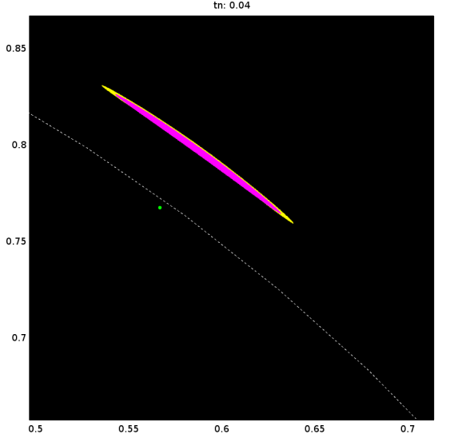
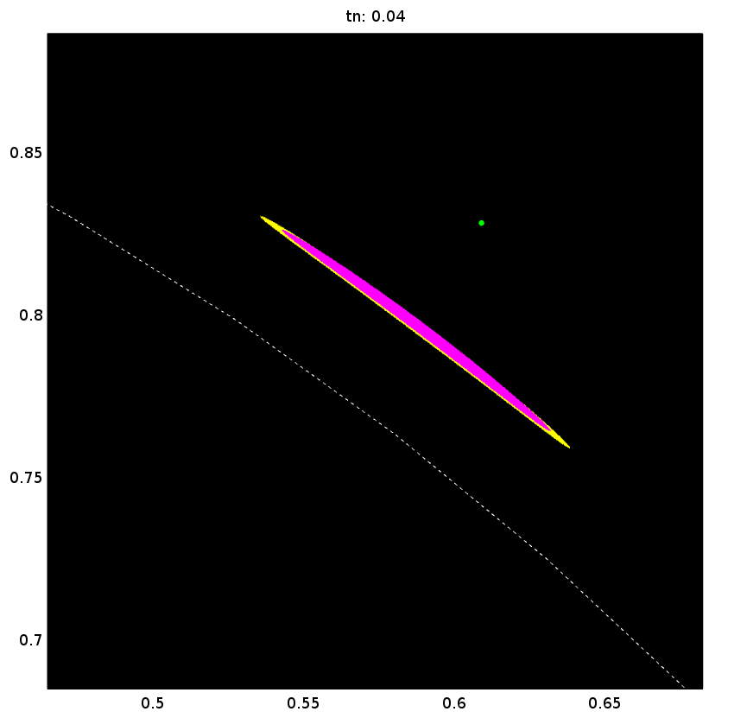
Einstein arcs for OB161195
The exterior Einstein arcs for the close and wide solutions (yellow) and for the best planetless fit (magenta) to OB161195 at the peak of the planetary perturbation. The arcs approximately bisect the line joining the two solutions.
Arcs by Nicholas Rattenbury

Slide 31
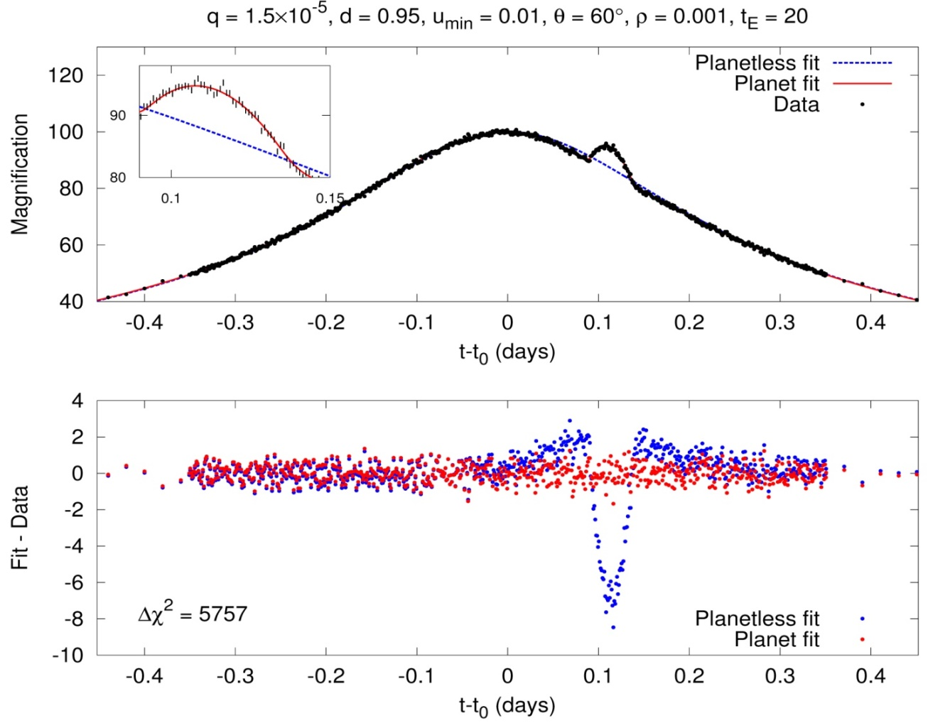
Measuring planetary mass function at low mass
Assume continuous observations made of the FWHM with 1-2m telescopes:-
Modelling by Lydia Philpott

Slide 32
Detection efficiency
1350 trials:-
u₀ : 6 values ± .02, ± .01, ±.005
t_{E} : 3 values 10 days, 20 days, 30 days
ρ : 3 values .0005, .001, .002
q : 5 values 1.5, 2.5, 3.5, 4.5, 5.5 × 10⁻⁵
s : 5 values .95, .85, .75, .65, .55
α : 1 value 60⁰ (for 30⁰ < α < 90⁰)
Follow-up data: 1 measurement every .001 day in FWHM at MOA cadence and precision in fair weather
Found fraction of events with Δχ² > 300
Abe et al, MNRAS 431, 2975, 2013

Slide 33
Typical results
Planet mass q = 5 × 10⁻⁵
Planet distance 0.6 < s < 1.7
Planet angle 30⁰ < α < 150⁰
or 210⁰ < α < 330⁰
Detection efficiency ̴ 75%
Planet mass q = 2 × 10⁻⁵
Planet distance 0.8 < s < 1.25
Planet angle 30⁰ < α < 150⁰
or 210⁰ < α < 330⁰
Detection efficiency ̴ 80%
Ideal for exploring the central regions (approx 2-4 AU) of planetary systems.

Slide 34
Examples: first two high mag planets
OGLE-2005-BLG-071 q = 0.0071 s = 1.29
OGLE-2005-BLG-169 q = 6 × 10⁻⁵ s = 1.02

Slide 35
More examples
OB150966
OB120026
OB161195

Slide 36
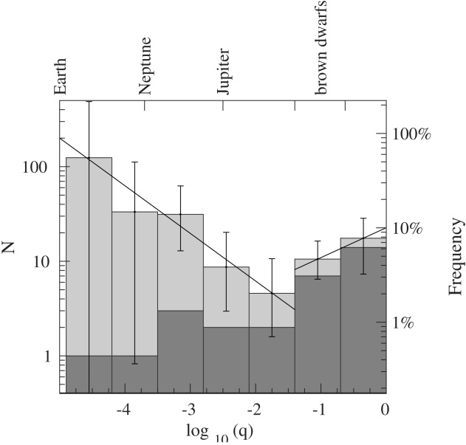
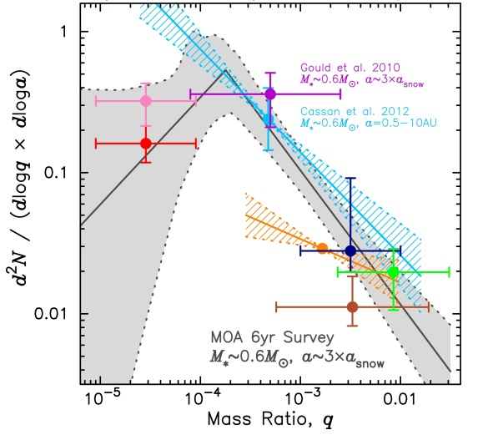
The planet mass function beyond the snowline
PLANET, Cassan et al,
Nature 48, 167, 2012
OGLE-MOA-WISE
Shvartzvald et al
MNRAS 457, 4089,
2016
MOA, Suzuki et
al, ApJ 833, 145
2017
Need more data at low masses

Slide 37
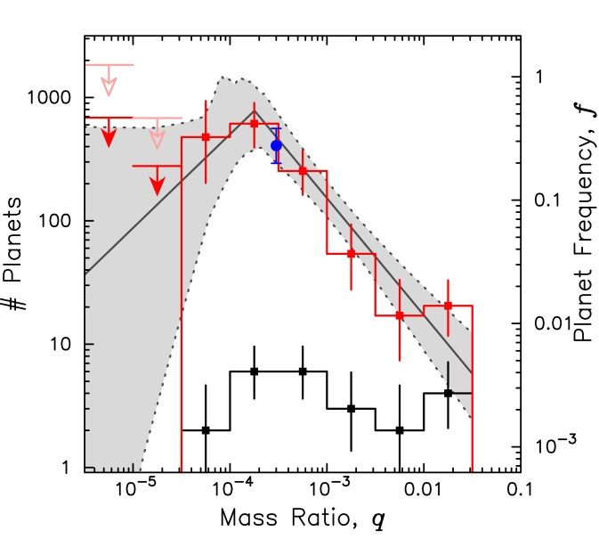
Few detections at low mass
OGLE-MOA-Wise
(4 years)
MOA
(6 years)
Single detections Nil detections

Slide 38
100 events with magnification 50 - 200
(detection efficiency) no. of detections
(0.67) 0.251 (0.36) 0.154 (0.11) 0.055 (0.0) 0.0 (0.0) 0.0
(0.67) 0.214 (0.53) 0.196 (0.23) 0.099 (0.04) 0.020 (0.0) 0.0
(0.67) 0.179 (0.62) 0.190 (0.36) 0.129 (0.12) 0.049 (0.0) 0.0
(0.67) 0.161 (0.65) 0.182 (0.42) 0.134 (0.20) 0.072 (0.01) 0.004
(0.67) 0.147 (0.67) 0.168 (0.44) 0.129 (0.23) 0.076 (0.06) 0.025
Assumes the MOA mass function and the FWHM of each high mag event is monitored continuously with 1-2m telescopes (Abe et al, MNRAS 431, 2975, 2013)
A total of approximately 3 planets detected with masses (1-6)M_{E} and separations approx 2 – 4 AU per 100 monitored events (3 years)

Slide 39
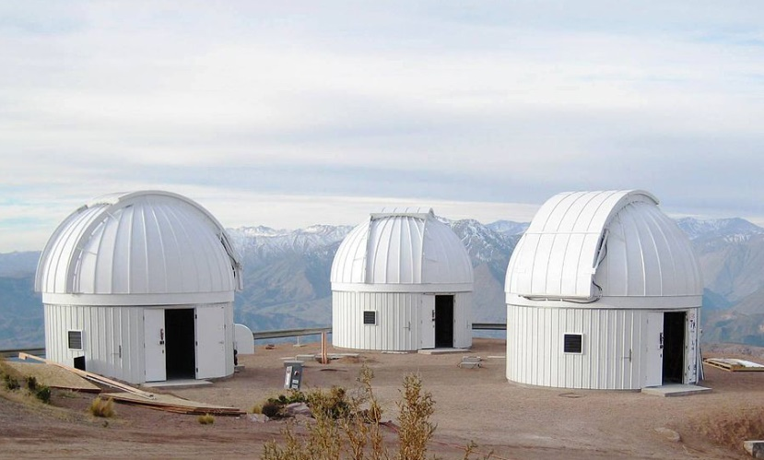
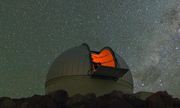
What might have been, and what will be
LCOGT network KMT network
1m follow-up telescopes 1.6m survey telescopes
Chile, South Africa, Australia Chile, South Africa, Australia
Monitor OGLE-MOA moderately Detect moderately high mag events
high mag alerts (~ 30 available per (~ 30 per year).
year).
Detect ~ 1 low mass planet per Will detect ~ 1 low mass planet per year according to the MOA mass year according to MOA mass function. function.
But FWHMs not monitored. E.g., OB161195

Slide 40
Summary
High mag technique sensitive to low-mass planets
Provides a “snapshot” of a planetary system near the Einstein ring
Multi-planets detectable
Statistics ok
No problems with low detection efficiencies
Statistically unbiased and independent sample of events
Other observations by MOA – free-floating planets, stellar shape, dark matter
Future telescopes – SAAO, WFIRST

Slide 41
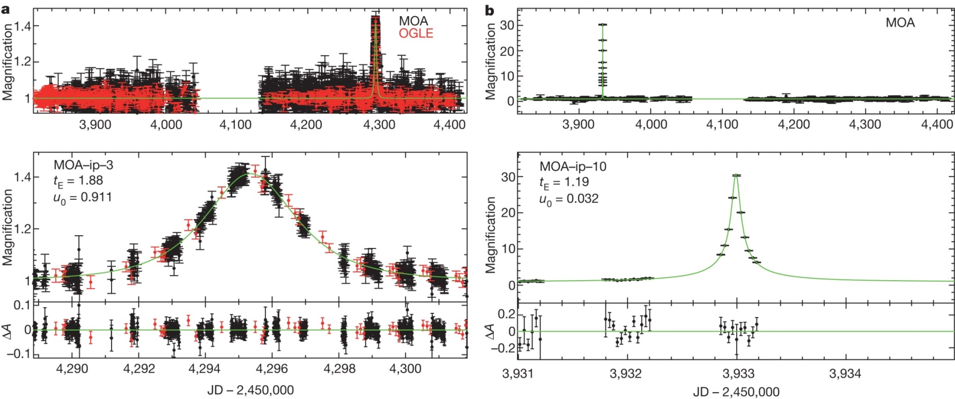
Possible free-floating planets
T. Sumi, K. Kamiya et al Nature 473, 349, 2011:-
More data needed, preferably independent.

Slide 42
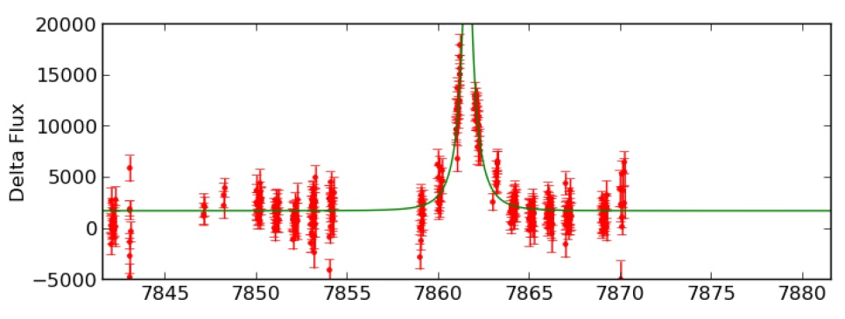
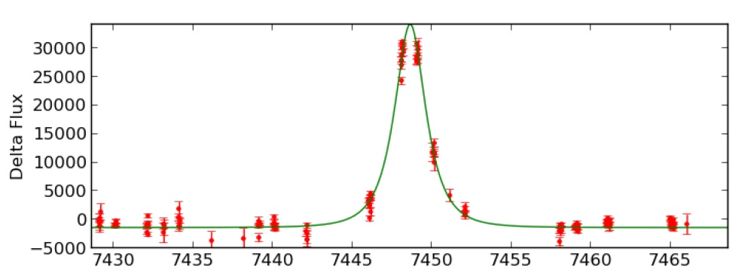
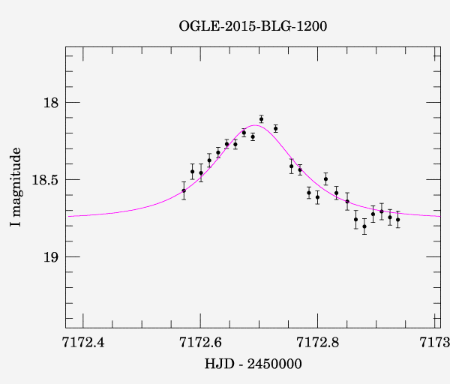
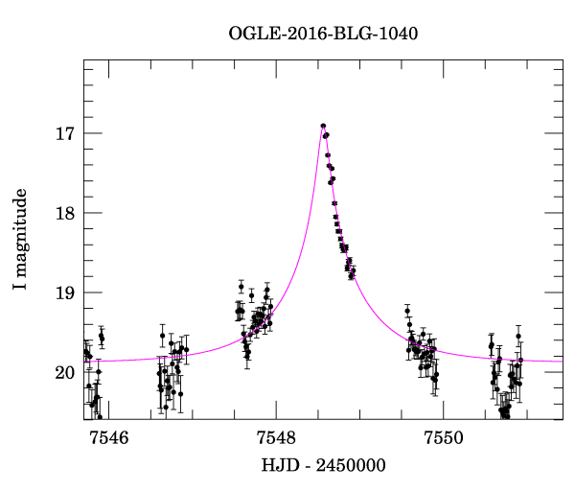
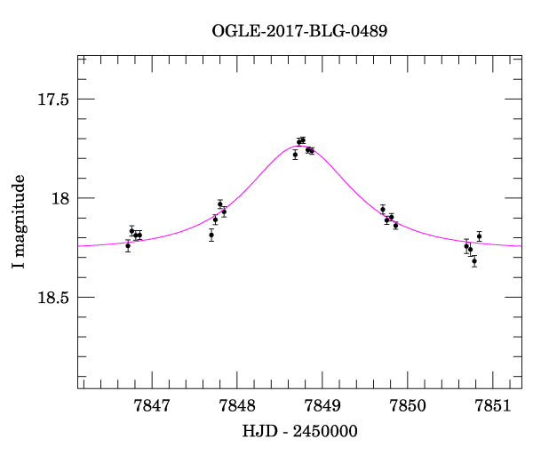
Some recent events
By MOA:-
MB16053 MB17180
1.57d 1.40d
By OGLE:-
0.11d 0.96d 0.87d

Slide 43
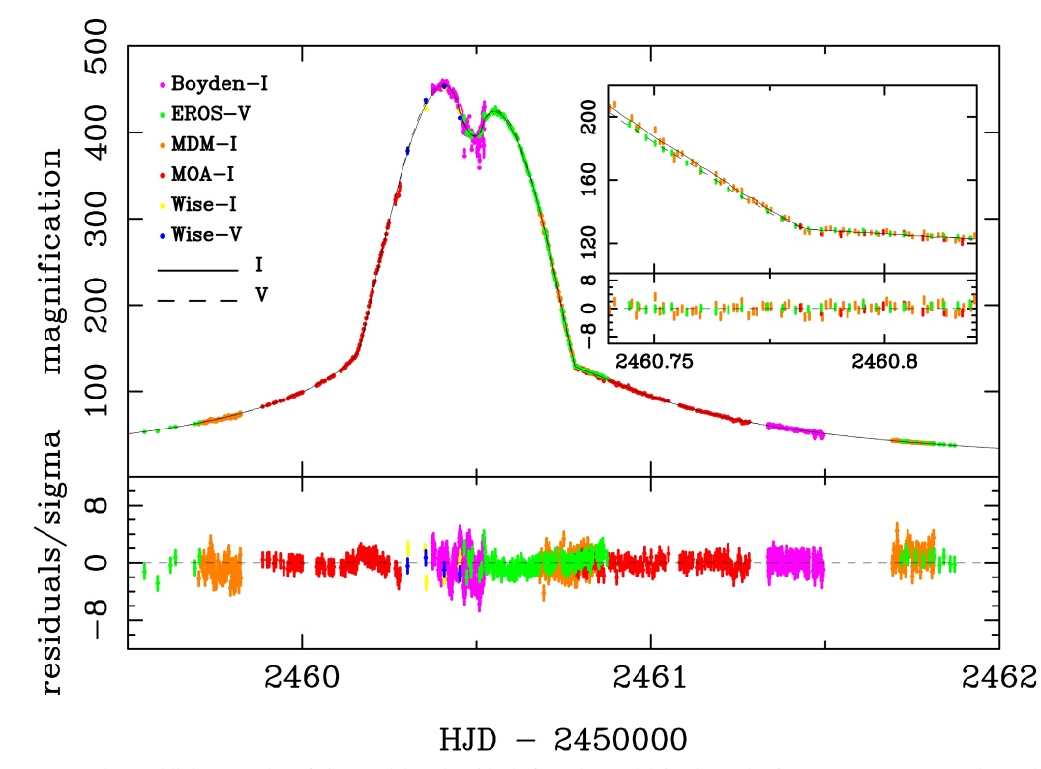
Stellar shape
MOA-2002-BLG-33
a/b = 1.02 ± 0.03 approx
a/b = 1.02 ^{+0.04} _{-0.02}
Angular resolution = 0.04 µas
N. Rattenbury et al, A&A 439, 645, 2005

Slide 44
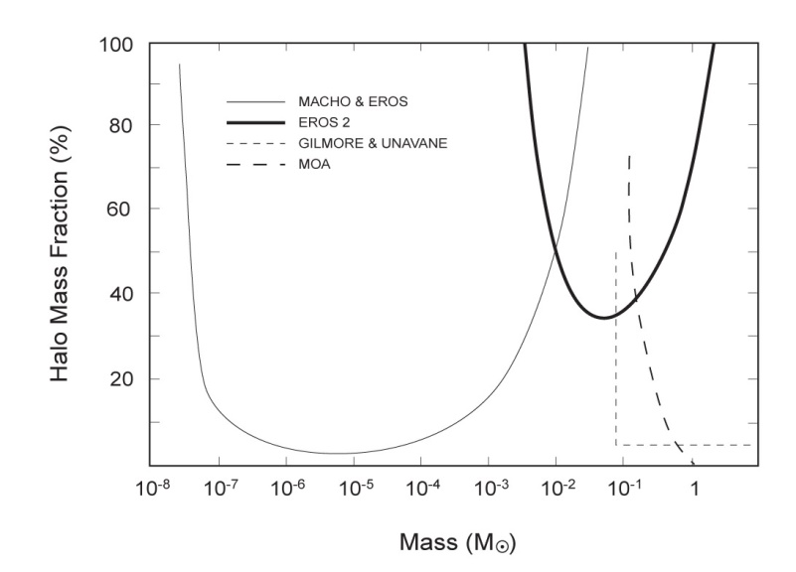
Dark matter?
Null result on brown dwarfs by MOA
Abe et al AJ 118, 261, 1999
Presently hunting for 30 solar mass black holes by
microlensing following the gravitational wave discoveries

Slide 45
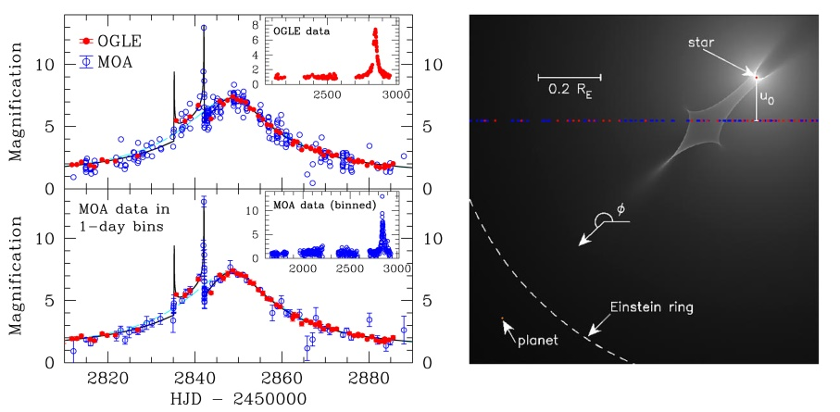
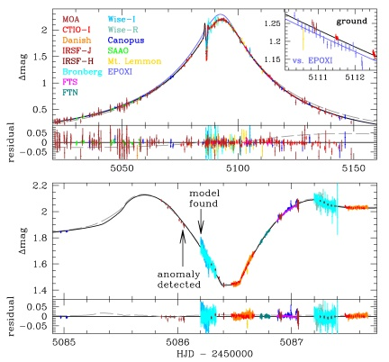
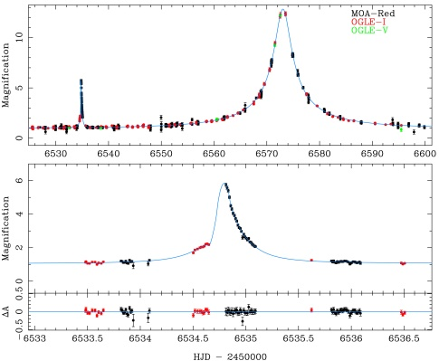
Further information: “Handbook of Exoplanets”
Yock contributiono be published
by Springer later this year.

Slide 46
Welcome to visit NZ anytime.
Skiing good, seeing pretty good.

Slide 47
Plaque at Mt John
Polish Trails

Slide 48
Rocket Lab NZ (Electron Rocket -150 kg payload)

Slide 49
2018 Microlensing Conference
at the City of Sails in NZ
25-28 January

