Slide 1
Structural Properties of OGLE Cepheid and RR Lyrae light curves and multiphase PC/PL relations: comparisons between theory and observations
Shashi M. Kanbur
SUNY Oswego
Celebrating 25 Years of the OGLE project: Warsaw July 2017

Slide 2
Collaborators
Lucas Macri, Chow Choong Ngeow, Marcella Marconi, HP Singh, Sukanto Deb
Anupam Bhardwaj, Earl Bellinger, Susmita Das, Richa Kundu
Dylan Richmond, Kenneth Roffo

Slide 3
Cepheids at Maximum Light
Galactic Cepheids at maximum light have a spectral type that is independent of period (Code 1945).
Simon Kanbur and Mihalas (1993), Kanbur (1995), Kanbur and Phillips (1996)

Slide 4
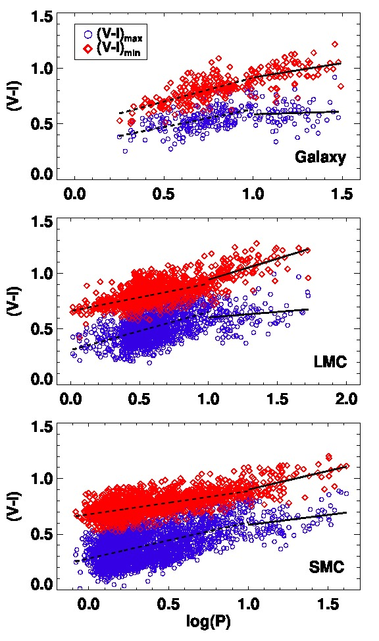
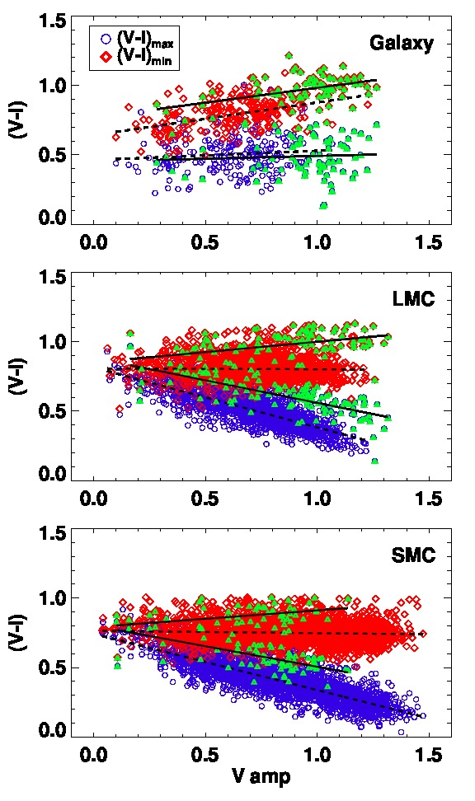
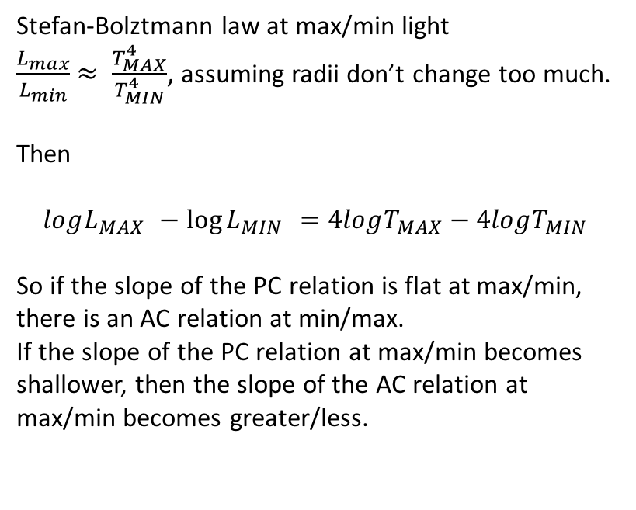
PC-AC Relations: Bhardwaj et al 2014, MNRAS
Stefan-Bolztmann law at max/min light
$\frac{L_{max}}{L_{min}}$ $≈ \frac{T_{MAX}^{4}}{T_{MIN}^{4}}$, assuming radii don’t change too much.
Then
$$logL_{MAX }−\log{L_{MIN }=4logT_{MAX}−4logT_{MIN}}$$
So if the slope of the PC relation is flat at max/min,
there is an AC relation at min/max.
If the slope of the PC relation at max/min becomes
shallower, then the slope of the AC relation at
max/min becomes greater/less.

Slide 5
HIF-Stellar Photosphere Interaction

Slide 6
HIF-Stellar Photosphere Interaction

Slide 7
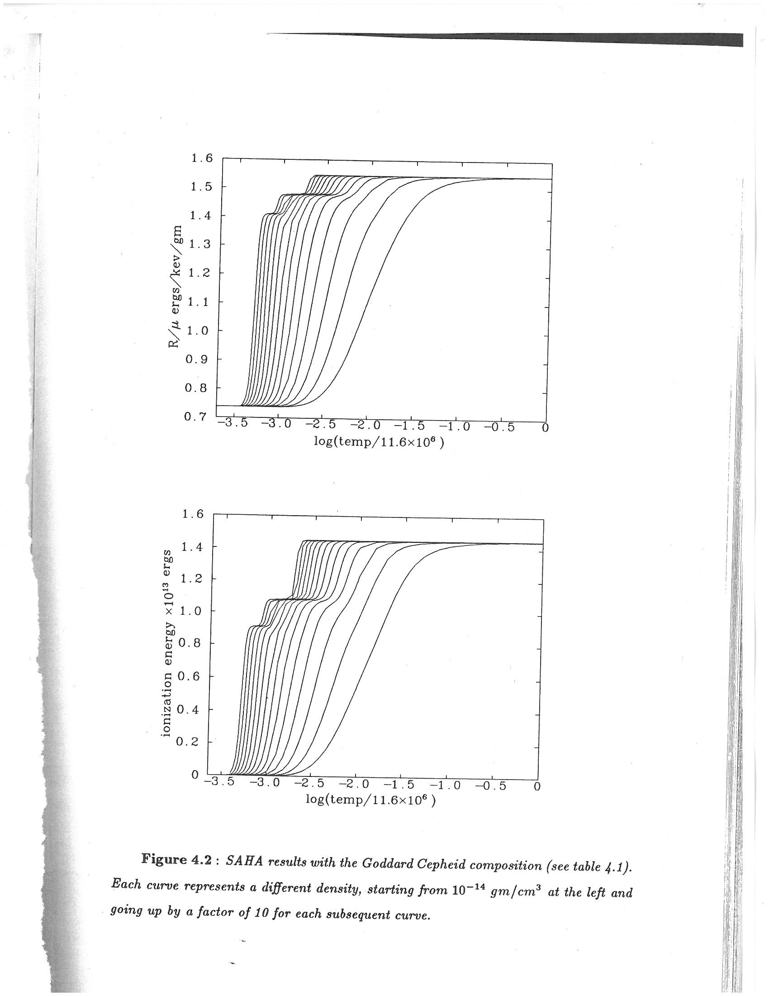
Saha Ionization Equilibrium

Slide 8
The HIF-photosphere interaction
In certain situations, the photosphere can lie at the base of the HIF.
Further movement into the mass distribution very hard due to opacity wall.
Then the temperature of the photosphere is very close to the temperature at which Hydrogen ionizes.
In this situation, the color of the star is the temperature at which Hydrogen ionizes.
In certain situations, this temperature is somewhat independent of global stellar parameters like period
Distance between stellar photosphere and HIF is important.

Slide 9
The HIF-photosphere interaction
Saha ionization equation used in stellar pulsation models.
Temperature at which Hydrogen ionizes is somewhat independent of density for low densities.
Thus, when the HIF-photosphere are engaged, temperature of stellar photosphere is somewhat independent of global stellar properties, such as period, at low densities.
This can lead to changes in the period-color relation, amplitude-color and PL relations.
This interaction varies with pulsation phase, period and metallicity.
Mean light relations are averages of relations at different phases.

Slide 10
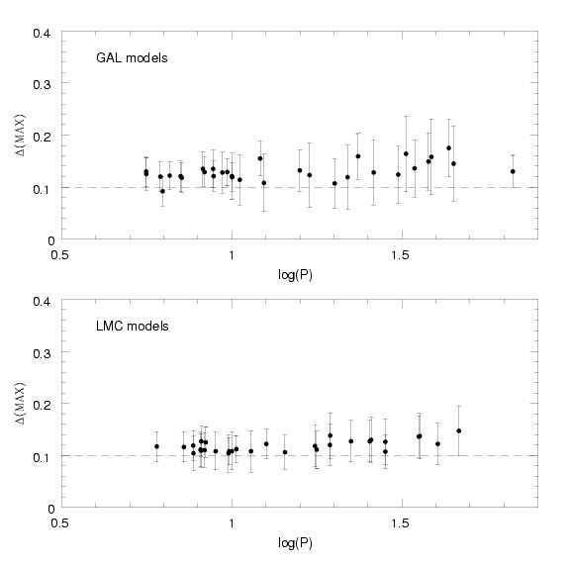

Slide 11
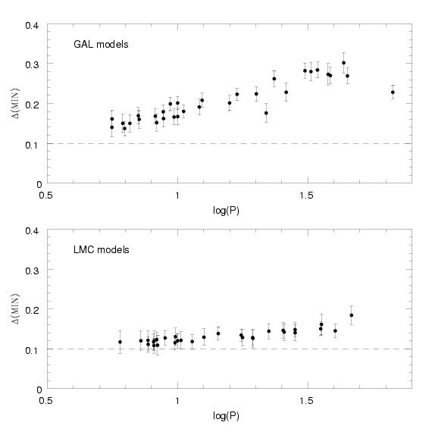

Slide 12
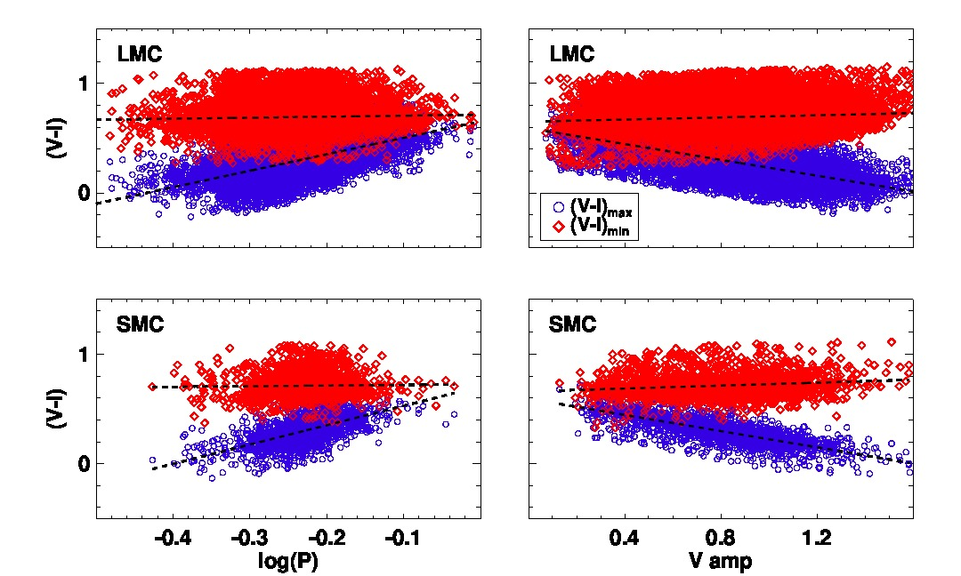
RR Lyraes

Slide 13
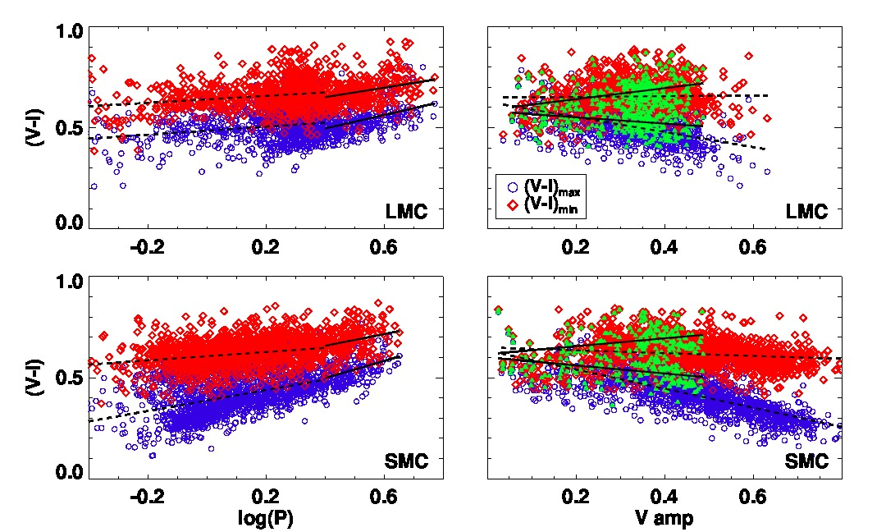
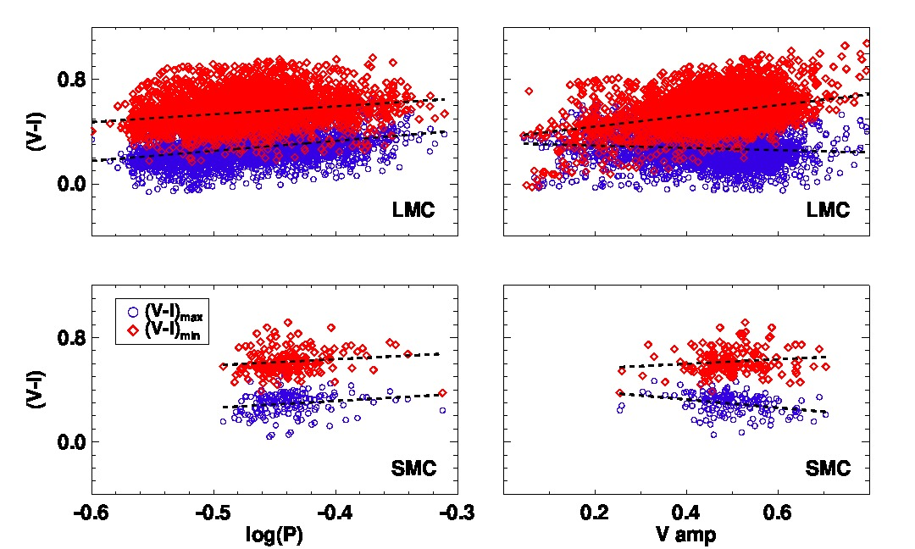
Cepheids/RR Lyraes First Overtone

Slide 14
OGLE IV: RRab

Slide 15
OGLE IV: RRc

Slide 16
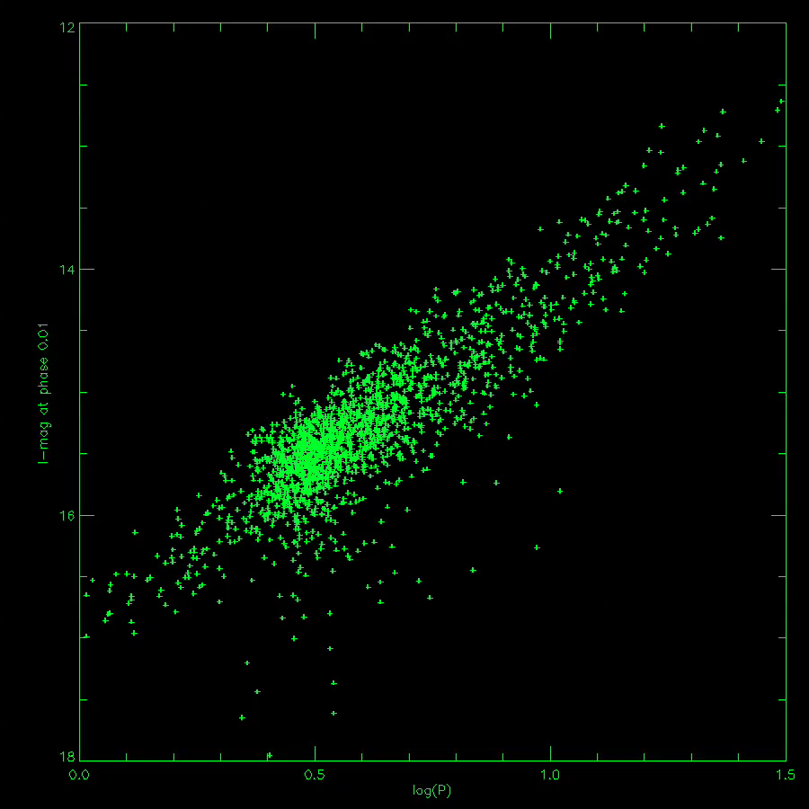
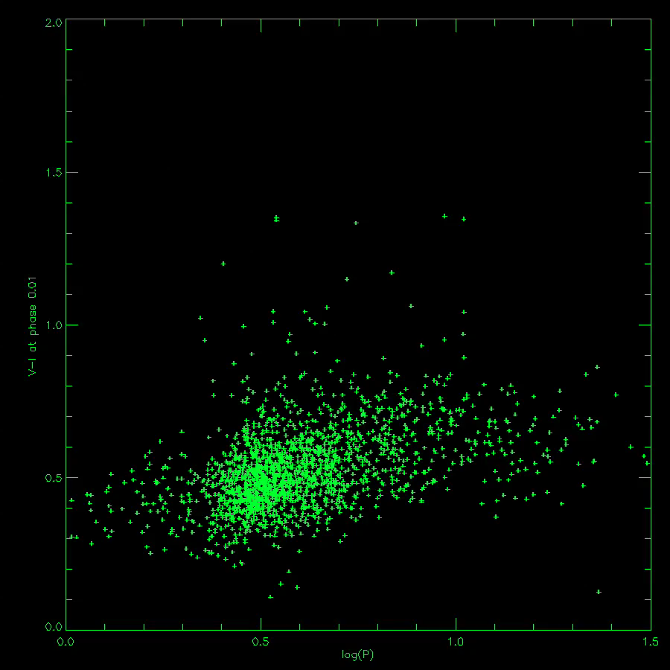
Multiphase and NonLinearity

Slide 17
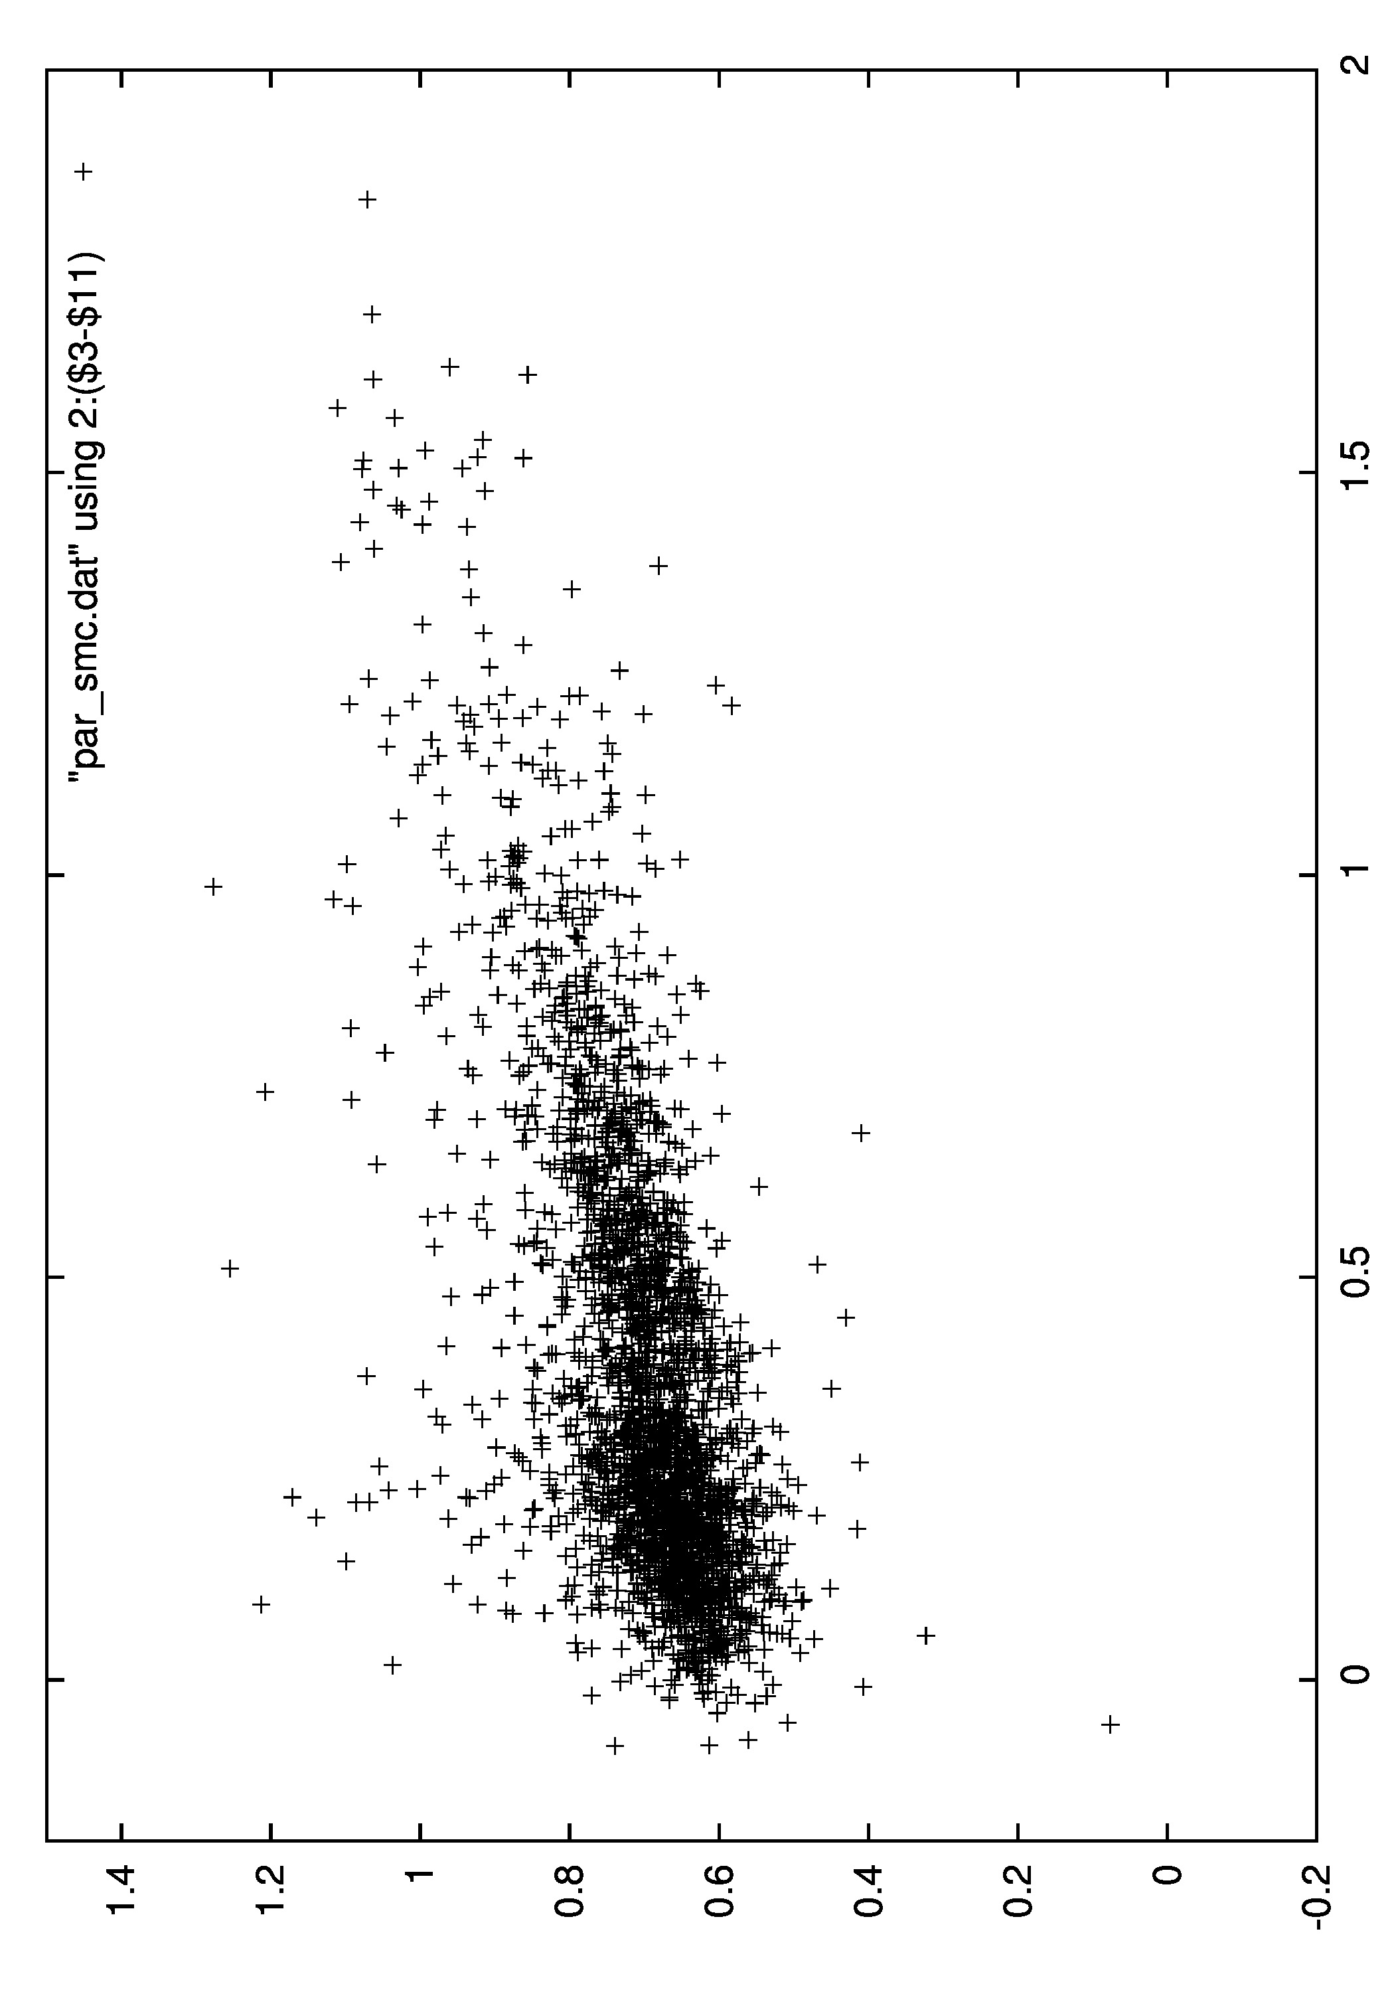
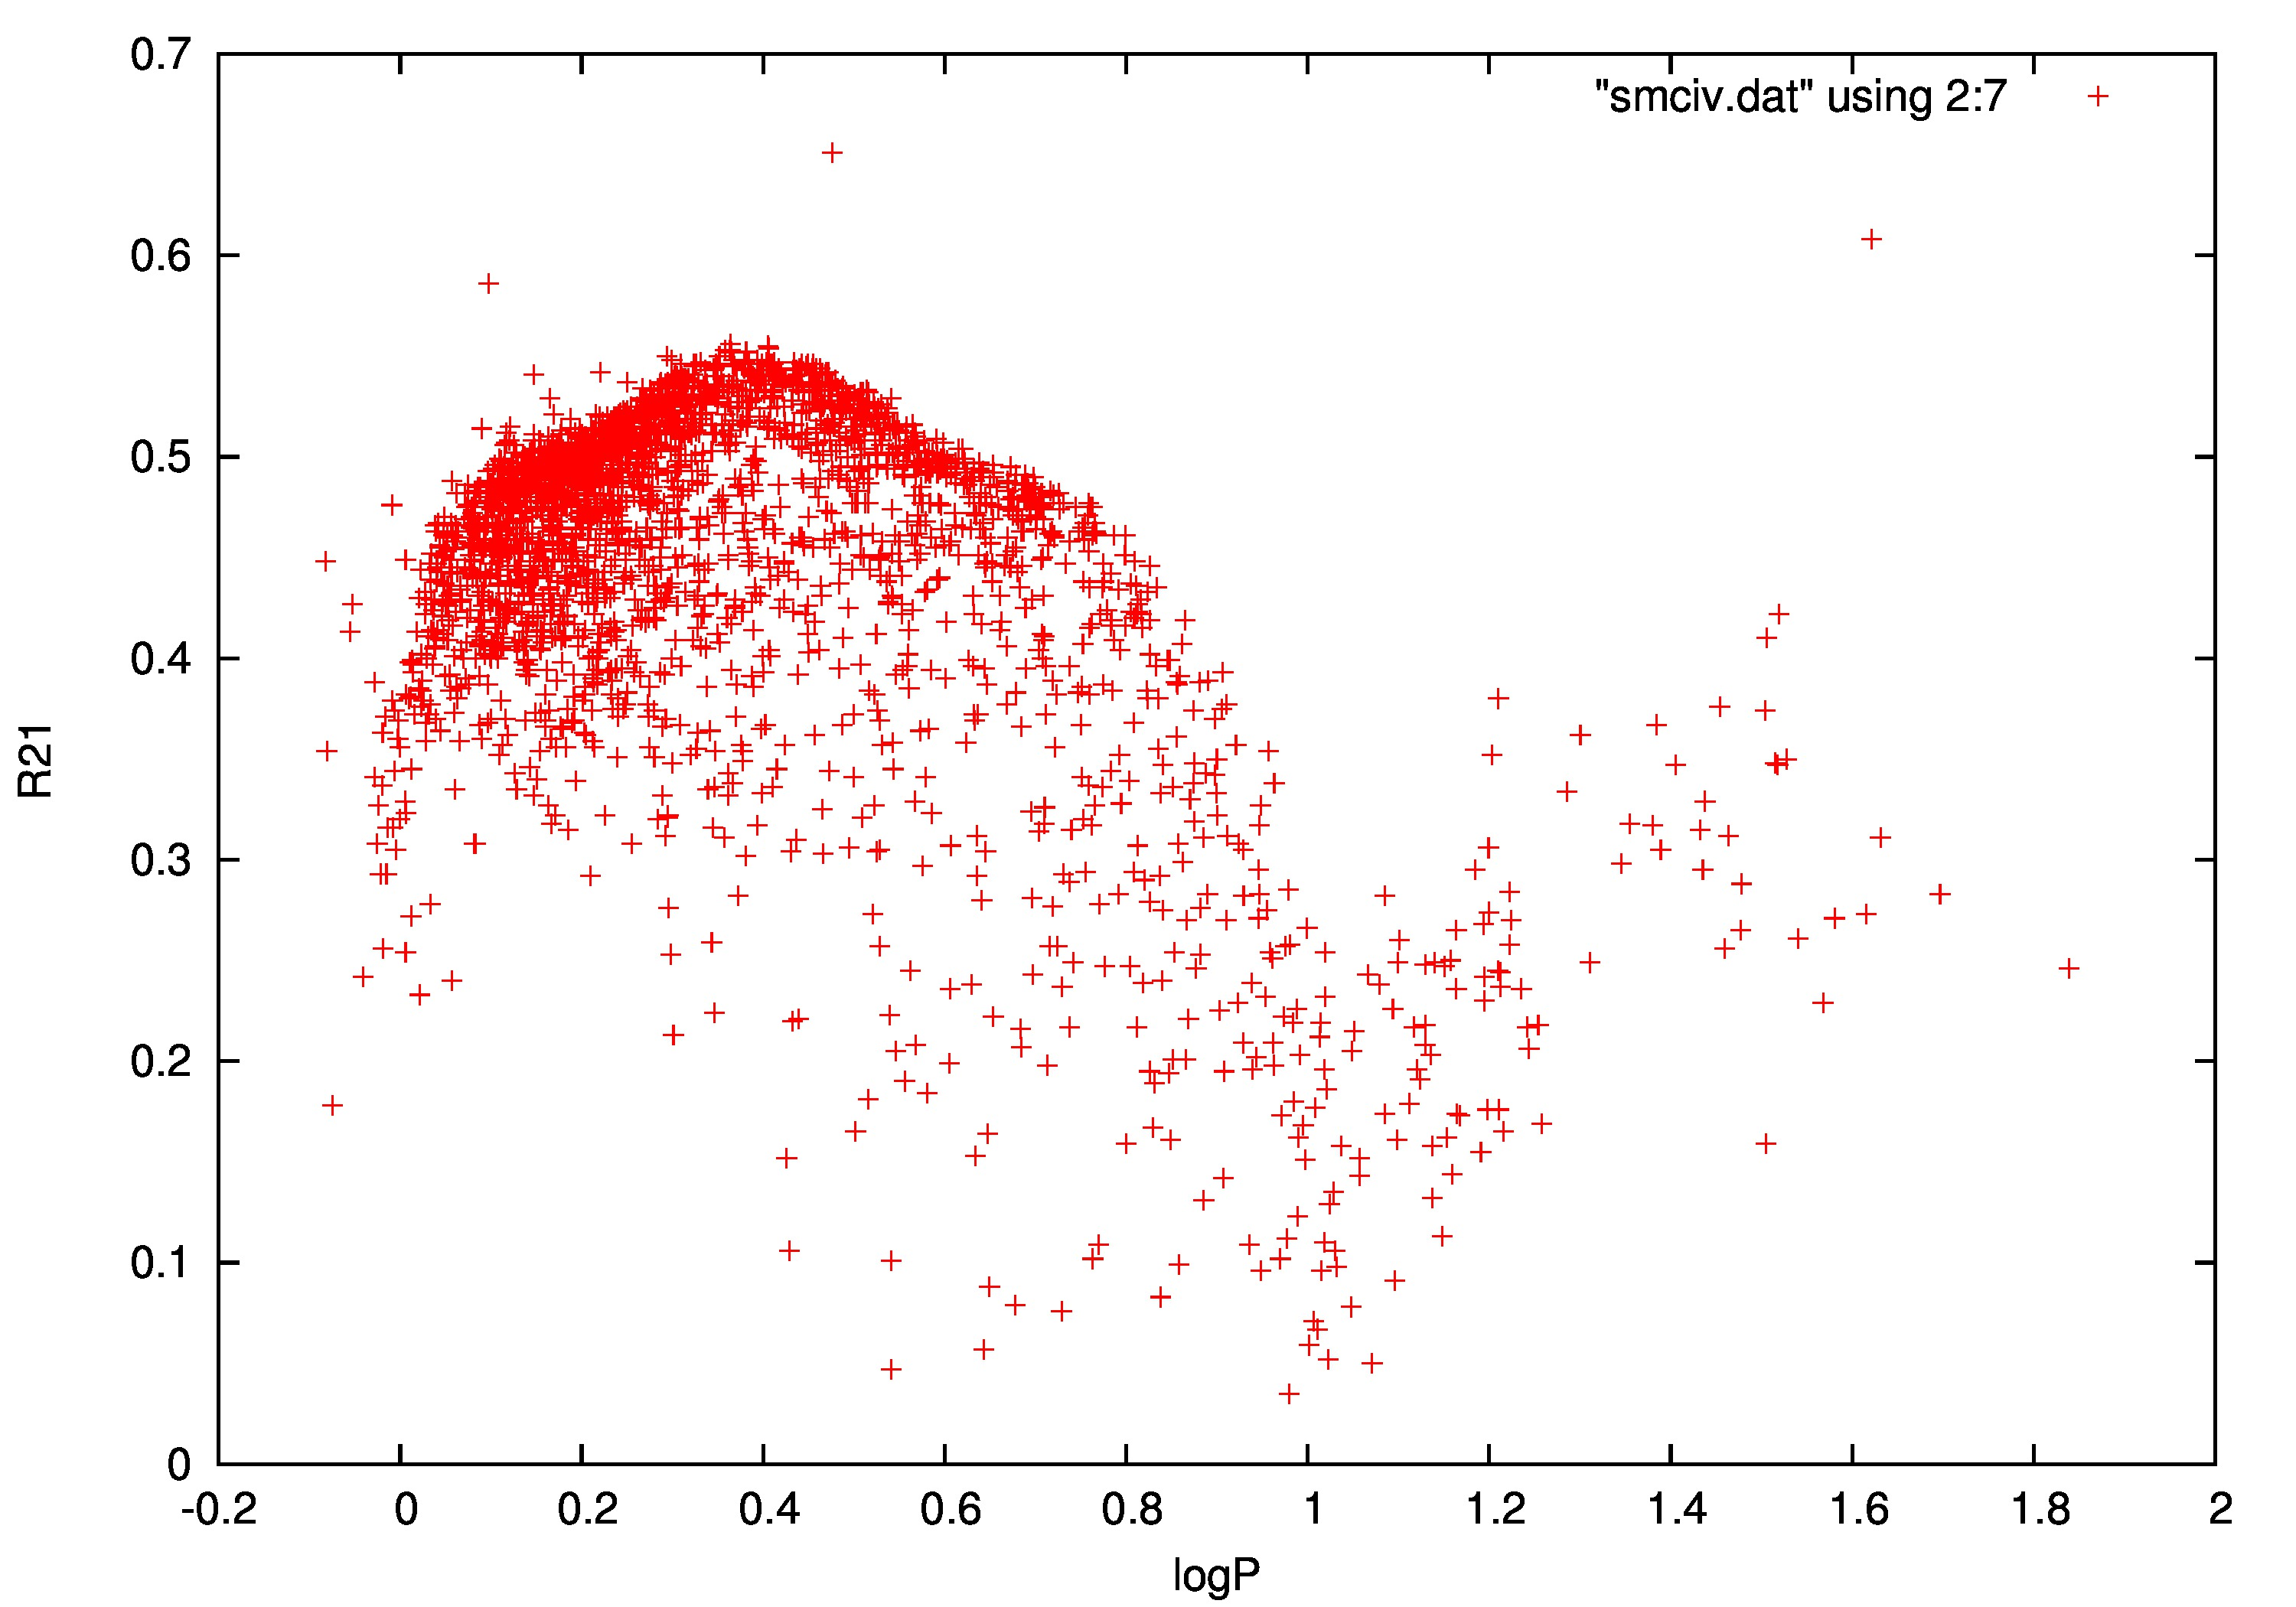
SMC FU PC relation using OGLE IV V-I data

Slide 18
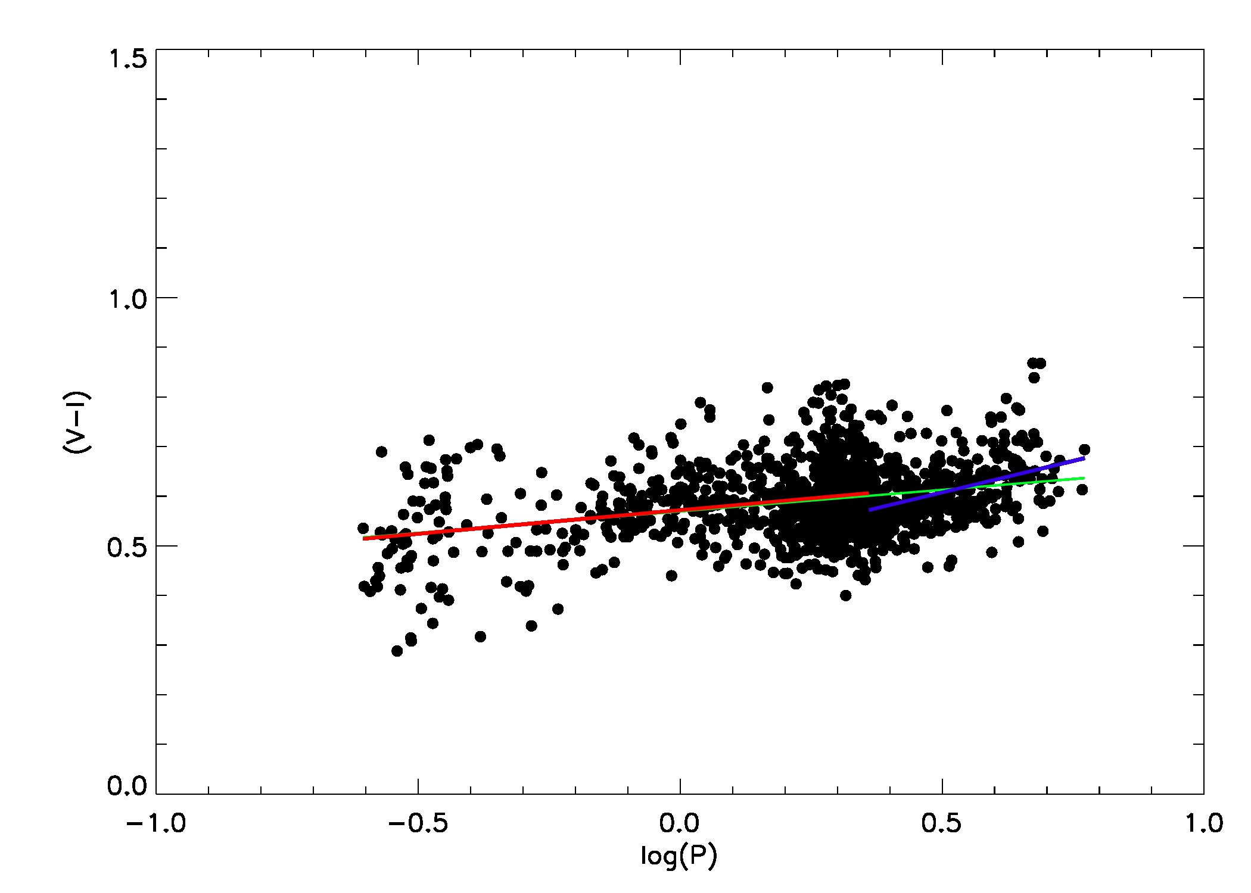
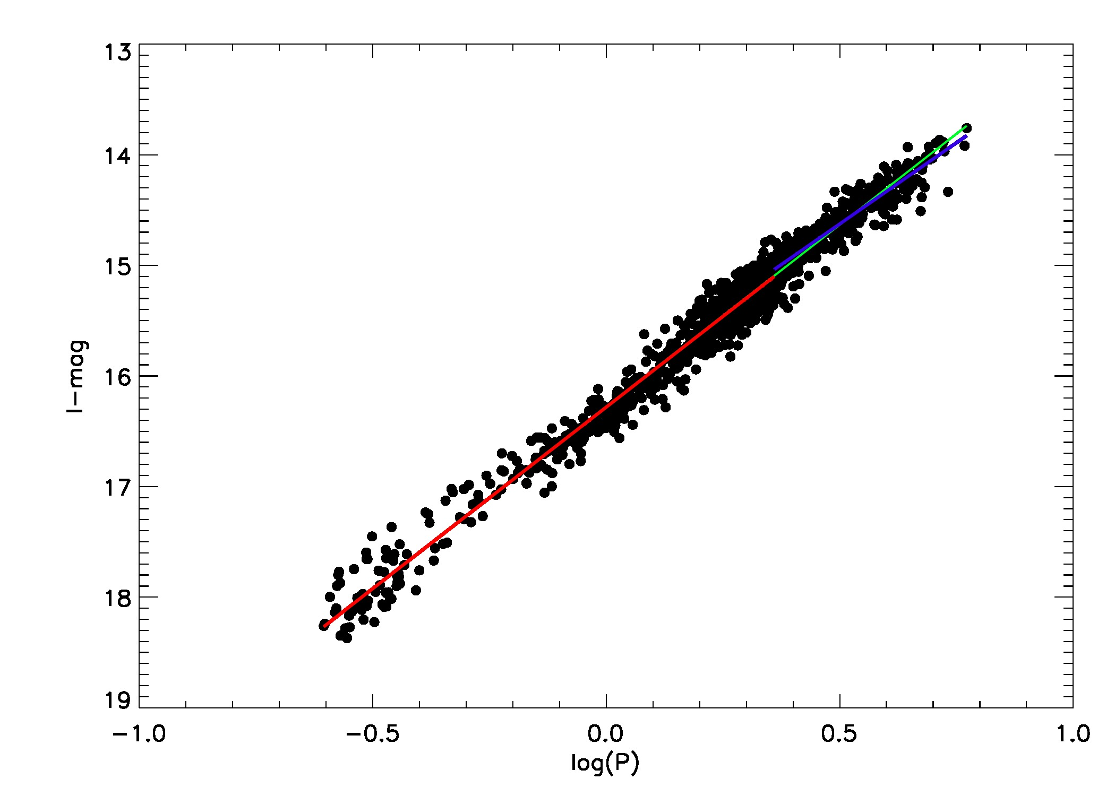
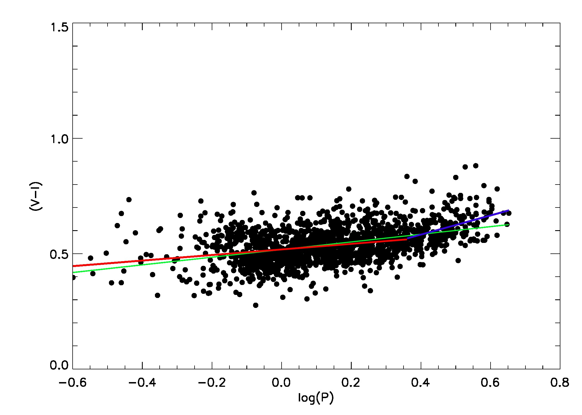
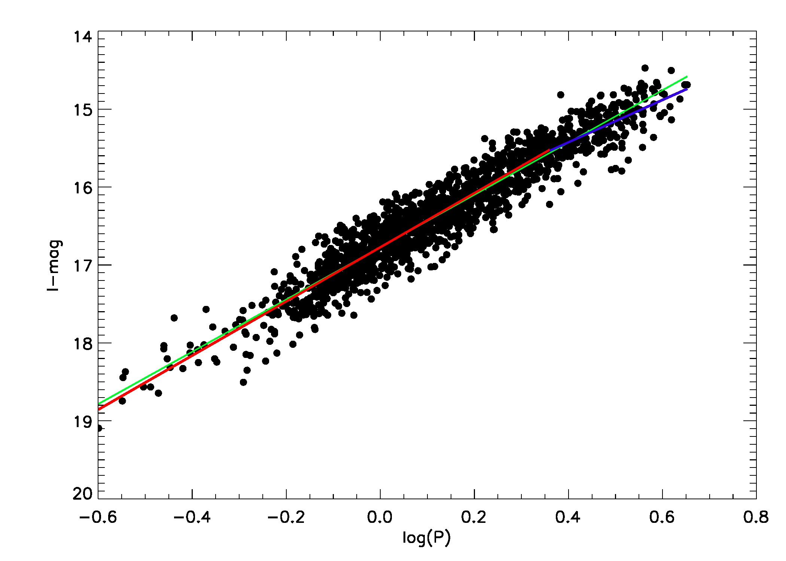
FO MC Possible Non-Linearity at short periods

Slide 20
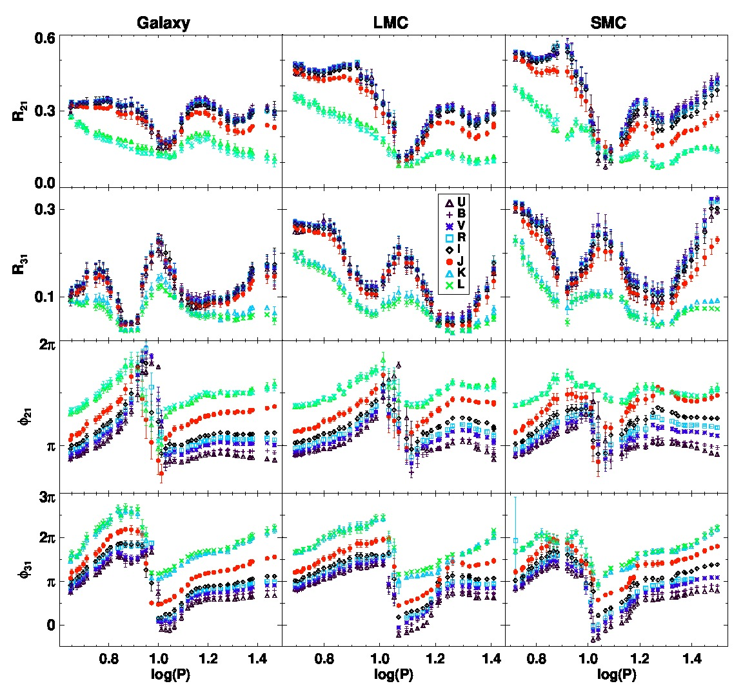
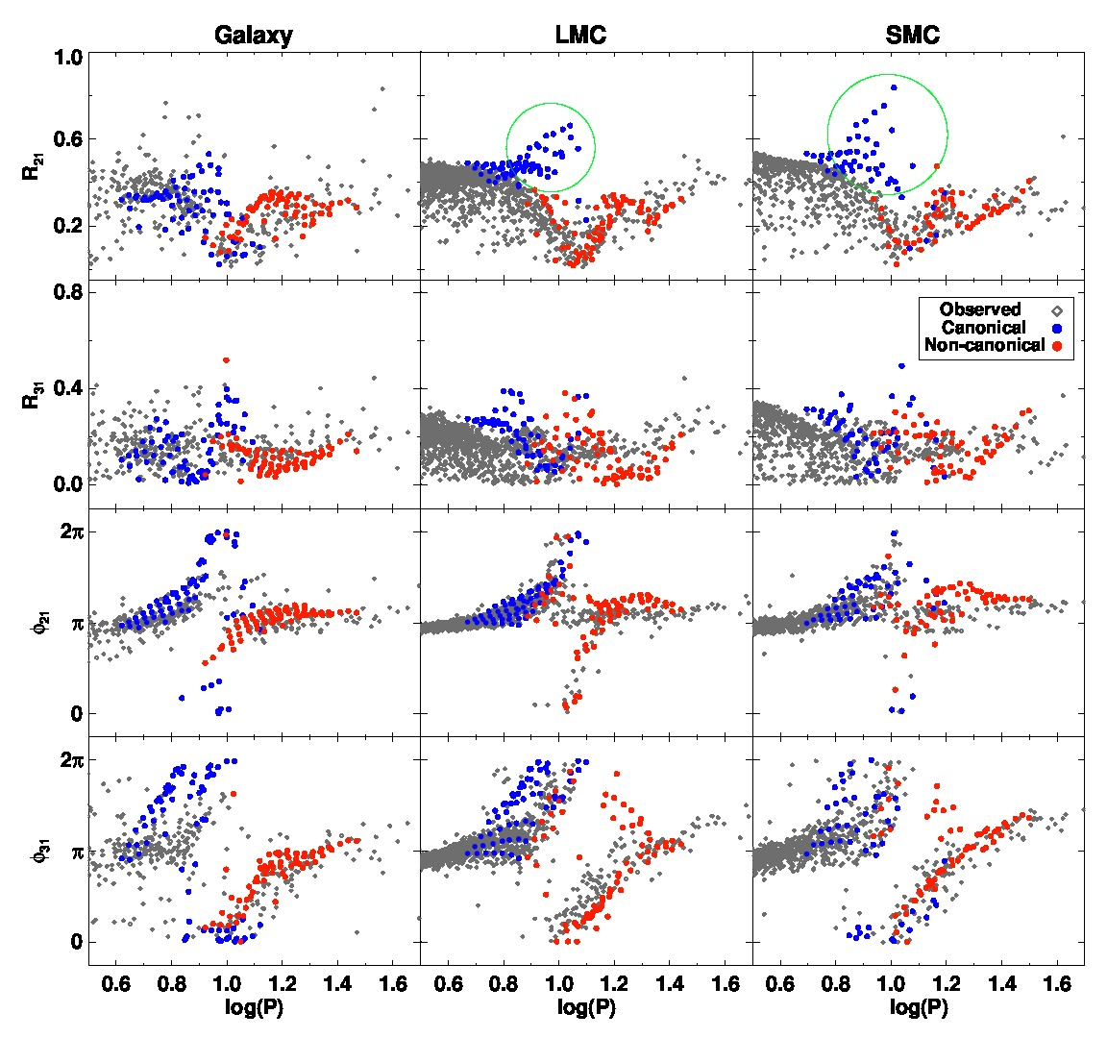
Light Curve Structure: Cepheids
Bhardwaj et al (2015, 2017, MNRAS)

Slide 21
Preliminary Results
Large offset between theory and observations for periods between 7 and 11 days with non-canonical mass-luminosity levels
Can be reduced by changing the mixing length parameter from 1.5 to 1.8
More models, especially at shorter periods

Slide 22
RR Lyrae PL Relations as a function of phase

Slide 23
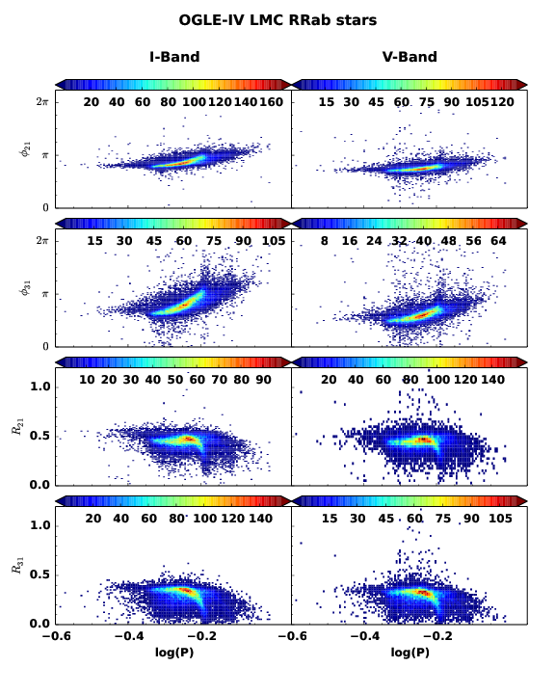
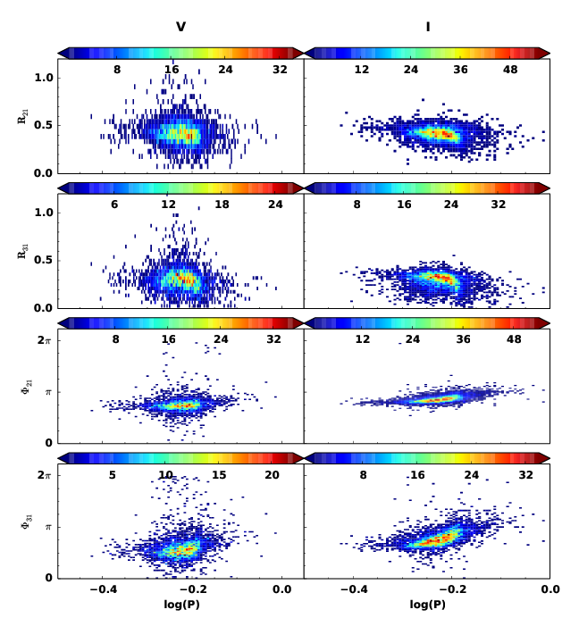
Light Curve Structure: RR Lyraes

Slide 24
Non-Linear Optimization
Fourier Parameters = f(M,L,T,X,Z)
For a fit of order 8, have 17 parameters, or 6 if we use Rk1 etc.)
Non-linear optimization problem to get the best M,L,T,X,Z.
Multiwavelength data
Approx. a million models….
Use machine learning techniques developed by Bellinger et al (2017).
Use MESA to produce full amplitude pulsation models that are completely consistent with stellar evolution

Slide 25
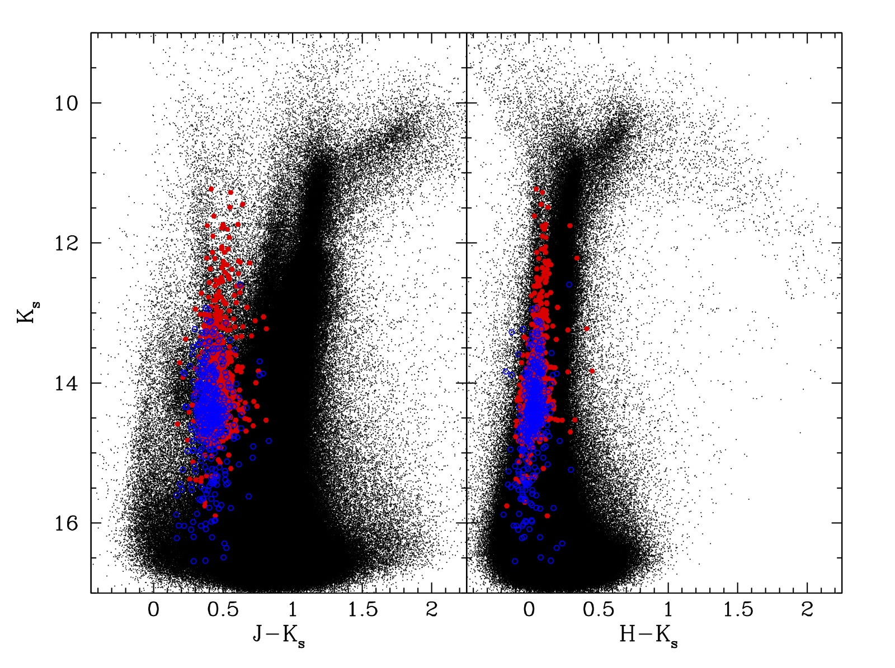
CPAPIR LMC JHK data

Slide 26
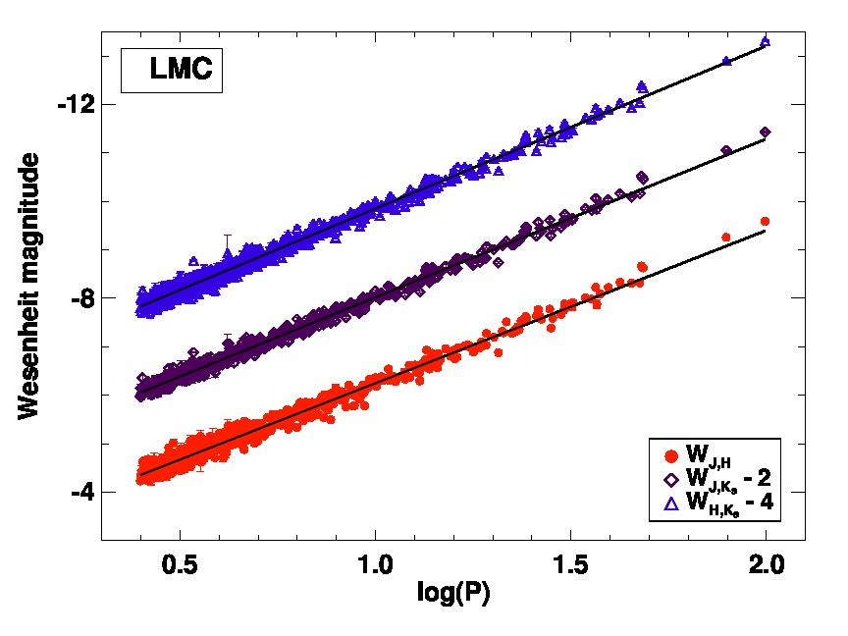
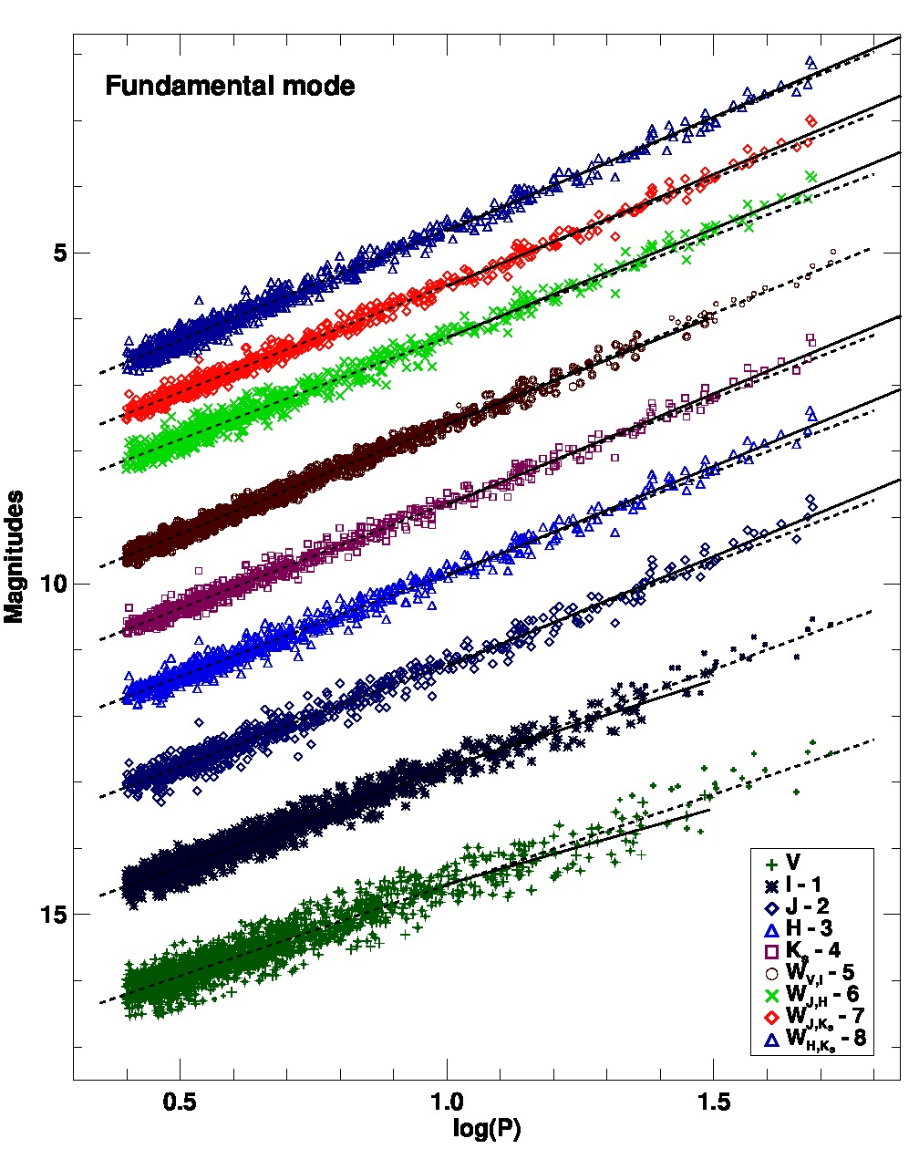
Cepheid Multiwavelength PL Relations

Slide 27
Conclusion
OGLE has dramatically changed variable star Astrophysics.
Many questions answered, but also many new questions.
SMC FU Cepheids have a positive slope in the PC minimum light relation with OGLE IV.
Physical cause for dispersion at minimum light
Stellar-Photosphere-HIF interaction: Saha Ionization equilibrium, optical depth=2/3 – f parameter (Dasznyska-Daskiewicz et al 2003)
NonLinear Optimization
Thank You to the entire OGLE team.

