Slide 1
Infrared time domain discoveries from VVV: eruptive protostars and astrometric science
Philip Lucas
University of Hertfordshire
Carlos Contreras Peña, Leigh Smith, Radostin Kurtev, Dante Minniti, Jura Borissova, Alessio Caratti o Garratti, Janet Drew, Nanda Kumar, Mark Thompson, Claudio Navarro, Mariusz Gromadzki, Michael Kuhn, Dirk Froebrich, Wayne Stimson, Tim Gledhill
OGLE@25 conference 25th July 2017

Slide 2
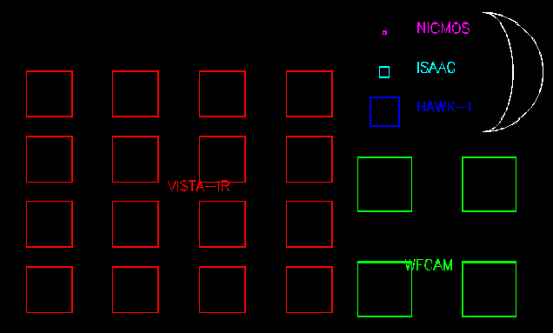
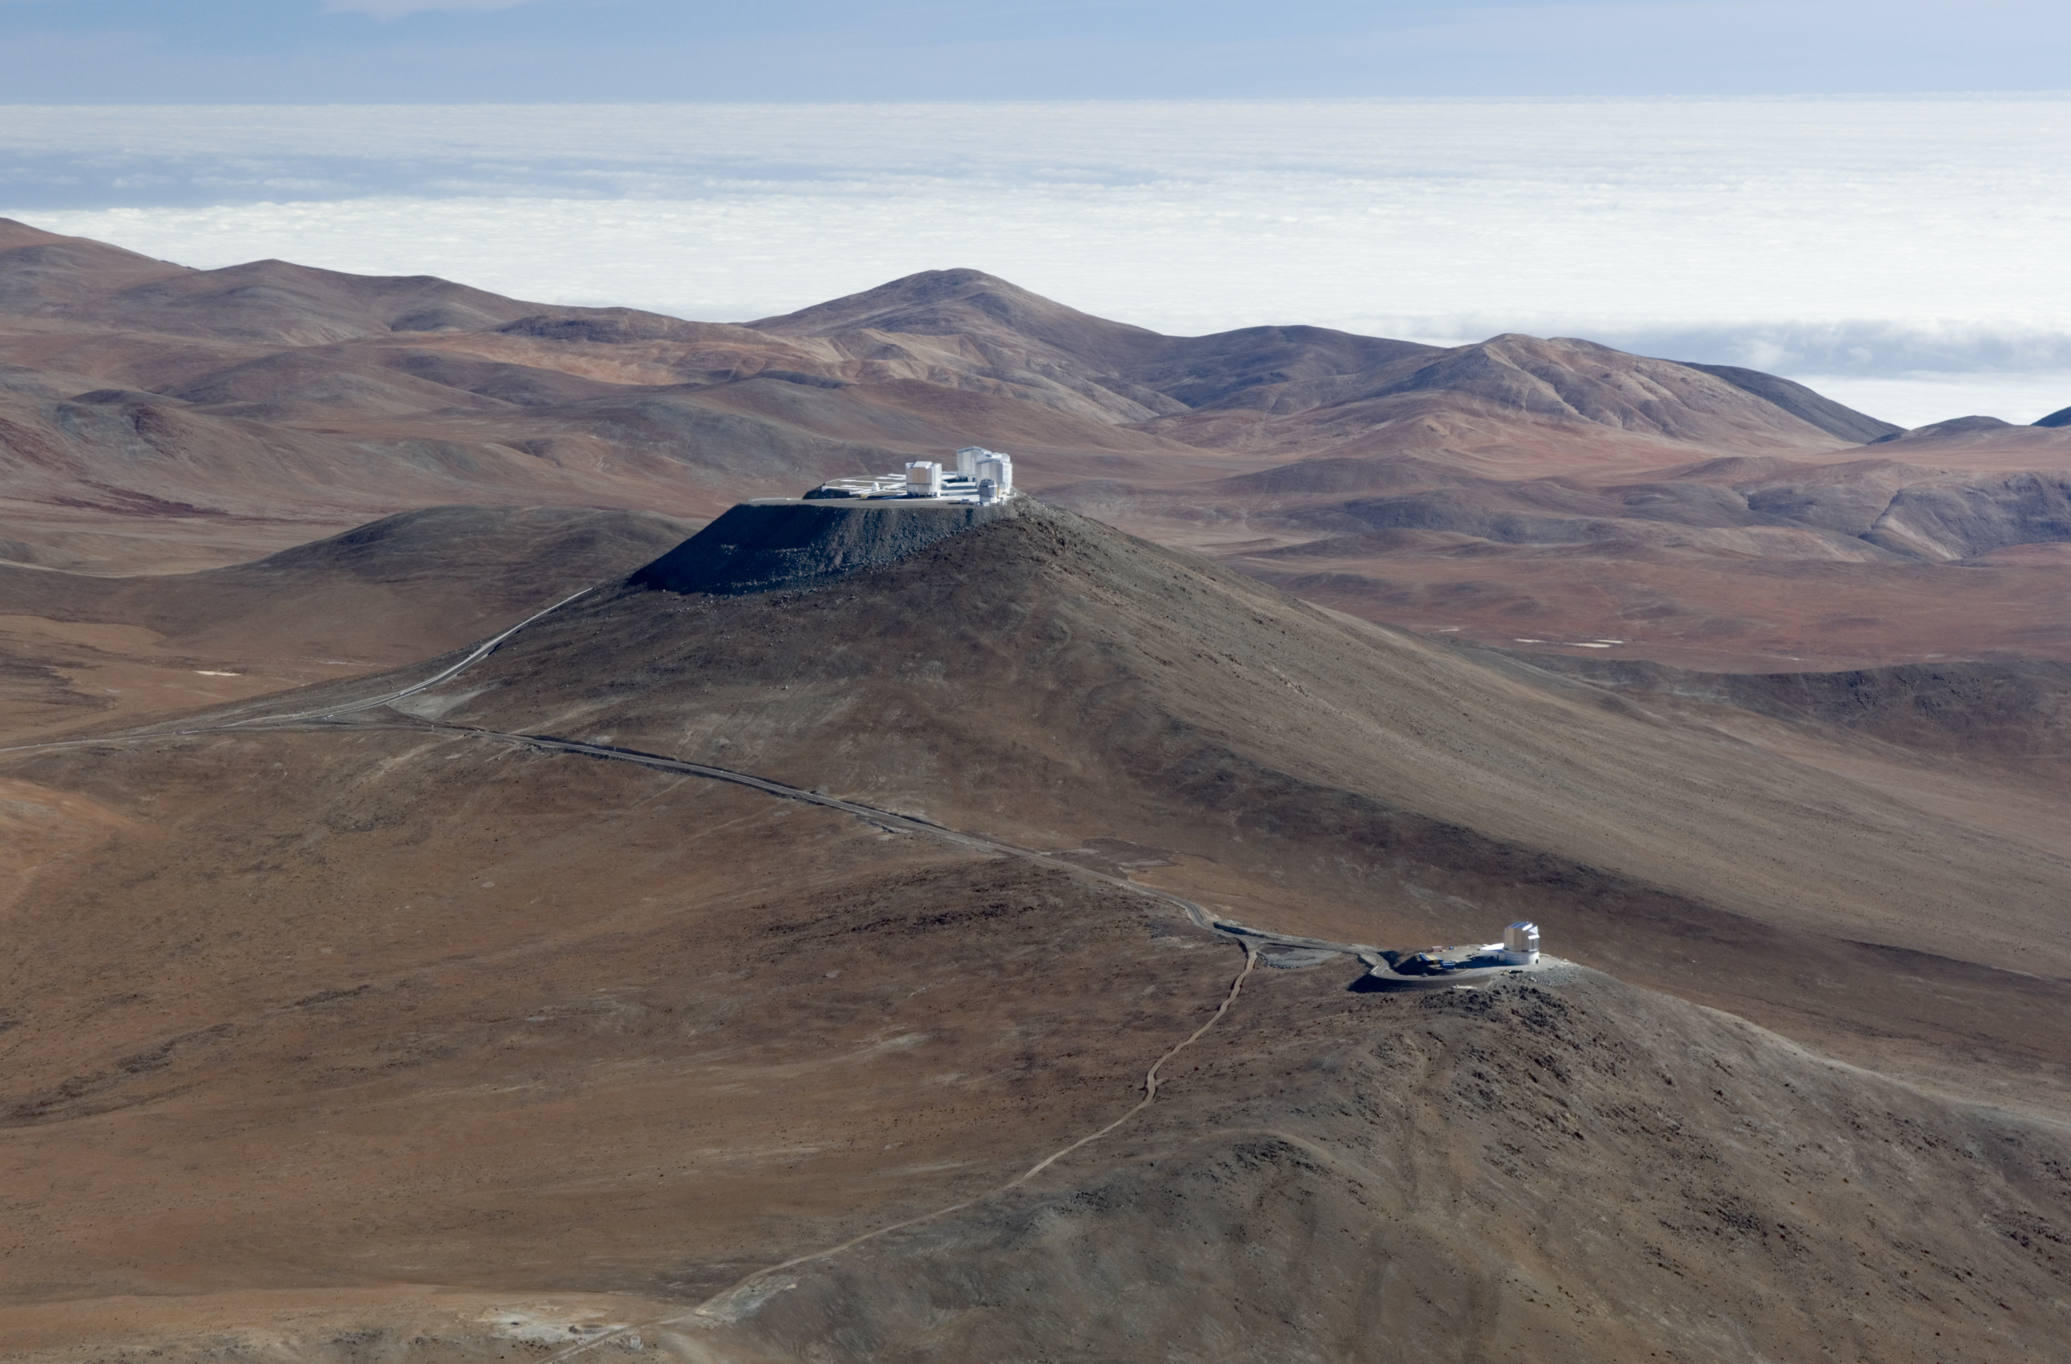
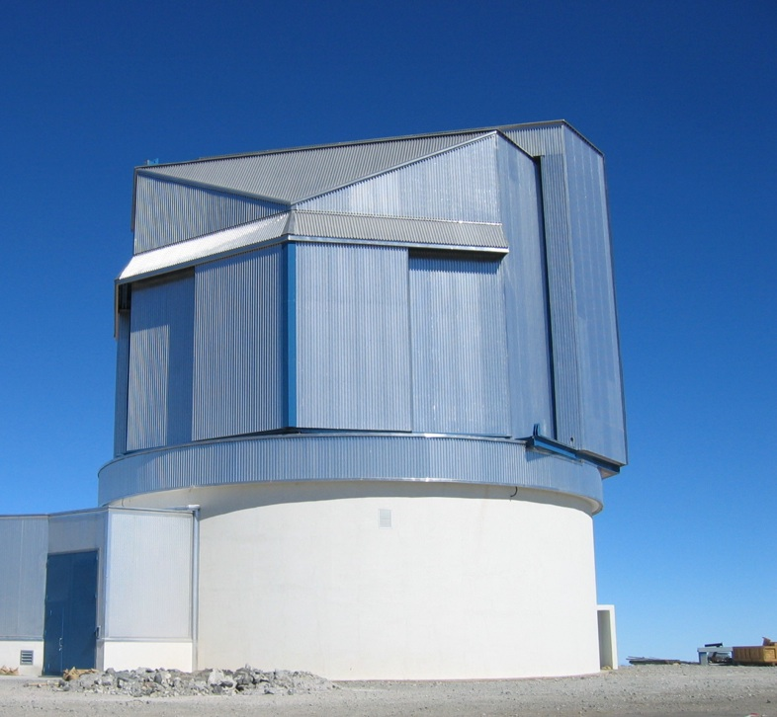
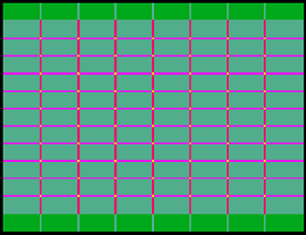
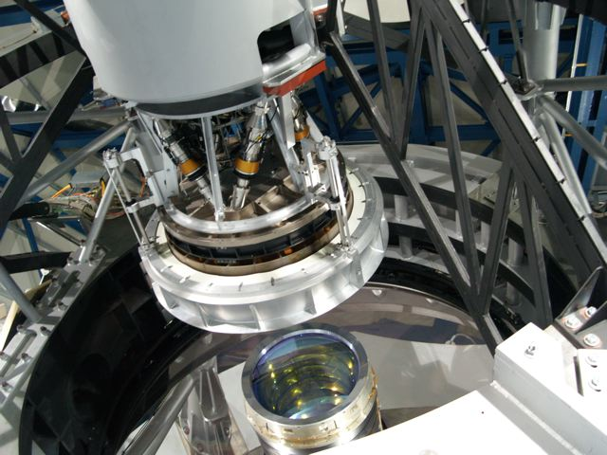
VISTA 4m telescope and VIRCAM at Paranal
16 2048x2048 HgCdTe arrays
1x1.5 deg FOV

Slide 3
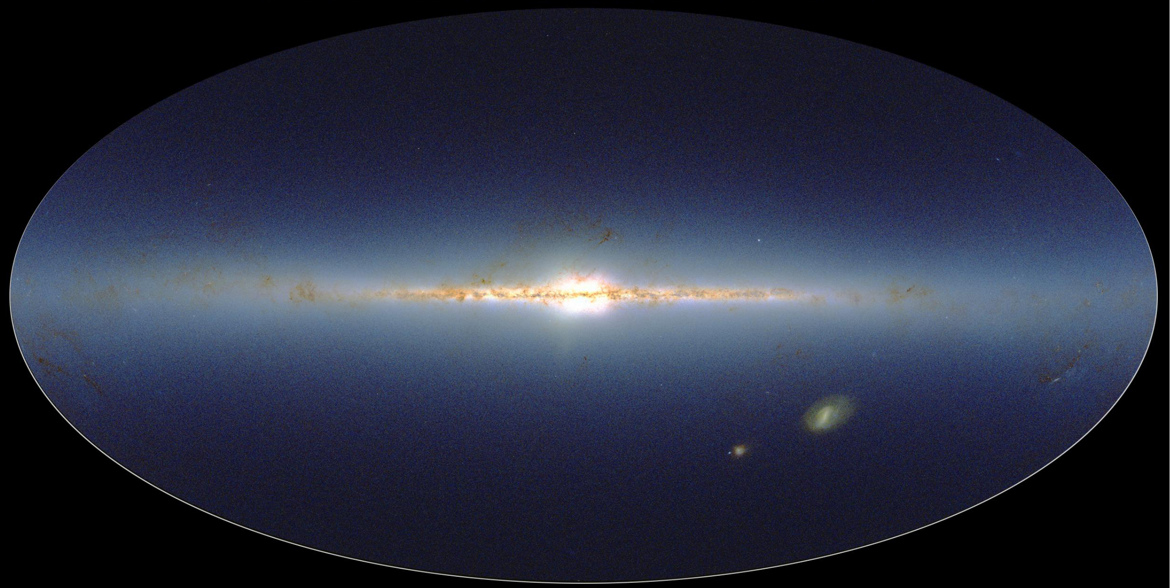
VVV
vvvsurvey.org
2MASS JHKs image
Bulge 300 sq deg: -10º < l < +10º ; -10º < b < +5º
Disk 220 sq deg: -65º < l < -10º ; - 2º < b < +2º
45-70 epochs of Ks from 2010-2015. COMPLETED!
2 epochs of JHKs. Separately 2 epochs of ZY.
Minniti, Lucas et al.2010, New Ast. 15, 433 (VVV definition)
Saito, Hempel et al.2012, A&A, 537, A107 (DR1 paper)

Slide 4
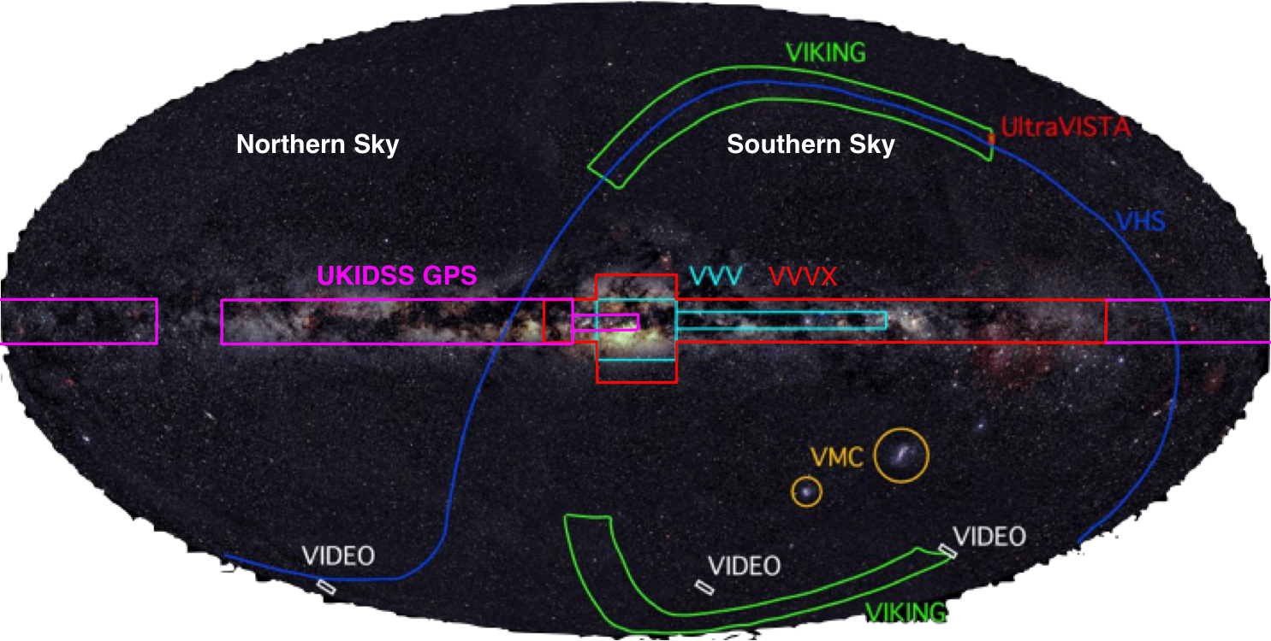
Infrared survey footprints & VVVX
1600 sq.deg.
~10⁷ variables
~2x10⁹ stars
25-40 epochs

Slide 5
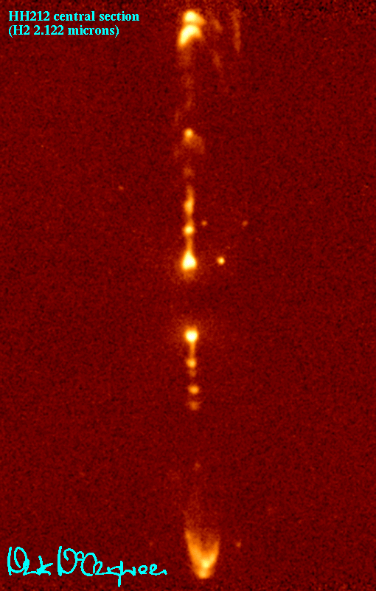
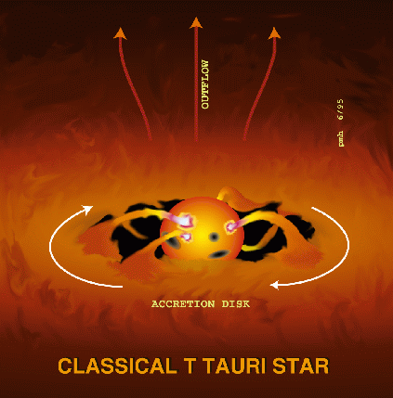
Variability in Young Stellar Objects (YSOs)
Most (93%) pre-main sequence stars are variable (Rice, Wolk & Aspin 2012, ApJ).
Hot & cold spots, changing extinction and changing accretion.
A very few YSOs were known to erupt. Episodic accretion.
FUors: long duration outbursts (decades). ~ 9 objects
EXors: short outbursts. ~ 8-12 objects
Only 3 deeply embedded IR eruptive variables were known.
Hodapp et al.’96, Persi et al.’07, Caratti o Garatti ’11.
Now Safron et al.’15 (Class 0 YSO) and more class 0 YSOs to come…
Zinnecker et al.1998, Nature

Slide 6
Importance of eruptive variability
Accretion-drive outbursts are thought to be common among pre-MS stars…..but rarely seen (e.g. Hartmann & Kenyon 1996, AnnRevAA, 34,207).
May explain the scatter in HR diagrams of PMS clusters. (Baraffe et al.’09).
Could also solve the “Luminosity problem” (Kenyon et al. 1990), Enoch et al.(2009) - most class I YSOs in nearby SFRs have low luminosities (~1 L).
….so masses & ages in the literature are often wrong??
Orion Nebula HR diagram
Weights, Lucas et al.2009

Slide 7
Cause of outbursts?
The theory is tricky, several dozen options discussed (Audard 2014 review).
Thermal instability (accretion limit cycle like dwarf novae)
GPI+MRI rate mismatch (Zhu, Hartmann et al.2009abc),
Binary companion on eccentric orbit (Bonnell & Bastien 1992)
Seen in LRLL 54361 with 10d period (Muzerolle et al.2013)
GI/fragments infalling (Vorobyov & Basu 2015)
Magnetic truncation of the disc just beyond the co-rotation radius (D’Angelo & Spruit 2010, 2012)

Slide 8
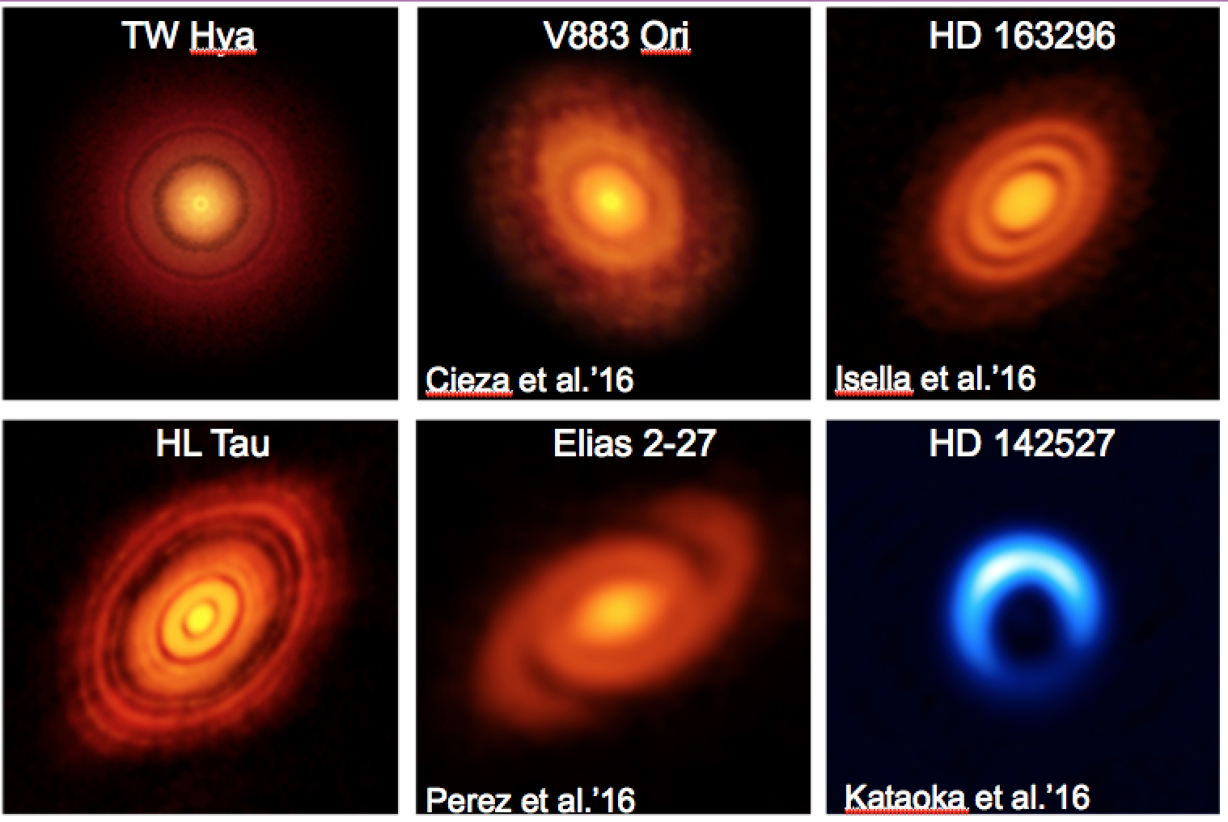
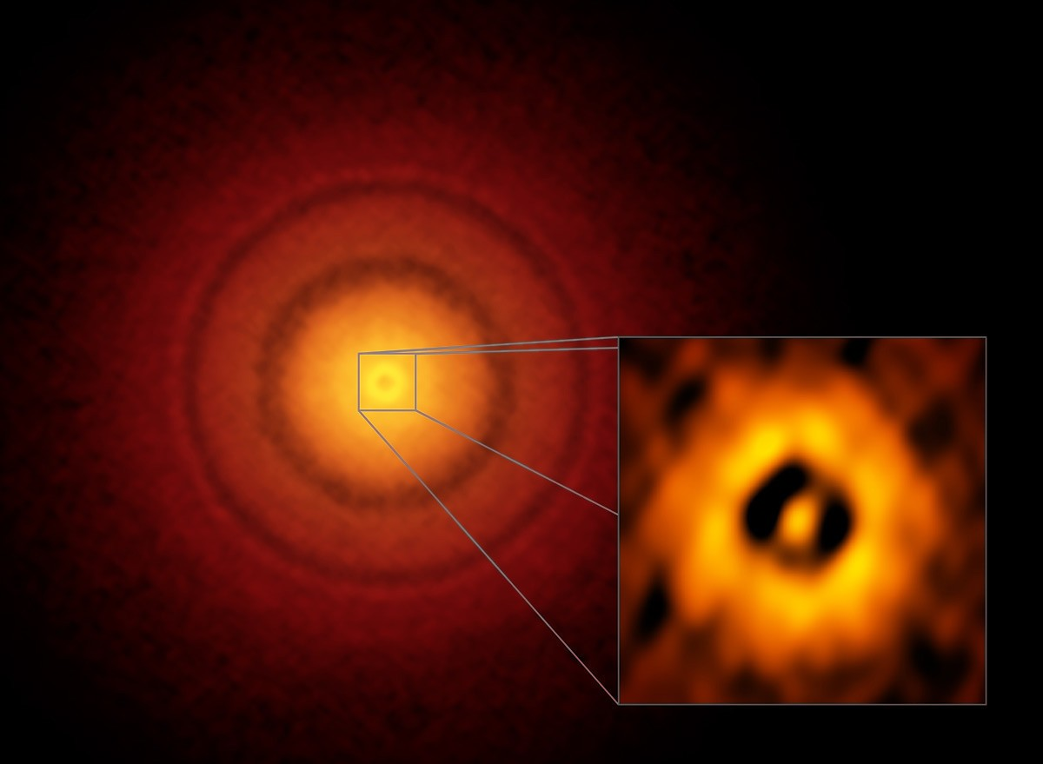
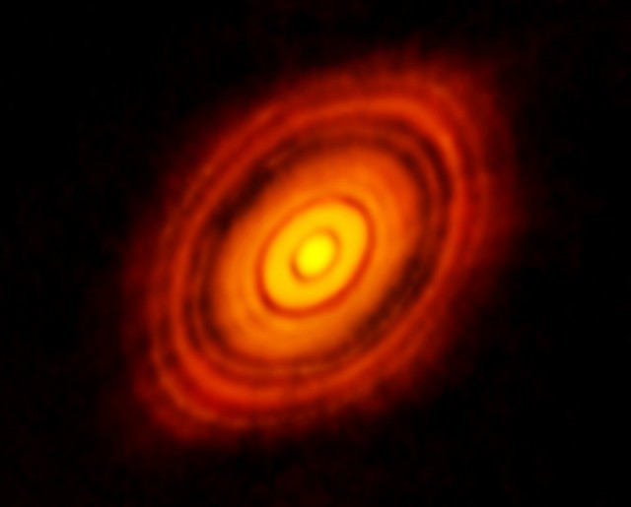
Accretion discs are not well understood!
ALMA observations of rings NOT predicted
Disc models do not have sufficient resolution to follow evolution when all the physics is included.
There is no accepted theory of viscosity
Models are usually in 2-D, often neglecting vertical T and ρ gradients.
TW Hya, Andrews et al.2016, ALMA
d = 50 pc, resolution = 1 au
HL Tau, Brogan et al.2015, ALMA

Slide 9
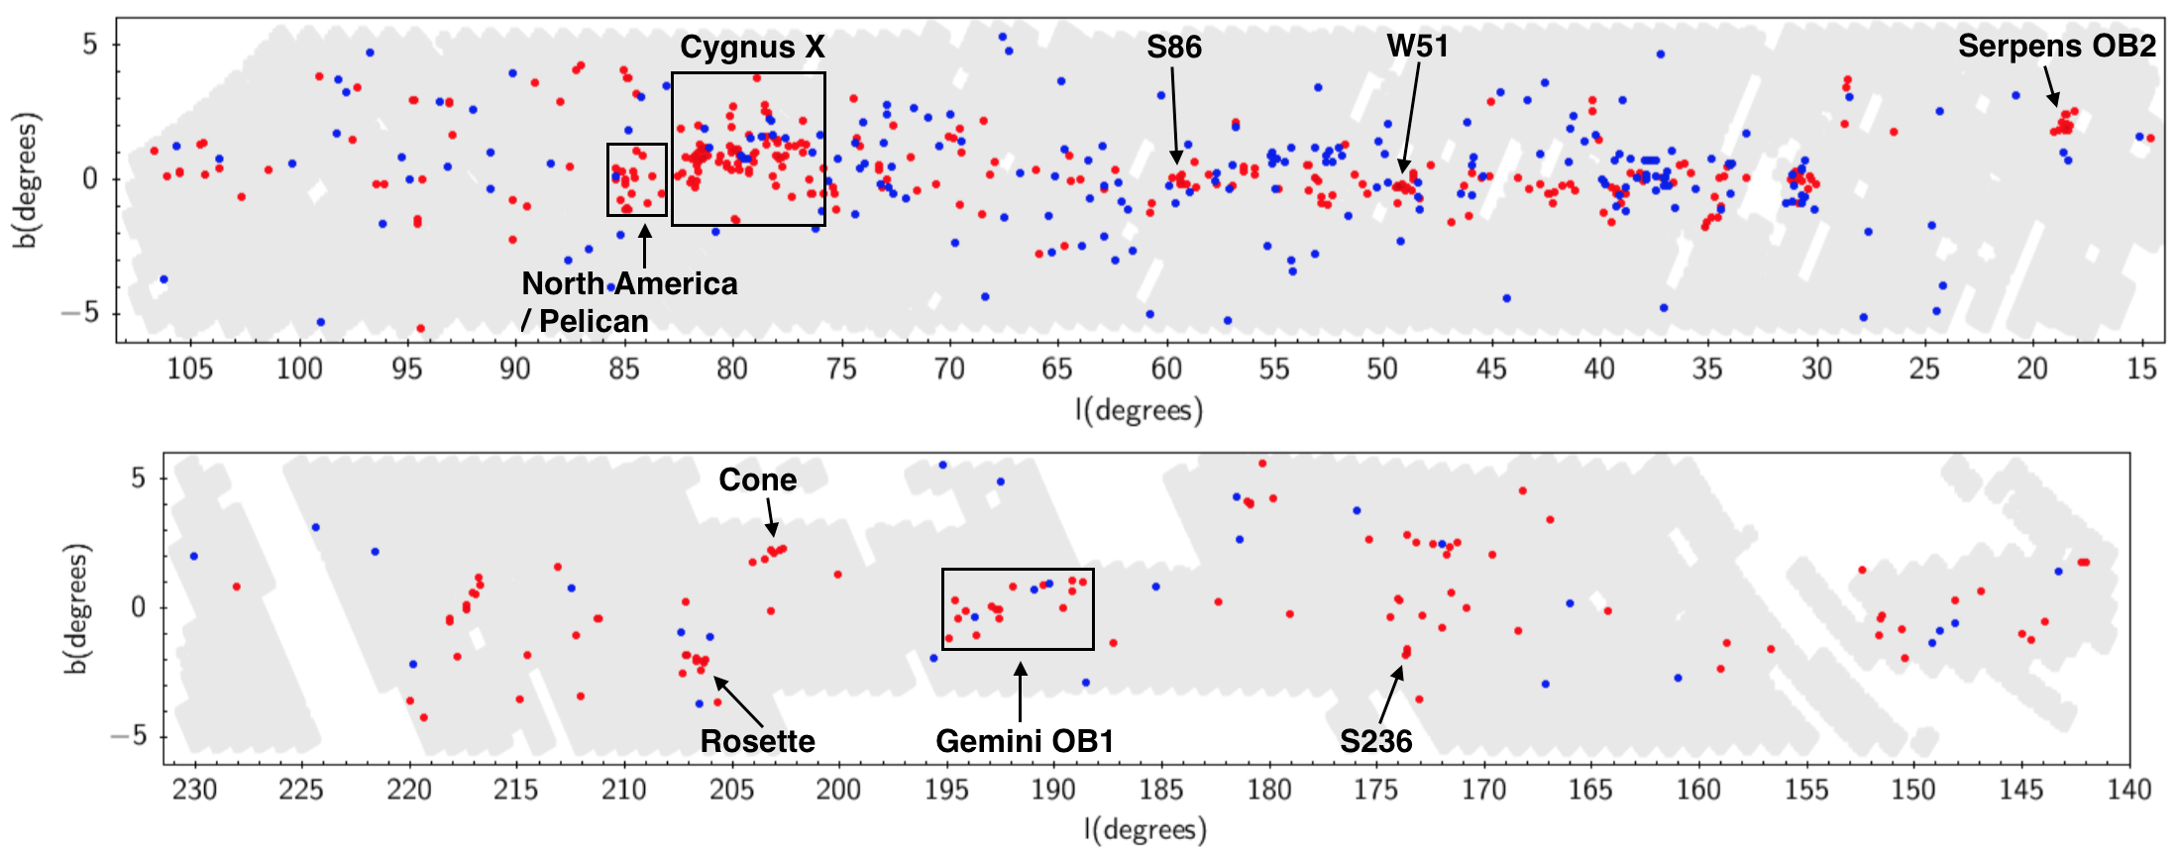
A wide view from UKIDSS GPS: 2 epochs only
A catalogue of 618 high amplitude variables across 1470 sq deg of the plane.
~60% are YSOs, but lots of other interesting things…. Lucas et al., MNRAS submitted
Red points are likely YSOs, based on SIMBAD & WISE colour images

Slide 10
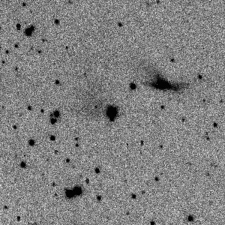
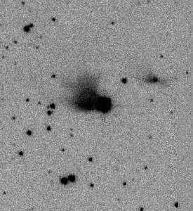
Source 551ab = 2MASS J20500940+4426522
in the North America/Pelican nebula at d=700 pc
July 2006
October 2011
N.B. these variable nebulae are unusual in the UGPS and VVV samples due to the point source selection criterion.
The UGPS sample misses ~90% of real high amplitude variables (see
S. Makin & D.Froebrich, submitted).

Slide 11
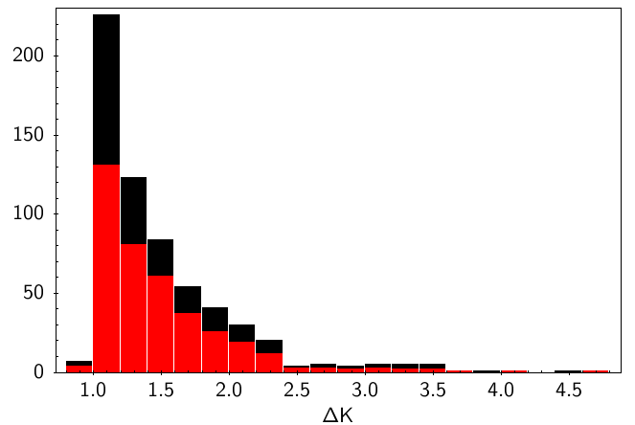
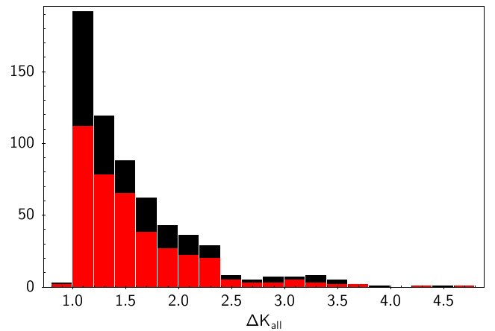
YSO/non-YSO selection in WISE
Amplitude distribution
2 UKIDSS epochs
2 UKIDSS epochs + 2MASS

Slide 12
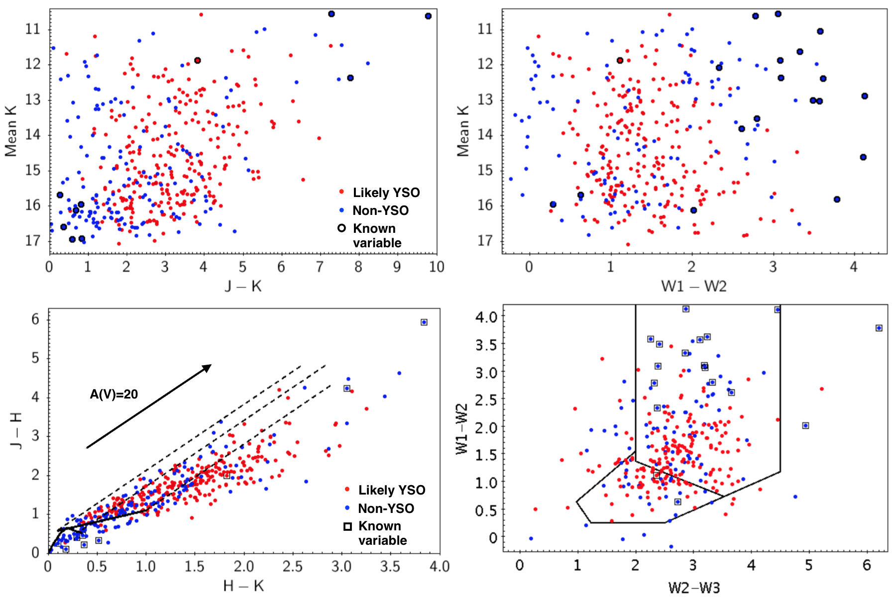
Colour-mag and two colour diagrams for the 618 UKIDSS variables

Slide 13
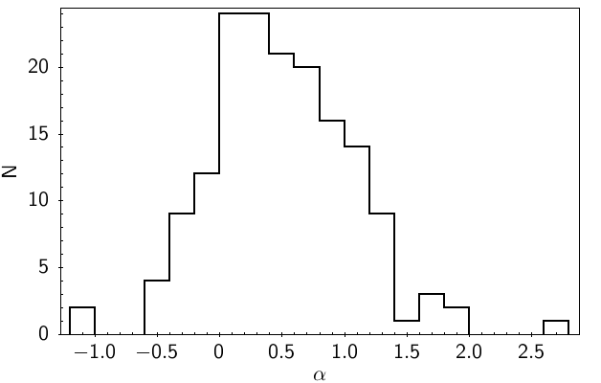
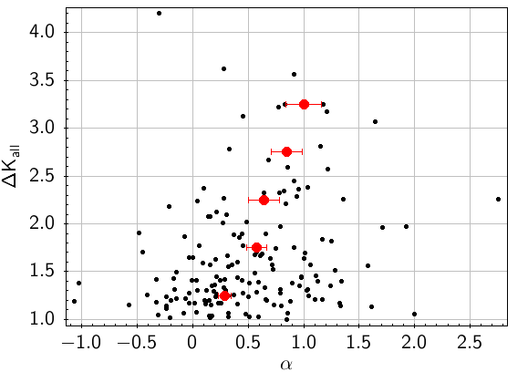
Spectral indices and amplitudes
Mostly class I and flat-spectrum YSOs
There is a clear tendency for higher amplitude YSOs to have redder SEDs

Slide 14
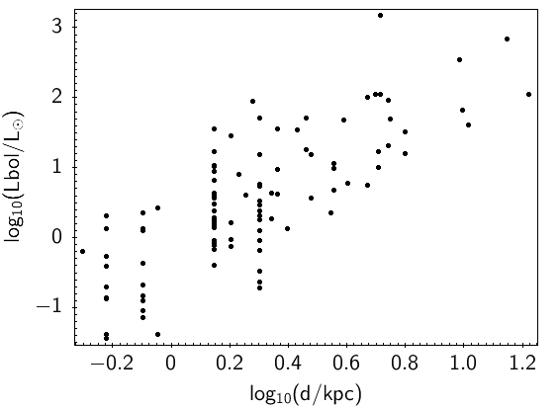
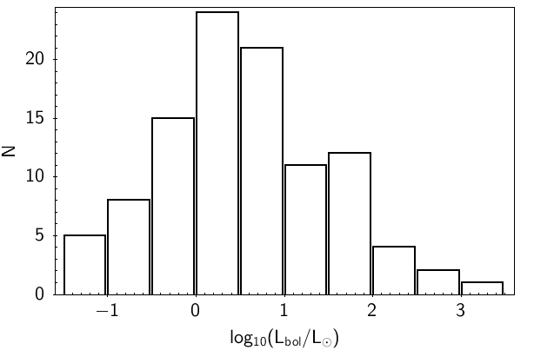
Luminosities and distances
Histogram of luminosities
log(L) vs log(d)

Slide 15
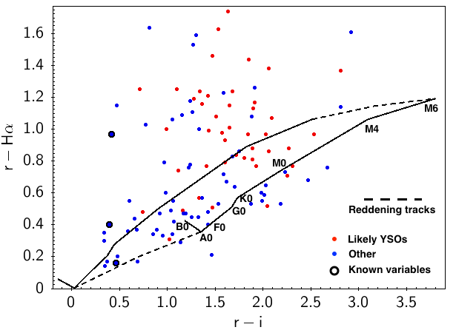
Hα emission
IPHAS and VPHAS+ (Drew et al.2005) provide r, i, Hα photometry.
Most of the YSOs have strong Hα emission … at the random IPHAS epoch.
Many non-YSOs also… including 2 known CVs, 1 PN…
and 3 new CV candidates with ΔK_{s} = 2.84, 2.30, 3.44.

Slide 16
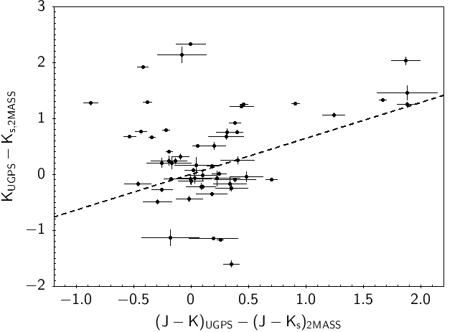
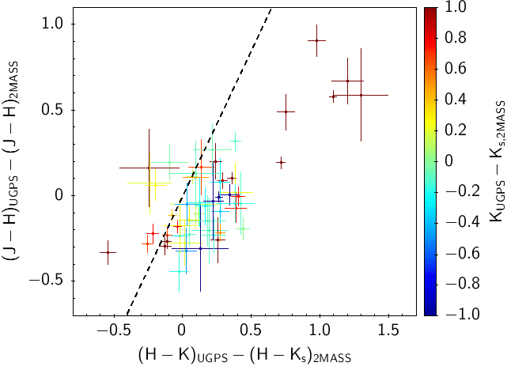
Colour variability: UKIDSS + 2MASS
Colour - magnitude changes
Colour - colour changes
Most sources with large UKIDSS: 2MASS flux differences do not show reddening-like changes. ΔJ = 1.19 ΔK_{s} + 0.13

Slide 17
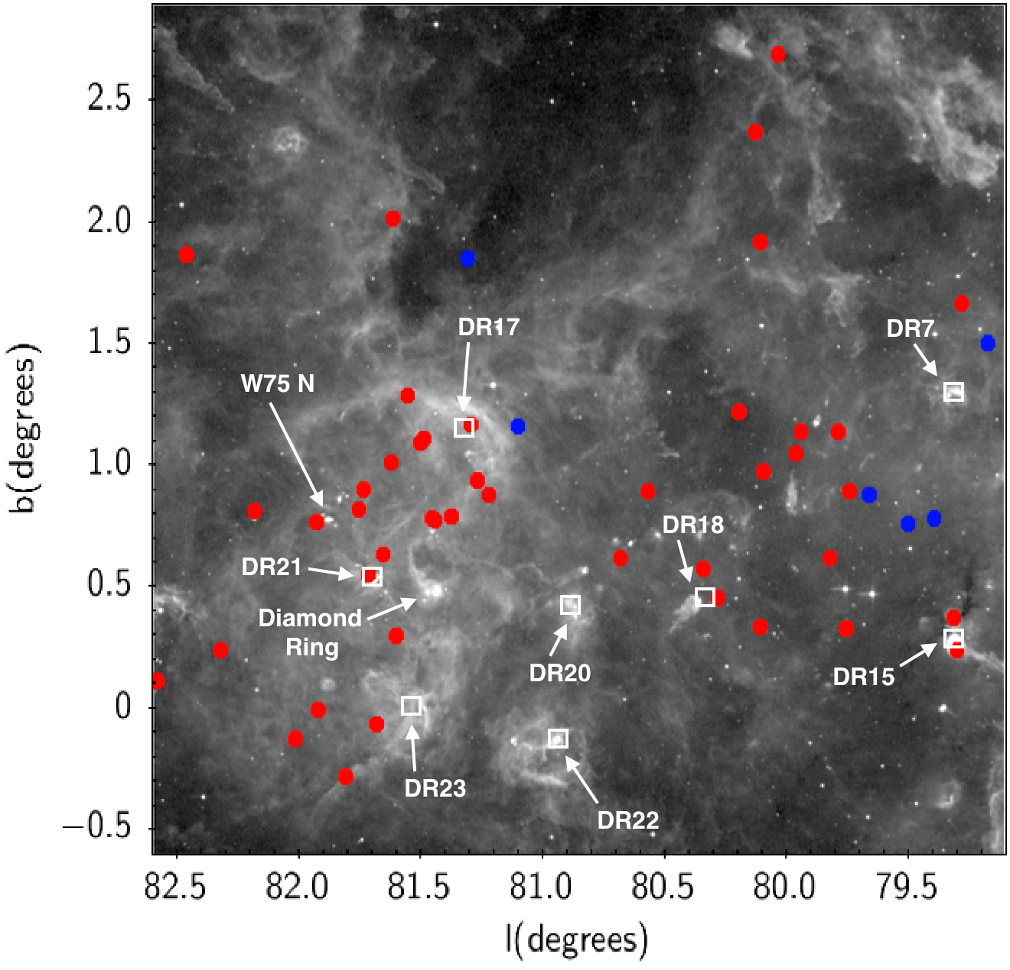
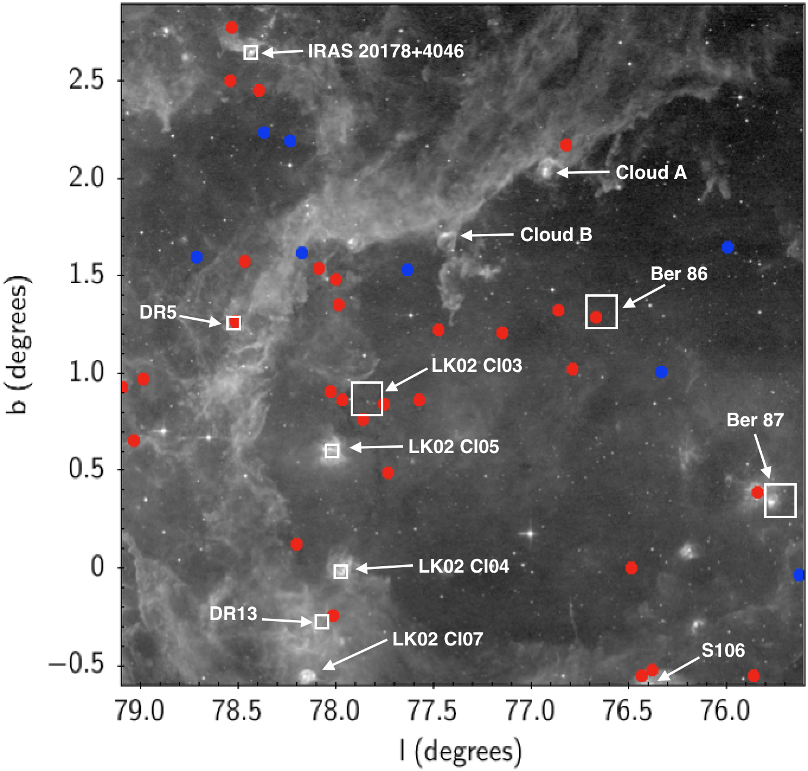
Cygnus X group
77 “likely YSOs”, 2 background YSOs, 14 “others”
Likely YSOs and other sources plotted on MSX 8 μm image.

Slide 18
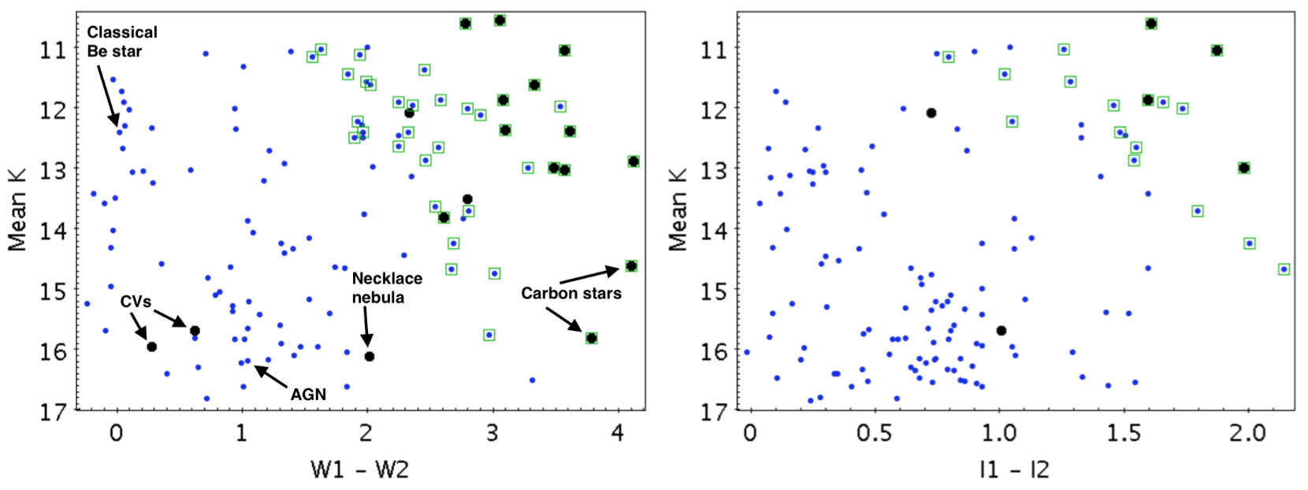
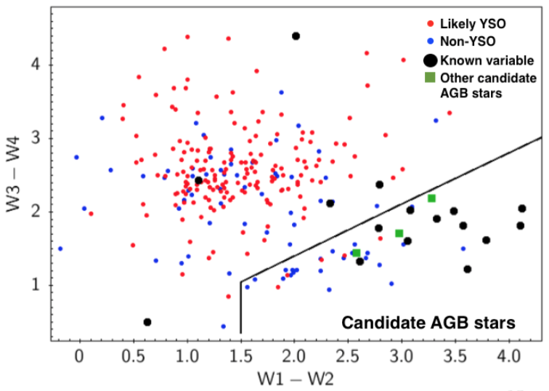
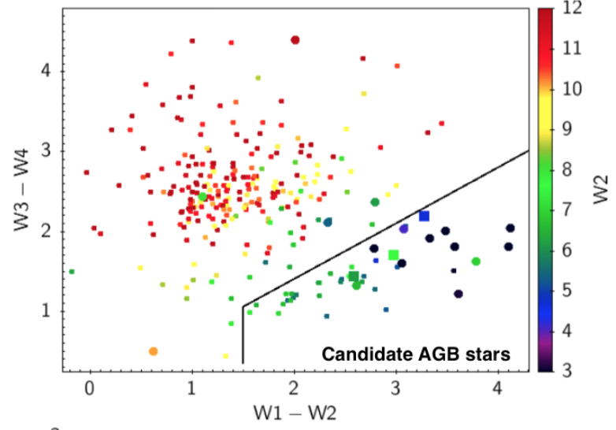
The non-YSOs
[3.4]-[4.6]
[3.6]-[4.5]

Slide 19
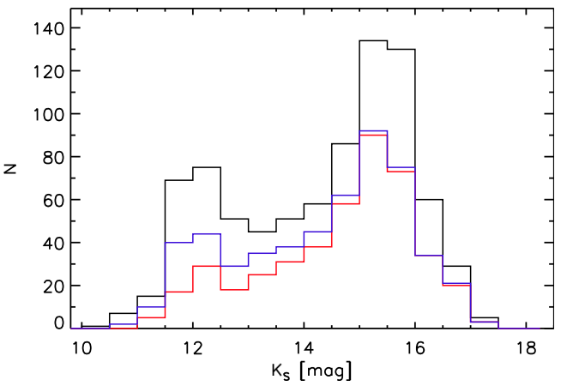
VVV searches – many discoveries
5.8-8.0
VVV disc region: searched for ΔKs>1 sources seen at all epochs in 2010-12.
Found 816 VVV sources down to Ks=16, of which 91 have ΔKs>2 mag.
Contreras Peña et al.2017a, MNRAS, 465, 3011; 2017b, MNRAS, 465, 3039
Black: all
Blue: in SFRs
Red: decontaminated
65% in SFRs – YSOs
Method has ~50% completeness
Also dusty Miras and Eclipsing Binaries
Notes:
Selection avoid transients

Slide 20
Time domain properties
Variability on all timescales up to ~250-300 days.
Class II & III YSOs vary most on rotational timescales (days)
Class I and flat spectrum YSOs vary most on all longer timescales.
Class I -- red
Flat -- green
Class II -- blue
Class III -- black

Slide 21
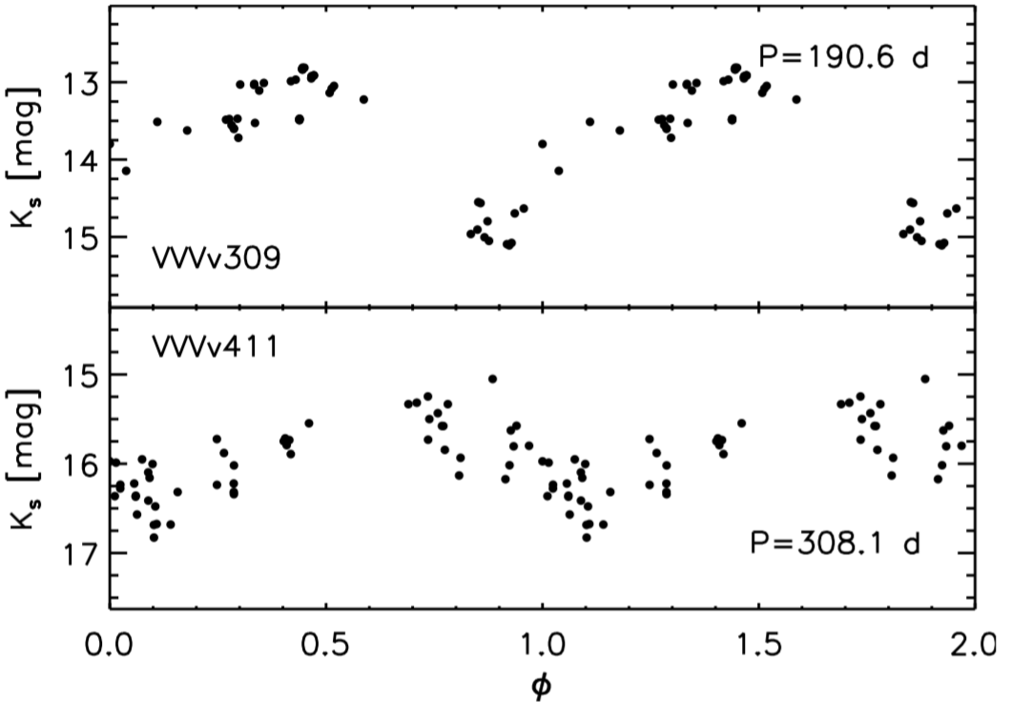
Light curves types in SFRs
Periodic: 162 short term variables, 65 long period variables, 24 EBs, 89 Miras
Aperiodic: 45 faders, 106 eruptive, 39 dippers
Eruptive YSOs have the reddest SEDs (ratio is 70 Class I to 5 Class II)
Eruptives and faders have the highest amplitudes.
Long period
Short period
Long period
Eclipsing

Slide 22
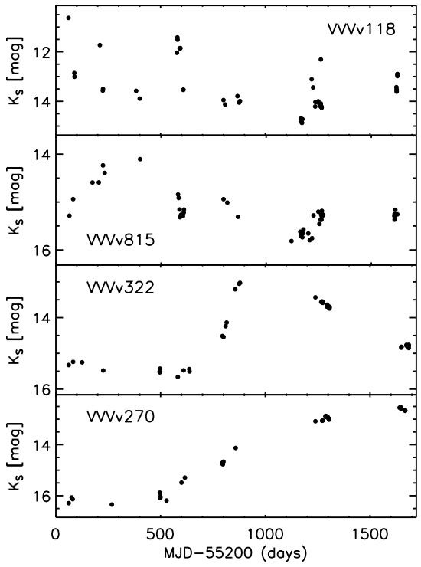
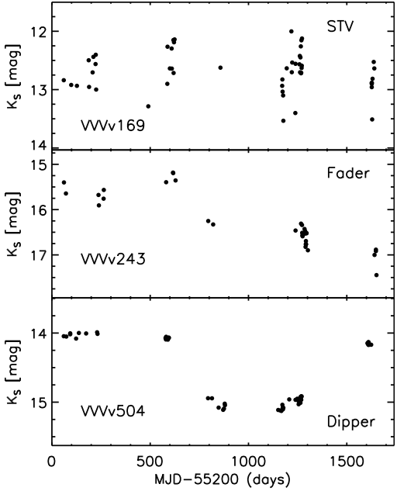
Light curves types in SFRs (2)
Eruptive
Eruptive
Eruptive
Eruptive

Slide 23
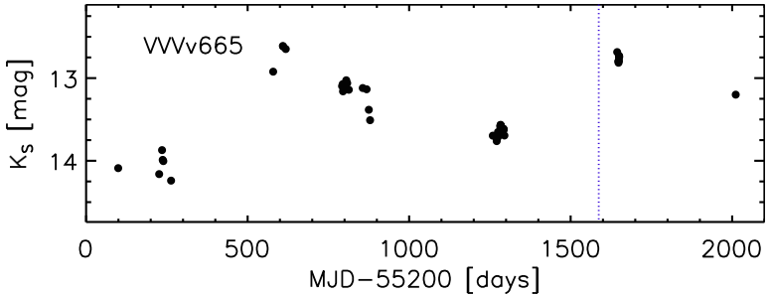
Eruptive light curves and Magellan spectra
Outbursts last typically 1 to 5 years.
Mostly emission line YSOs, sometimes EXor-like BUT H₂ and [FeII] emission, longer outbursts, redder spectra.
We mainly see the disk, not the star.
19 spectroscopically confirmed eruptive variables (15 eruptive LCs, 3 LPVs, 1 fader).
Magellan/FIRE R=6000
Notes:
1-2 AU dynamical timescale, like spectroscopic variations in normal Class I YSOs

Slide 24
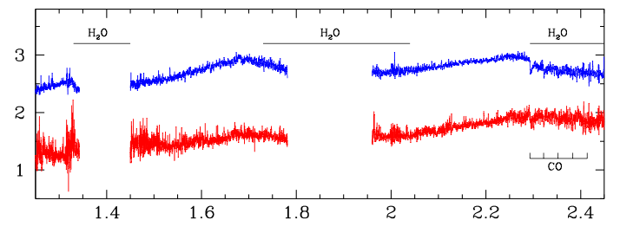
V322, a fast FUor
2013 spectrum
2014 spectrum

Slide 25
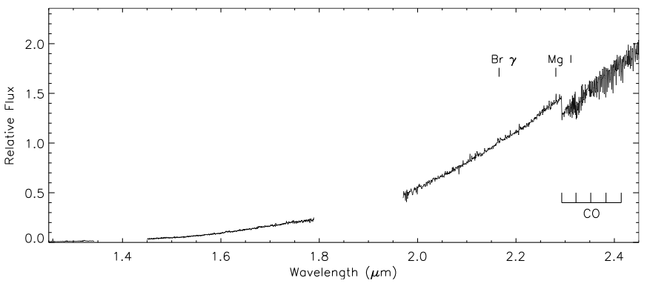
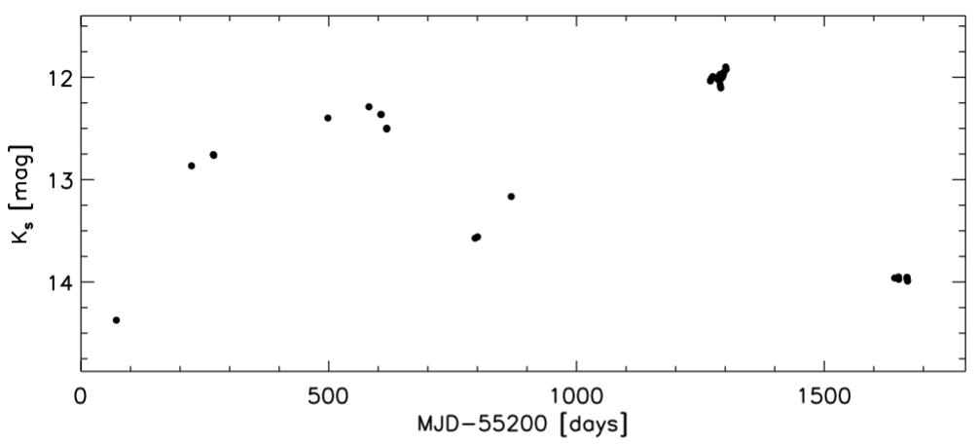
V717, a long-term periodic FUor?

Slide 26
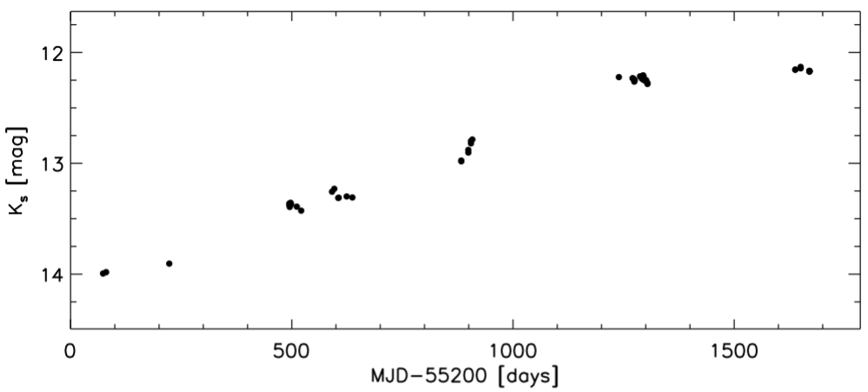
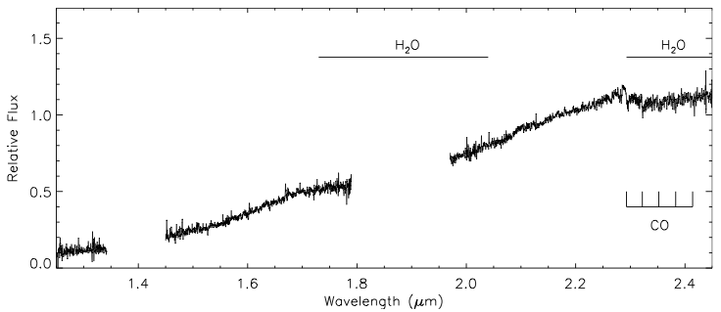
VVVv721
Classical FUor?

Slide 27
Summary so far
VVV and UKIDSS GPS have revealed a large new population of high amplitude IR variable YSOs.
YSOs dominate the IR variable sky at high amplitudes in the Galactic disc.
Luminosities 0.1 to 10³ L …. but rarely over 10^{2.5} L.
Extreme variability is an order of magnitude more common in protostars (class I & flat spectrum YSOs) than in class II, class III YSOs.
A factor of ~5 increase in the sample of eruptive variables.
3 -- 6% of class I YSOs underwent eruptions between 2010 and 2014.
MNors: a new subclass of eruptive YSO – mainly embedded systems.
Outburst durations and spectra have characteristics in between FUors and Exors
Named after V1647 Ori, which illuminates McNeil’s Nebula.
Notes:
Nanda Kumar poster on luminous high amplitude YSOs. 1000 Lsun or more.

Slide 28
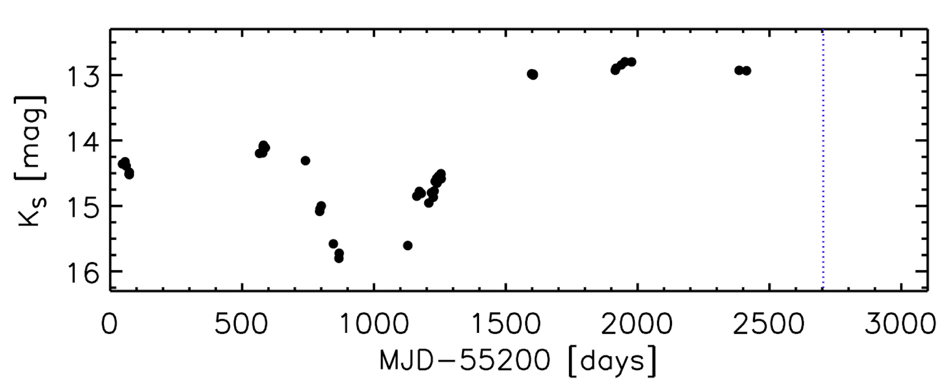
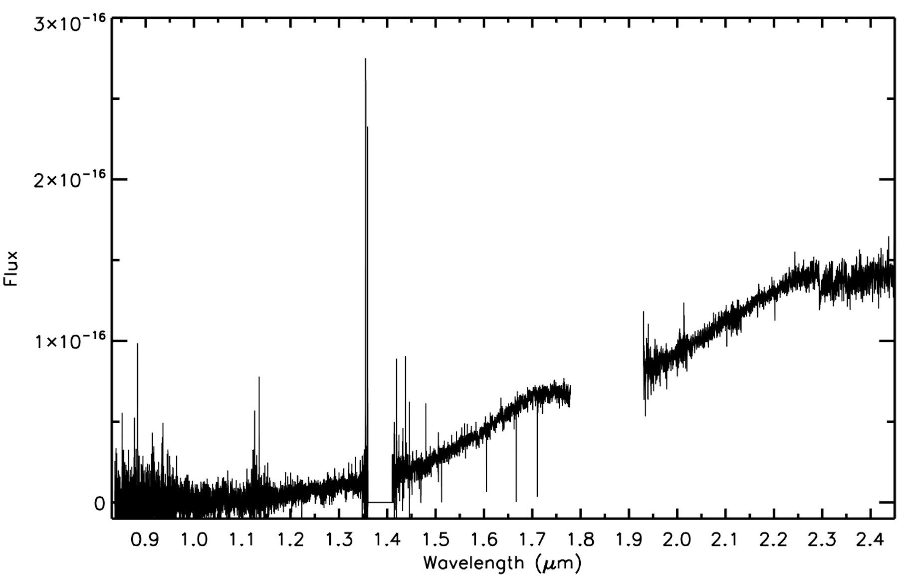
VVVX era long term monitoring, more spectra

Slide 29
What next?
Spectroscopic variability.
Enlarge the spectroscopic sample – lpv-YSOs, faders, dippers
AO imaging, jets
Enlarge the sample
Search for higher amplitude systems
Invert the search with external YSO lists
Quantify incidence with Spitzer YSOs (Robitaille 2008 list)
Also explore the “WIT” sky for new types of variable star or transient
VVV has found 20 novae so far (mostly Roberto Saito but 2 by Carlos).
Also 6 “VVV-WIT” objects.

Slide 30
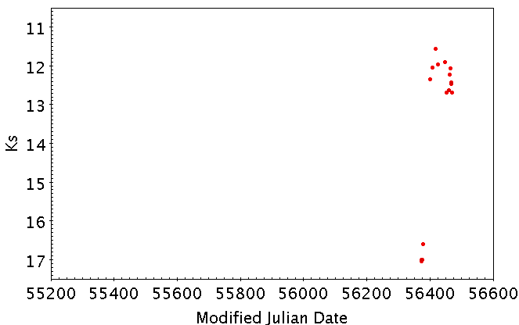
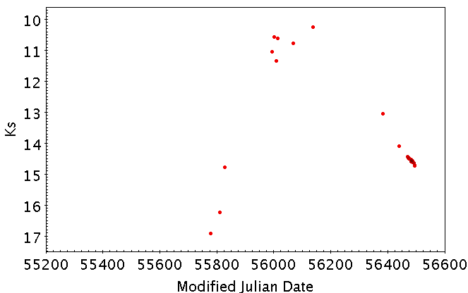
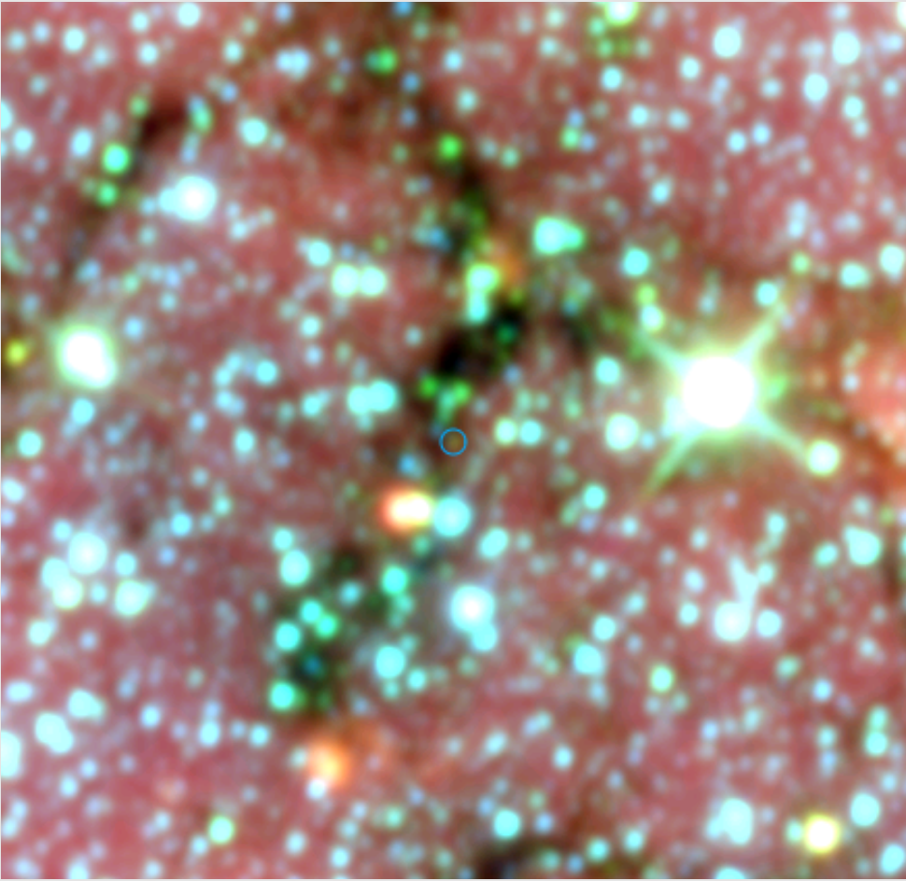
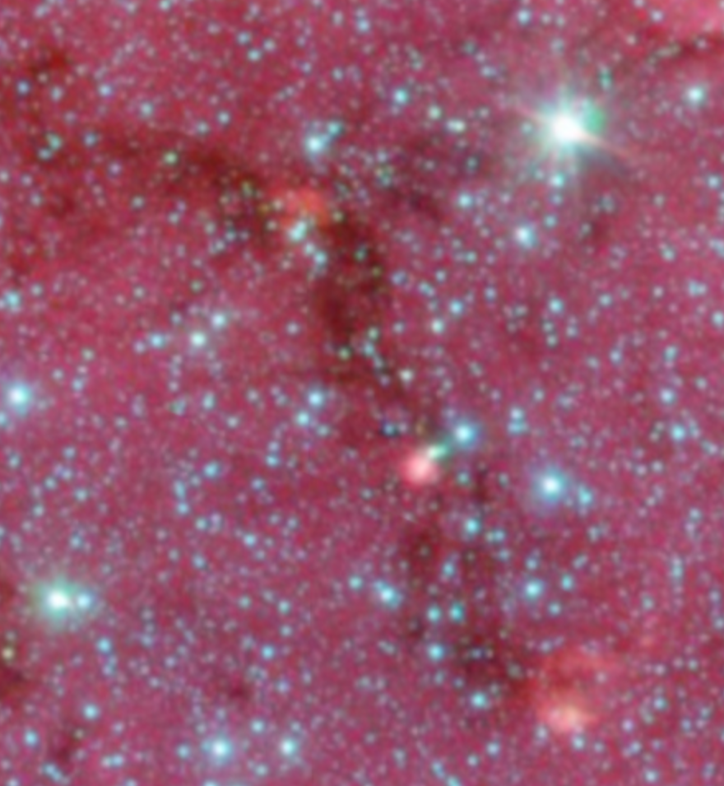
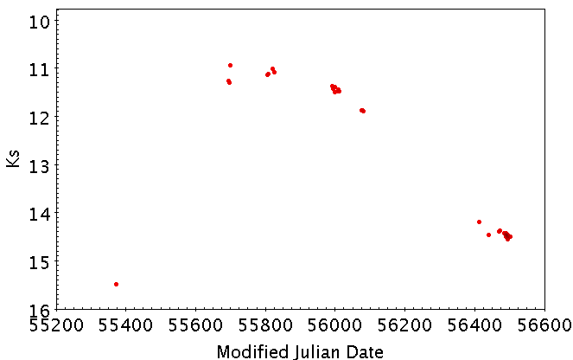
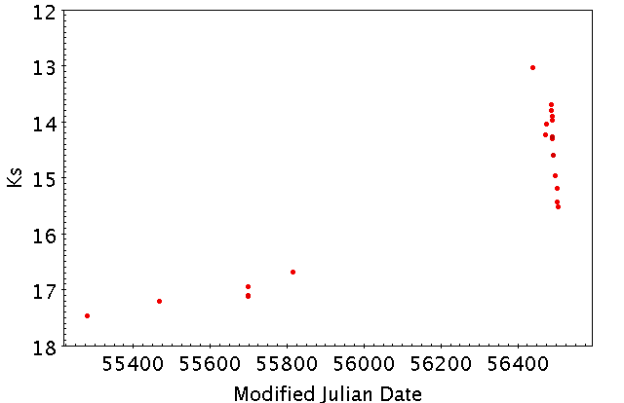
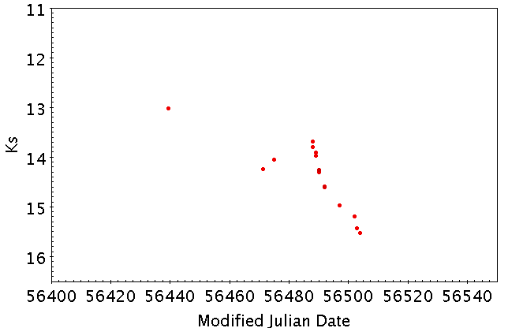
Interesting variables
Var 402
Var 357
Var 336 - red
Var 328
Notes:
Var402 Var357 Var328 Var336_Robit

Slide 31
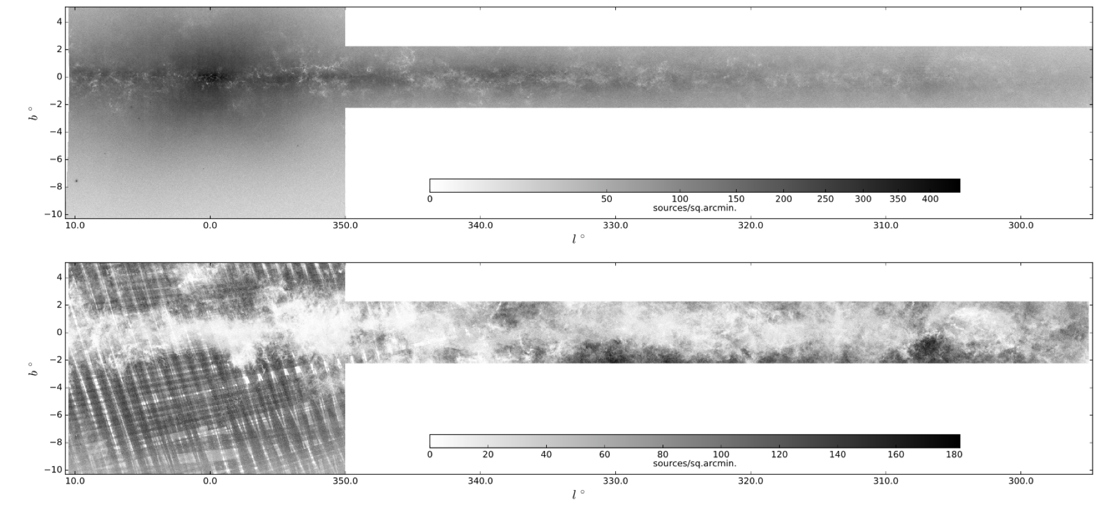
The VVV Infrared Astrometric Catalogue (VIRAC)
VVV source density map (10 < Ks < 16)
GAIA DR1
VVV
GAIA DR1 source density map

Slide 32
VIRAC version 1 (Leigh Smith, Phil Lucas et al.)
V1 is relative astrometry, using Cambridge pipeline catalogue.
V2 will be PSG astrometry on the GAIA absolute reference frame.
V3: Shift & Stack astrometry (fingers crossed…)
Full survey, 312 million stars,119 million “reliable”
0.67 mas median error
1 pawprint

Slide 33
Parallaxes – the largest ground-based catalogue
Parallaxes measured for 6935 stars at >5σ. 1.1 mas median precision.
(MEarth: 1507 parallaxes, 5 mas precision, Dittman et al.’14).
Tycho-GAIA match for faint companions

Slide 34
Some useful brown dwarfs
Discovery of β Circini B – a 400 Myr brown dwarf benchmark binary.
(Smith, Lucas et al.2015, MNRAS 454, 4476)
Discovery of LTT 7251B
benchmark binary with over 20 elemental abundances from HARPS GTO obs.
Discovery of 2MASS 1256-6202, an L7 sub-dwarf. PM=1.1”/ yr.
One of only 4 late L sub-dwarfs or extreme sub-dwarfs.
Metal poor ([M/H] ~ -1) brown dwarfs test star formation theory.

Slide 35
Galactic rotation curves
Using red clump giants in a slice at l = 300°, 0.5°<|b|<1°
Vtan precision as good as 1.5 km/s

Slide 36
Cluster decontamination
Proper motion decontamination of FSR 1735 = 2MASS GC03
A globular cluster at d=11 kpc (see Carballo-Bello et al.2016, MNRAS 462, 501)
(see R. Contreras PSF proper motions version for better results)

Slide 37
Motion of the Sagittarius dwarf galaxy
Sag stars
Galaxies
F-G dwarfs
Bulge giants
M dwarfs

Slide 38
Thank you!

